Slide 1
PhD seminar 2021
16.6.2021
STRUCTURALIZATIONS
PHENOMENA IN LIQUID CRYSTAL
BASED COMPOSITES
RNDr. KATARÍNA ZAKUŤANSKÁ

Slide 2
PUBLICATIONS:
Related to the topic:
Zakutanská K., Petrov D., Kopčanský P., Węgłowska D. and Tomašovičová N. Fréedericksz Transitions in 6CB Based Ferronematics—Effect of Magnetic Nanoparticles Size and Concentration, In: Materials, 2021, vol. 14, pp.3096
Burylov, S., Petrov, D., Lacková, V., Zakutanská, K., Burylova, N., Voroshilov, A., Skosar, V., Agresti, F., Kopčanský, P. and Tomašovičová, N. Ferromagnetic and antiferromagnetic liquid crystal suspensions: Experiment and theory, In: Journal of Molecular Liquids, 2021, vol. 321, pp. 114467.
Zakutanská, K., Tomašovičová, N., Éber, N., Tóth-Katona, T., Kováč, J., Lacková, V., Jadżyn, J. and Kopčanský, P. Alternating current magnetic susceptibility of ferronematics: The case of high concentration of magnetic nanoparticles. In: Journal of Magnetism and Magnetic Materials, 2020, vol. 500, pp. 166331.
Zakutanská, K., Feoktystov, A., Lacková, V., Tomašovičová, N., Appel, I., Behrens, S. and Kopčanský, P., SANS Study of Liquid Crystal Doped with CoFe₂O₄ Nanoparticles. In: Acta Physica Polonica A, 2020, vol. 137, no. 5, pp. 663-666.
Gdovinová, V., Tomašovičová, N., Jeng, S. C., Zakutanská, K., Kula, P. and Kopčanský, P., Memory effect in nematic phase of liquid crystal doped with magnetic and non-magnetic nanoparticles. In: Journal of Molecular Liquids, 2019, vol. 282, pp. 286-291.
Citované v:
Manaila-Maximean, D. Confined Liquid Crystals-Polymer Dispersed Liquid Crystal Films. In: University Politehnica of Bucharest Scientific Bulletin-Series A-Applied Mathematics and Physics, 2021, vol. 83, no. 1, 271-278.
Makarov, D. V. and Novikov, A. A. Shear-induced ferrocholesteric-to-ferronematic transitions in magnetic field. In: Journal of Magnetism and Magnetic Materials, 2021, vol. 532, pp. 167967.
Citované v:
Park, E. G., Oh, C. W. and Park, H. G. Improvement of the electro-optical properties of nematic liquid crystals doped with strontium titanate nanoparticles at various doping concentrations. In: Liquid Crystals, 2020, vol. 47, no. 1, pp. 136-142.
Romero-Hasler, P. N., Kurihara, L. K., Mair, L. O., Weinberg, I. N., Soto-Bustamante, E. A. and Martínez-Miranda, L. J. Nanocomposites of ferroelectric liquid crystals and FeCo nanoparticles: towards a magnetic response via the application of a small electric field. In: Liquid Crystals, 2020, vol. 47, no. 2, pp. 169-178.
Ayeb, H., Missaoui, T., Mouhli, A., Jomni, F. and Soltani, T. Dielectric spectroscopy study on the impact of magnetic and nonmagnetic nanoparticles dispersion on ionic behavior in nematic liquid crystal. In: Phase Transitions, 2021, vol. 94, no. 1, pp. 37-46.
Rastogi, A., Hegde, G., Manohar, T. and Manohar, R. Effect of oil palm leaf-based carbon quantum dot on nematic liquid crystal and its electro-optical effects. In: Liquid Crystals, 2020, vol. 48, no. 6, pp. 812-831.
Varshney, D., Kumar, A., Prakash, J., Meena, R. and Asokan, K. Gamma irradiation induced dielectric modulation and dynamic memory in nematic liquid crystal materials. In: Journal of Molecular Liquids, 2020, vol. 320, pp. 114374.

Slide 3
Zakutanská, K., Lacková, V., Tomašovičová, N., Burylov, S., Burylova, N., Skosar, V., Juríková, A., Vojtko, M., Jadżyn, J. and Kopčanský, P. Nanoparticle’s size, surfactant and concentration effects on stability and isotropic-nematic transition in ferronematic liquid crystal. In: Journal of Molecular Liquids, 2019, vol. 289, pp. 111125.
Citované v:
Canevari, G. and Zarnescu, A. Design of effective bulk potentials for nematic liquid crystals via colloidal homogenisation. In: Mathematical Models and Methods in Applied Sciences, 2020, vol. 30, no. 2, pp. 309-342.
Makarov, D. V. and Novikov, A. A. Shear-induced ferrocholesteric-to-ferronematic transitions in magnetic field. In: Journal of Magnetism and Magnetic Materials, 2021, vol. 532, pp. 167967.
Other publications:
Krajčíková, K., Semančíková, E., Zakutanská, K., Kondrakhova, D., Mašlanková, J., Stupák, M., Talian, I., Tomašovičová, N., Kimáková, T., Komanický, V., Dubayová, K., Breznoščáková, D., Pálová, E., Demančík, J. and Tomečková, V. Tear fluid biomarkers in major depressive disorder: Potential of spectral methods in biomarker discovery, In: Journal of Psychiatric Research, 2021, vol. 138, pp. 75-82.
Balejčíková, L., Tomašovičová, N., Zakutanská, K., Batková, M., Kováč, J. and Kopčanský, P. Dechlorination of 2,4,40-trichlorobiphenyl by magnetoferritin with different loading factors, In: Chemosphere, 2020, vol. 260, pp. 127629.
Hu, P.-S., Tomašovičová, N., Chou, H.-J., Li, M.-C., Vojtko, M., Zakutanská, K., Majorošová, J., Chen, S. J. and Kopčanský, P., 2020. Hypertermia Induced by Near-Infrared Laser Irradiated CsWO₃ Nanoparticels Disintegrates Preformed Lysozyme Amyloid Fibrils. In: Nanomaterials, vol. 10, no. 3, pp. 442.
Lacková, V., Tomašovičová, N., Olejniczak, A., Zakutanská, K., Majorošová, J., Hu, P.-S. and Kopčanský, P. Bio-inorganic nanocomposites of lysozyme amyloid fibrils and magnetic nanoparticles of different shape anisotropy. In: Journal of Magnetism and Magnetic Materials, 2020, vol. 502, pp. 166515.
Citované v:
Nikazar, S., Barani, M., Rahdar, A., Zoghi, M. and Kyzas, G. Z. Photo‐and Magnetothermally Responsive Nanomaterials for Therapy, Controlled Drug Delivery and Imaging Applications. In: ChemistrySelect, 2020, vol. 5, no. 40, pp. 12590-12609.

Slide 4
Glinská, G., Krajčíková, K., Zakutanská, K., Shylenko, O., Kondrakhova, D., Tomašovičová, N., Komanický, V., Mašlanková, J. and Tomečková, V. Noninvasive diagnostic methods for diabetes mellitus from tear fluid. In: RSC Advances, 2019, vol. 9, pp. 18050-18059.
Tomašovičová, N., Hu, P. S., Zeng, C. L., Majorošová, J., Zakutanská, K. and Kopčanský, P. Dual Size-Dependent Effect of Fe₃O₄ Magnetic Nanoparticles Upon Interaction with Lysozyme Amyloid Fibrils: Disintegration and Adsorption. In: Nanomaterials, 2019, vol. 9, no. 1, pp. 37.
Krajčíková, K., Mašlanková, J., Shylenko, O., Zakutanská, K., Glinská, G., Tomečková, V., Komanický, V. and Tomašovičová, N. Novel strategies in diagnostics of eye diseases from tear fluid. In: Quaere, 2018, vol. 8, pp. 586-577.
Jeníková, M., Zakutanská, K., Kováč, J., Girman, V., Kopčanský, P. and Tomašovičová, N. Characterization of Carbon Nanotubes. In: Acta Physica Polonica A, 2017, vol. 131, no. 4, pp. 952-954.
Citované v:
Nikazar, S., Barani, M., Rahdar, A., Zoghi, M. and Kyzas, G. Z. Photo‐and Magnetothermally Responsive Nanomaterials for Therapy, Controlled Drug Delivery and Imaging Applications. In: ChemistrySelect, 2020, vol. 5, no. 40, pp. 12590-12609.
Citované v:
Jampílek, J., Kráľová, K., Novák, P. and Novák, M. Nanobiotechnology in neurodegenerative diseases. In: Nanobiotechnology in Neurodegenerative Diseases, 2019, pp. 65-138.
Sarkar, S., Gulati, K., Mishra, A., and Poluri, K. M. Protein nanocomposites: Special inferences to lysozyme based nanomaterials. In: International journal of biological macromolecules, 2020, vol. 151, pp. 467-482.
Khodabandeh, A., Yakhchian, R., Hasan, A., Paray, B. A., Shahi, F., Rasti, B., Mirpour, M., Sharifi, M., Derakhshankhah, H., Akhtari, K., Zhang, Z., Gong, G., Zheng, Y. and Falahati, M. Silybin as a potent inhibitor of a-synuclein aggregation and associated cytotoxicity against neuroblastoma cells induced by zinc oxide nanoparticles. In: Journal of Molecular Liquids, 2020, vol. 310, pp. 113198.
Zhao, Z., Zhang, G., Zhang, Y., Dou, M. and Li, Y. Fe₃O₄ accelerates tetracycline degradation during anaerobic digestion: Synergistic role of adsorption and microbial metabolism. In: Water Research, 2020, vol. 185, pp. 116225.
Citované v:
Dlova, S., Ayeleru, O. O., Adams, F. V., Mamo, M. A. and Olubambi, P. A. Development of multi-walled carbon nanotubes obtained from recycled plastics by single stage pyrolysis process. In: Materials Today: Proceedings, 2021, vol. 38, pp. 1170-1173.

Slide 5
POSTER PRESENTATIONS:
European XFEL Users' Meeting and Satellite Meetings, 2018, DESY-Hamburg and European XFEL, Hamburg, Germany, 24.-26. January 2018
School of XFEL and synchrotron radiation users “SFEL2018“ – 5th International Scientific School - Liptovský Ján, Slovakia, 27. – 31. May 2018
17th Czech and Slovak Conference on Magnetism, Košice, Slovakia, 3. –7. June 2019
International Conference on Magnetic Fluids – ICMF 2019, Paris, France. 8. – 12. July 2019
The European School on Magnetism 2019, CEITEC Brno University of Technology, Purkynova 123, 612 00 Brno, Czech Republic, 1. – 13. September 2019
ORAL PRESENTATIONS:
II. Meeting of FTIR and Raman spectrometer users BRUKER, 2018, CEITEC VUT, Purkyňova 123, Brno, Czech Republic, 26.9.2018
National Chiao Tung University, College of Photonics, No. 301, Gaofa 3rd Road, Guiren District, Tainan City, 71150 Taiwan, 30.september – 4.november 2019
Young Scientists Competition, IEP SAS – 11. december 2019
Young Scientists Competition, IEP SAS – 9. december 2020
Seminar of Condensed Matter Physics, Pavol Jozef Šafárik University in Košice - 15.4.2021
PhD students competition, SAV, 20.4.2021
AWARDS:
3rd place in Young Scientists Competition, IEP SAS 2020
1st place in competition of scientific works of young physicists, Slovak Physical Society
1st place in PhD students competition, SAV

Slide 6
POSTER PRESENTATIONS:
European XFEL Users' Meeting and Satellite Meetings, 2018, DESY-Hamburg and European XFEL, Hamburg, Germany, 24.-26. January 2018
School of XFEL and synchrotron radiation users “SFEL2018“ – 5th International Scientific School - Liptovský Ján, Slovakia, 27. – 31. May 2018
17th Czech and Slovak Conference on Magnetism, Košice, Slovakia, 3. –7. June 2019
International Conference on Magnetic Fluids – ICMF 2019, Paris, France. 8. – 12. July 2019
The European School on Magnetism 2019, CEITEC Brno University of Technology, Purkynova 123, 612 00 Brno, Czech Republic, 1. – 13. September 2019
ORAL PRESENTATIONS:
II. Meeting of FTIR and Raman spectrometer users BRUKER, 2018, CEITEC VUT, Purkyňova 123, Brno, Czech Republic, 26.9.2018
National Chiao Tung University, College of Photonics, No. 301, Gaofa 3rd Road, Guiren District, Tainan City, 71150 Taiwan, 30.september – 4.november 2019
Young Scientists Competition, IEP SAS – 11. december 2019
Young Scientists Competition, IEP SAS – 9. december 2020
Seminar of Condensed Matter Physics, Pavol Jozef Šafárik University in Košice - 15.4.2021
PhD students competition, SAV, 20.4.2021
AWARDS:
3rd place in Young Scientists Competition, IEP SAS 2020
1st place in competition of scientific works of young physicists, Slovak Physical Society
1st place in PhD students competition, SAV

Slide 7
SHORT-TERM BUSINESS TRIPS:
European XFEL Users' Meeting and Satellite Meetings, 2018, DESY-Hamburg and European XFEL, Hamburg, Germany, 24.-26. January 2018
38th Berlin School on Neutron Scattering, Berlin, Germany 1. – 9. March 2018
School of XFEL and synchrotron radiation users “SFEL2018“ – 5th International Scientific School - Liptovský Ján, Slovakia, 27. – 31. May 2018
Basic skills training FTIR and Raman spectrometry BRUKER, Brno, Czech Republic, 24.5.2018
Institute of Physics of the Czech Academy of Sciences, Cukrovarnická 112/10, Praha, Czech Republic, 06.-10. November 2018
Institute for Solid State Physics and Optics, Wigner Research Centre for Physics, HAS, Budapest, Hungary, 26. – 31. May 2019
II. Meeting of FTIR and Raman spectrometer users BRUKER, 2018, CEITEC VUT, Purkyňova 123, Brno, Czech Republic, 26.9.2
The European School on Magnetism 2019, CEITEC Brno University of Technology, Purkynova 123, 612 00 Brno, Czech Republic, 1. – 13. September 2019
Institute for Solid State Physics and Optics, Wigner Research Centre for Physics, HAS, Budapest, Hungary, 3. – 5. December 2019
International Conference on Magnetic Fluids – ICMF 2019, Paris, France. 8. – 12. July 2019
Ústav polymérov SAV, Dúbravská cesta 9, 845 41 Bratislava, 8. – 10. September 2020
LONG-TERM BUSINESS TRIPS:
National Chiao Tung University, College of Photonics, No. 301, Gaofa 3rd Road, Guiren District, Tainan City, 71150 Taiwan, 30.september – 4.november 2019
Institute for Solid State Physics and Optics, Wigner Research Centre for Physics, HAS, Budapest, Hungary, 1.March – 30. Apríl. 2020 – SAIA – canceled
Institute for Solid State Physics and Optics, Wigner Research Centre for Physics, HAS, Budapest, Hungary, 1.March – 30. Apríl. 2021 – SAIA – postponed and canceled
DOKTOGRANT:
APP0049 - Influence of nanoparticle size on ac susceptibility of ferronematics

Slide 8
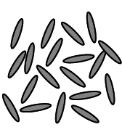
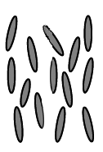
THERMOTROPIC LIQUID CRYSTALS
Decreasing of temperature
n
Isotropic phase
Nematic phase
Crystal phase
Mesophase
Mesophase - arrangement of molecules
- anisotropic properties

Slide 9
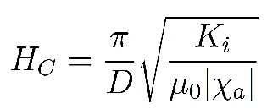
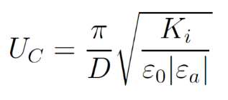
FRÉEDERICKSZ TRANSITION
ε_{a} > 0
χ _{a} > 0
n
Nematic liquid crystal: ,
χ _{a} - diamagnetic susceptibility anisotropy ε_{a} - dielectric permittivity anisotropy
μ₀ - vacuum permeability ε₀ - vacuum permittivity
D - thickenss of cell/liquid crystal layer K _{i} - Frank elastic constants
dielectric permittivity anisotropy low voltages
diamagnetic susceptibility anisotropy large magnetic fields
DOPING WITH MAGNETIC NANOPARTICLES
A combination of liquid properties of crystals and magnetic nanoparticles in order to prepare materials suitable for optical liquid crystal devices controlled by a magnetic field.
Nematic iquid crystals doped with magnetic nanoparticeles FERRONEMATICS

Slide 10
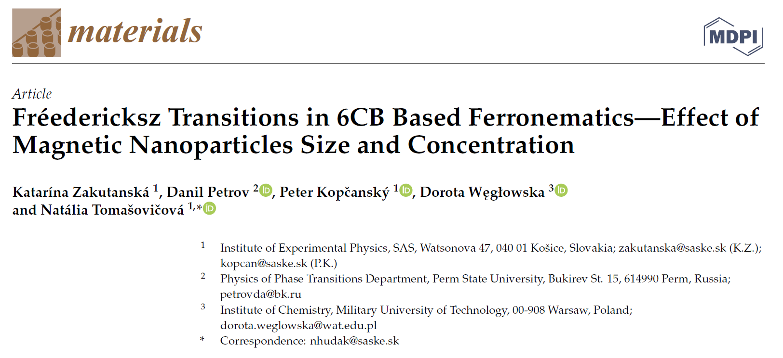
Zakutanská, K., Lacková, V., Tomašovičová, N., Burylov, S., Burylova, N., Skosar, V., Juríková, A., Vojtko, M., Jadżyn, J, Kopčanský, P. Nanoparticle's size, surfactant and concentration effects on stability and isotropic-nematic transition in ferronematic liquid crystal. Journal of Molecular Liquids. 289 (2019) 111125
6CB + Fe₃O₄ nanoparticles
Isotropic-nematic phase transition temperature
6CB + Fe₃O₄ nanoparticles
Fréedericksz transition

Slide 11
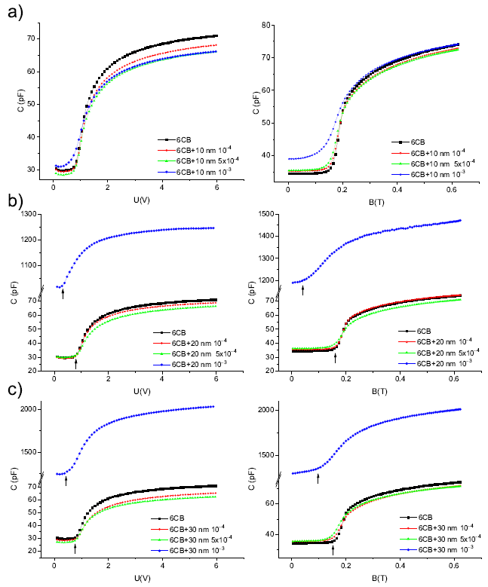
Burylov, S.V. and Raikher, Y.L. Molecular properties of ferronematic caused by orientational interactions on the particle surface. II. Behavior of real ferronematics in external fields. Molecular Crystals and Liquid Crystals 258 (1995) 123–141.
Zakhlevnykh, A.N. and Petrov, D.A. Weak coupling effects and re-entrant transitions in ferronematic liquid crystals. Journal of Molecular Liquids 198 (2014) 223–233.
soft anchoring between director n and nanoparticles magnetization vector m, which allows nIIm or n⊥m
decreasing of threshold magnetic field suggests nIIm

Slide 12
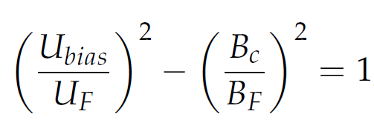
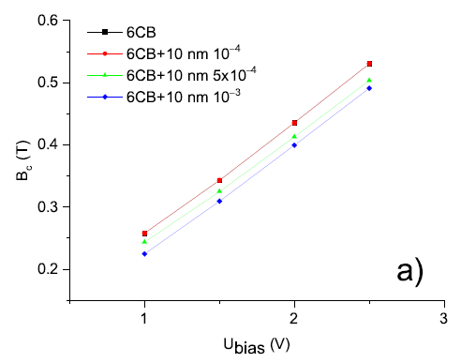
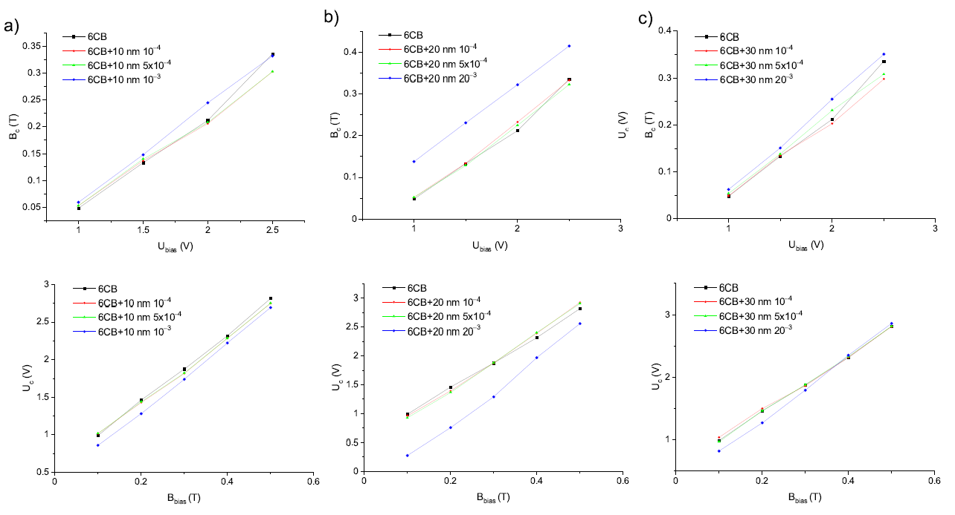
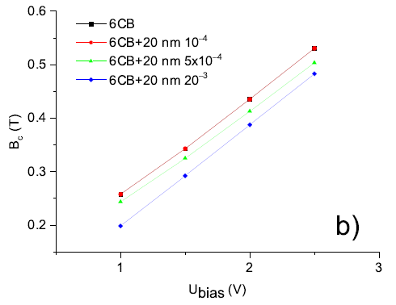
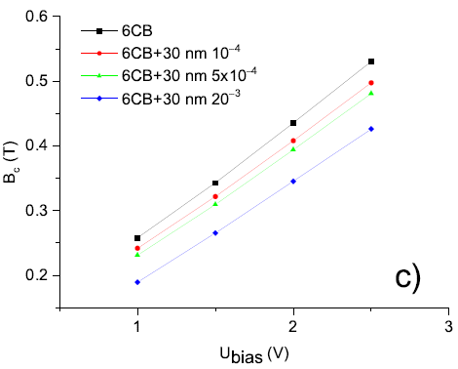
Tomašovičová, N., Kopčanský, P., and Éber, N. Anisotropy Research: New Developments, Nova Science: Hauppauge, NY, USA (2012) 245–276.

Slide 13
CONCLUSIONS
.....
10 nm, 20 nm and 30 nm iron oxide nanoparticles decrease threshold magnetic field and voltage of 6CB liquid crystal.
Results indicate parallel initial orientation of director n and nanoparticles magnetization vector m.
The decrease of critical values was the most pronounced for composites with volume concentration 10⁻³, but the isotropic to nematic phase transition of the composite is significantly shifted to lower valueas and wide range of temnperatures is needed for the transition, as it was shown in our previous paper.

Slide 14
THANK YOU FOR YOUR ATTENTION!

