Slide 1

EFFECT OF SOLVENT PROPERTIES ON PROTEIN AMYLOID AGGREGATION
-FACTORS INDUCING AGGREGATION PATHWAYS-
RNDr. Vladimír Vaník
Department of Biophysics, IEP, SAS
Supervisor: RNDr. Diana Fedunová, Ph.D.
Doctoral students' seminar 16/6/2021

Slide 2
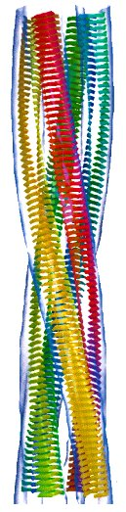
MOTIVATION
Protein amyloid aggREGation
association with many serious diseases – AMYLOIDOSES (systemic/neurodegenerative)
complicates the handling and storage of protein preparations
biotechnological applications (applicability)
CURRENT EFFORT >> ELUCIDATION OF AGGREGATION-DRIVING MECHANISM
          MORE EFFECTIVE DRUG DEVELOPMENT for amyloidoses
          USE OF THE FIBRILS TO PRODUCE BIOMATERIALS
OUTCOMES
IONIC LIQUIDS (Ils)
new progressive solvents – comprised exclusively of ions, liquid at T <100°C
DESIGNER SOLVENTS >>> ion combinability of ILs >>> adjustment of physical and chemical properties of ILs >>> specific solvent for the specific purpose
  ILs have ABILITY TO MODULATE the process of protein amyloid aggregation
    predicting the effect on particular protein is still challenging
    the exact mechanism-of-action on proteins is yet unknown
amyloid fibril
CHITI F., DOBSON C. 2006

Slide 3
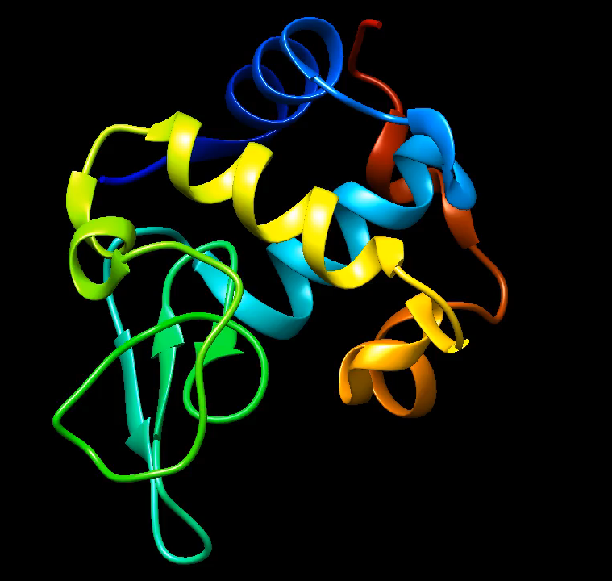
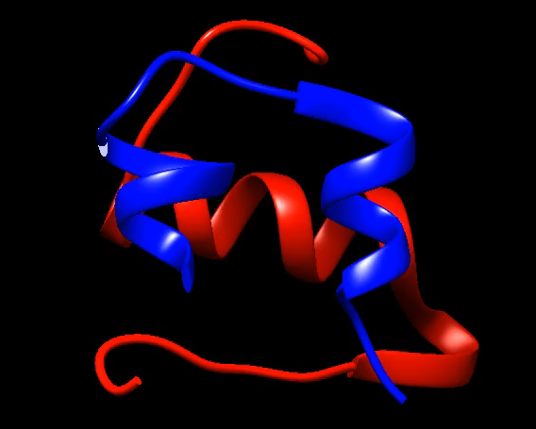
STUDIED PROTEINS
APPLIED METHODS
LYSOZYME
(PDB ID: 2ZIJ)
M = 14.3 kDa
HUMAN INSULIN
(PDB ID: 3I3Z)
M = 5.8 kDa
KINETICS EXPERIMENT
ThT fluorescence assay
SECONDARY STRUCTURE CHARACTERIZATION
ATR FT-IR spectroscopy
CD spectroscopy
TERCIARY STRUCTURE CHARACTERIZATION
Intrinsic fluorescence spectroscopy
CD spectroscopy
FIBRIL MORPHOLOGY VISUALIZATION
Atomic force microscopy (AFM)
PROTEIN STABILITY DETERMINATION
Differential scanning calorimetry (DSC)
ACTIVITY MEASUREMENTS
Turbidity assay
model globular proteins
  different size
  different secondary structure arrangement
  different charge

Slide 4
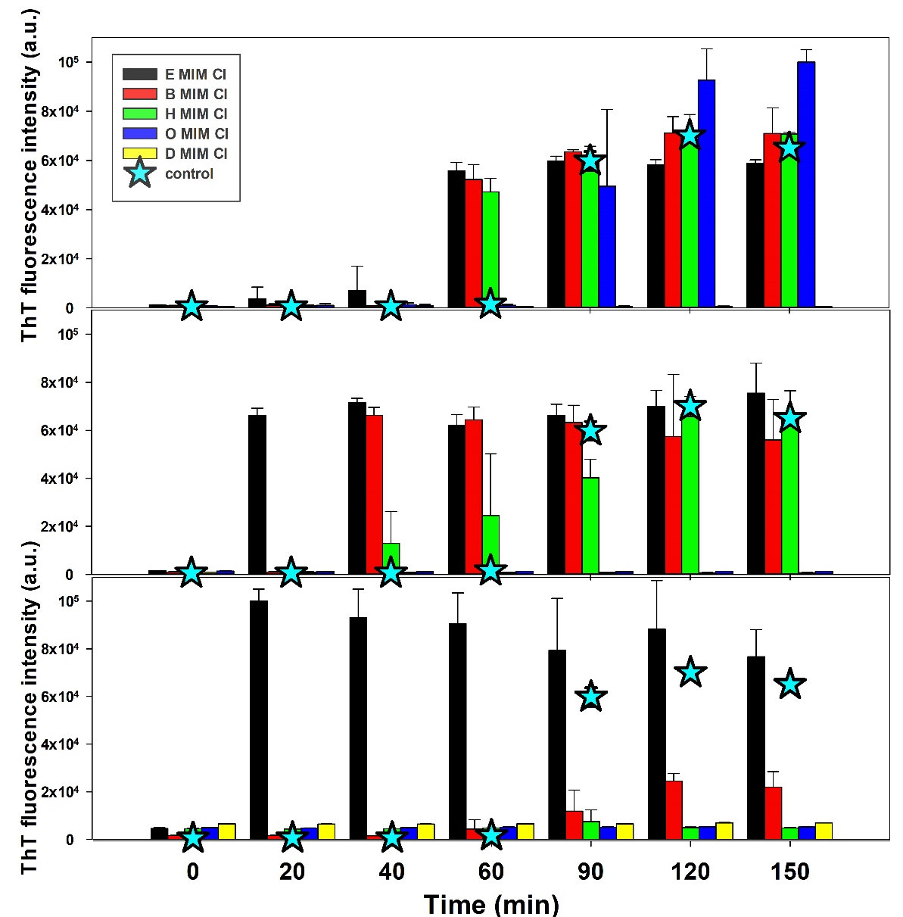

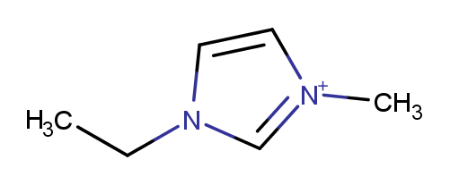
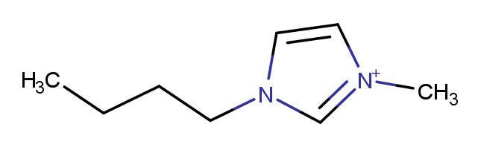
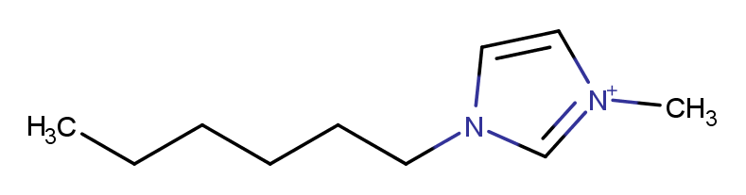
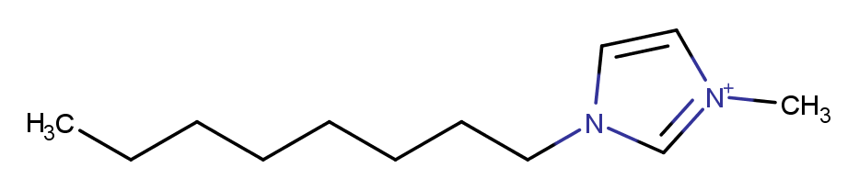
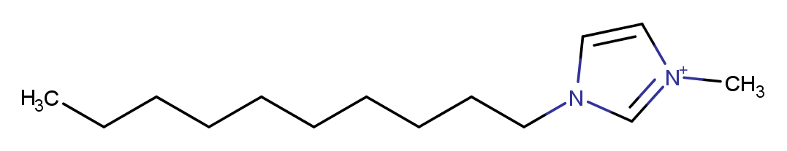
CATION EFFECT ON THE INSULIN AMYLOID AGGREGATION
IONIC LIQUID = CATION + ANION
CATIONS ANION
1-x-3-methylimidazolium
(x-MIM)
chloride
x = ethyl (E)
10mM
x = butyl (B)
x = hexyl (H)
x = octyl (O)
100mM
x = decyl (D)
Effect depends on IL concentration and chain-length
EMIM Cl encourages fibrillization over the studied concentration range (10-1000 mM)
DMIM Cl inhibits fibrillization over the entire range
Other ILs inhibit/induce fibrillization in dependence on IL concentration
Hydrophobic interactions must play a MAJOR ROLE
1000mM

Slide 5
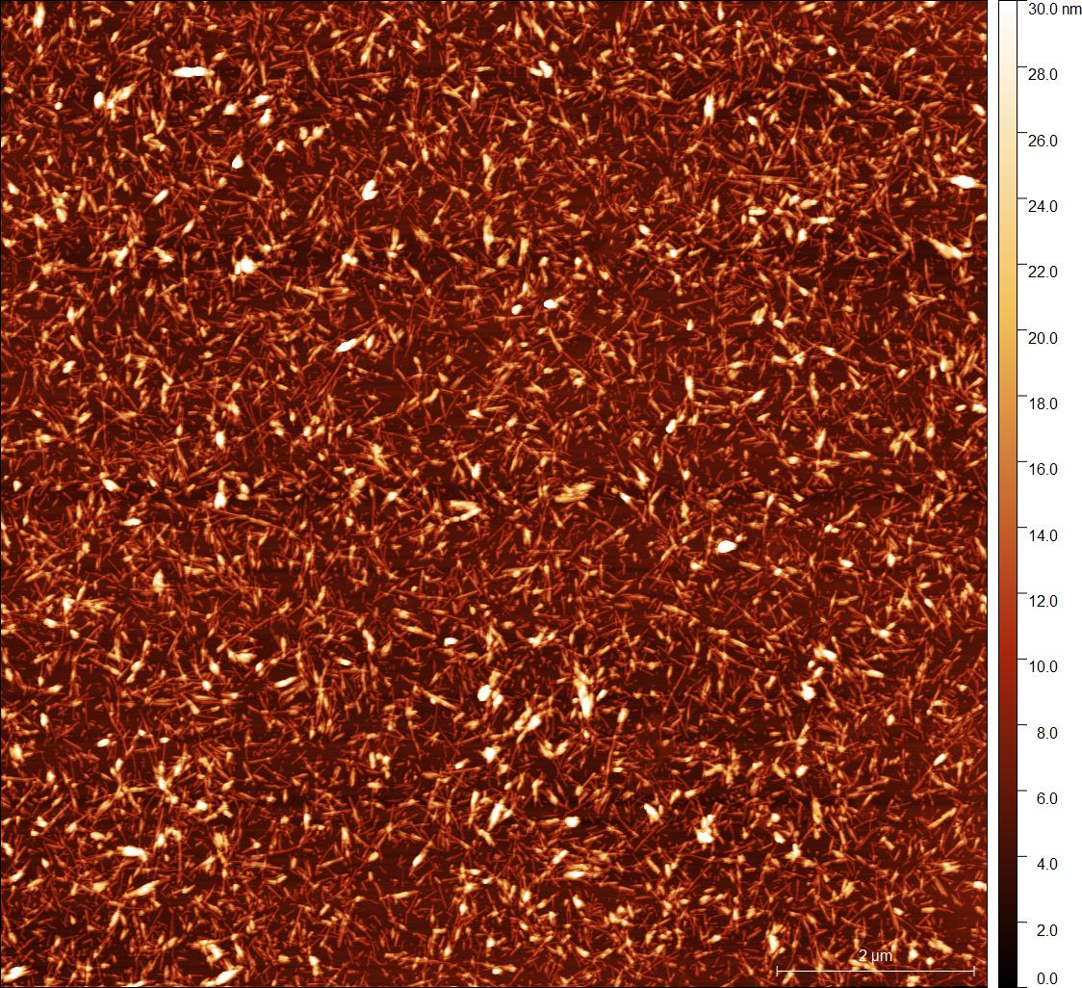
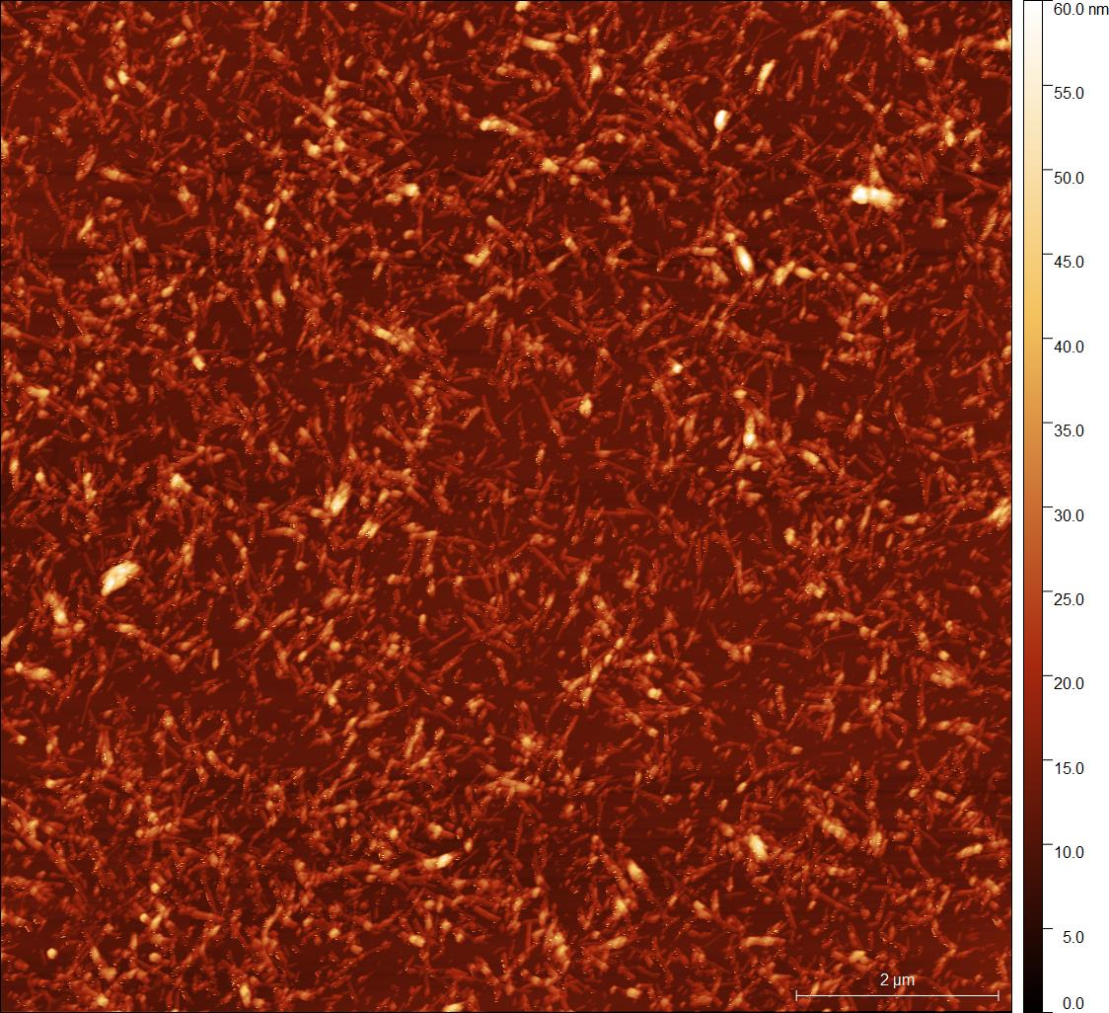
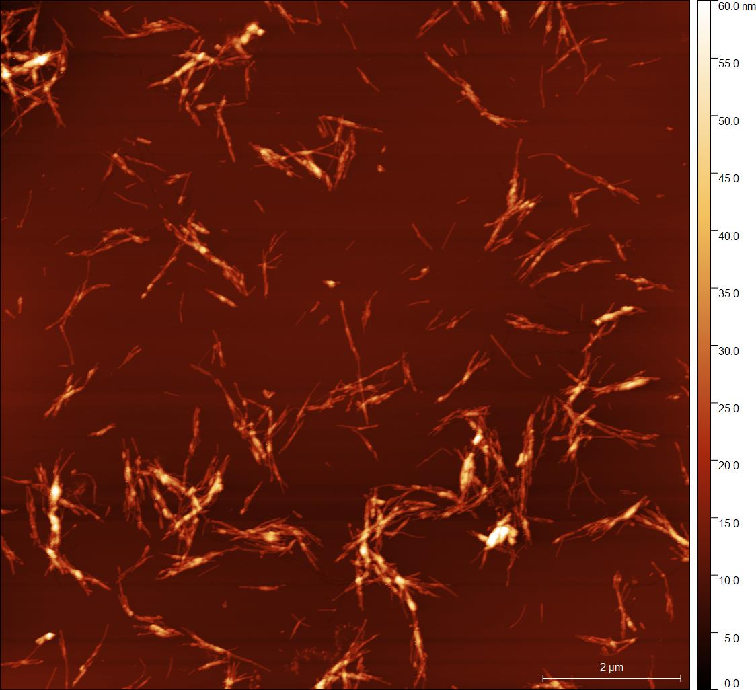
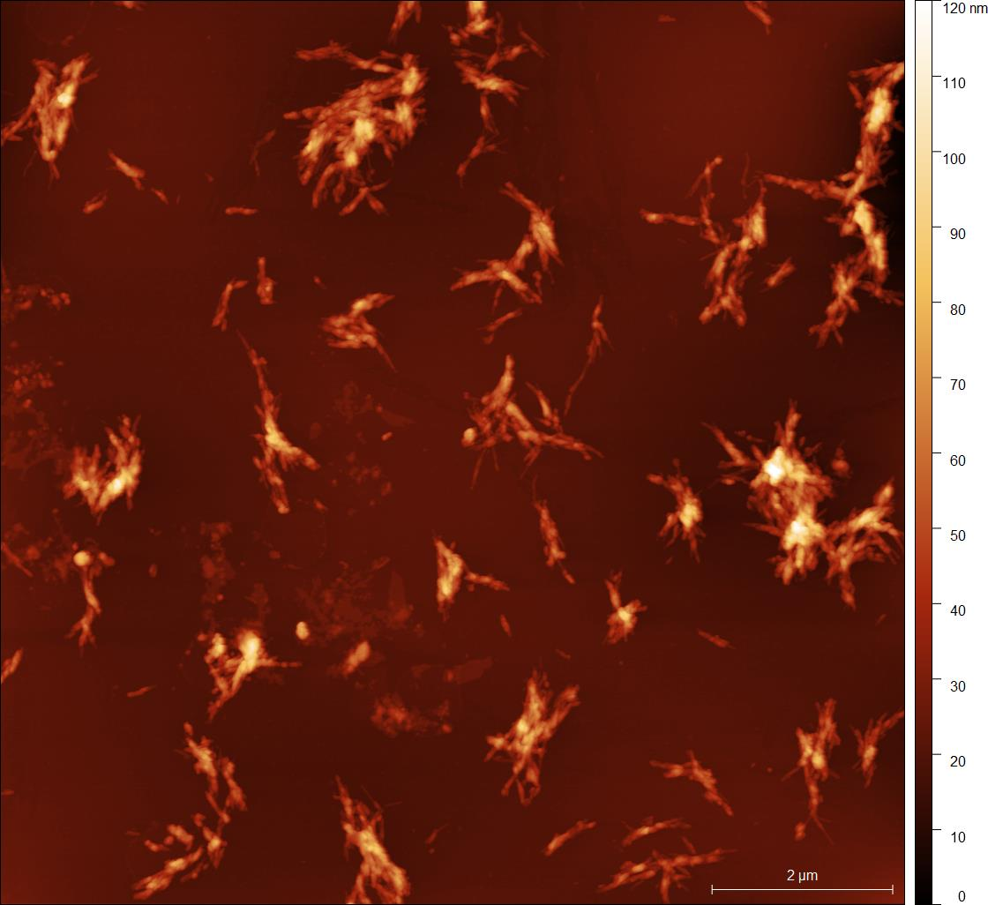
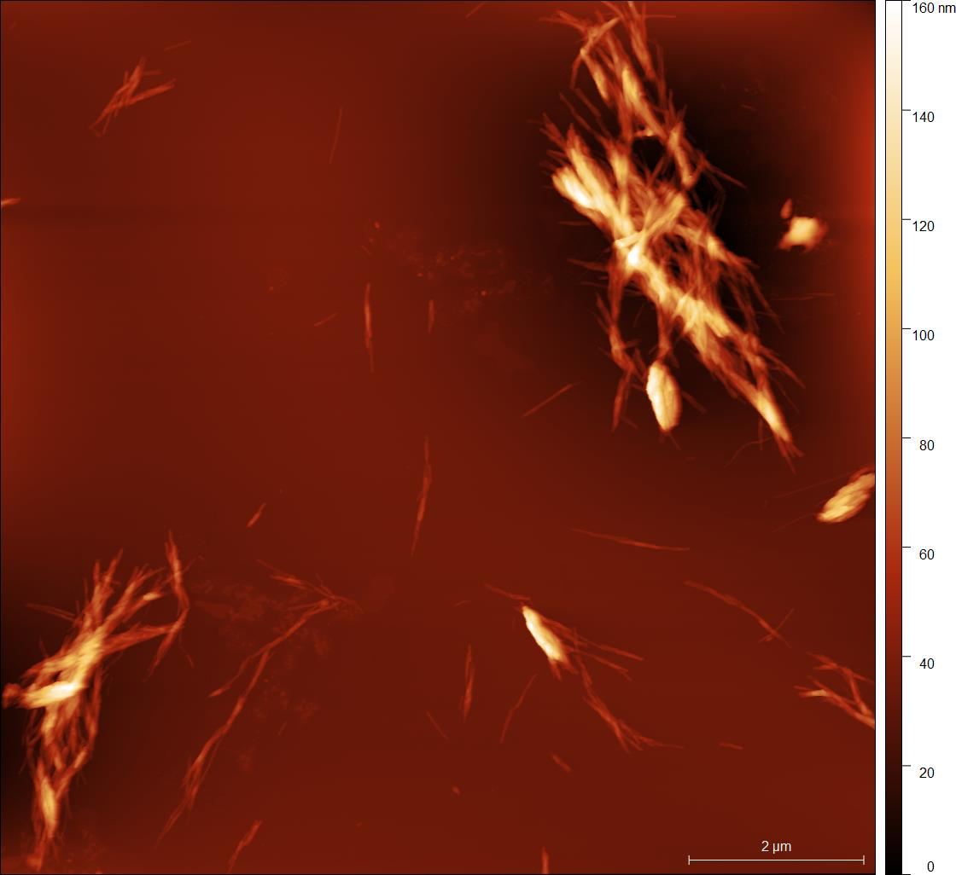
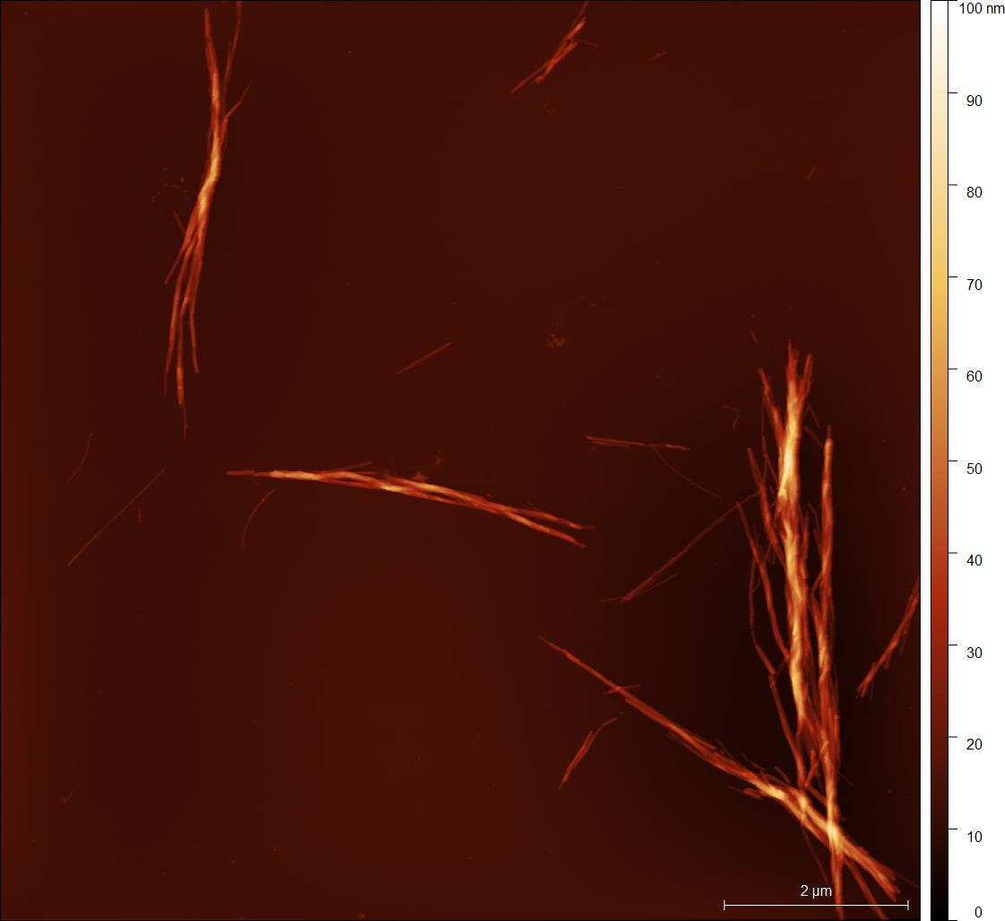
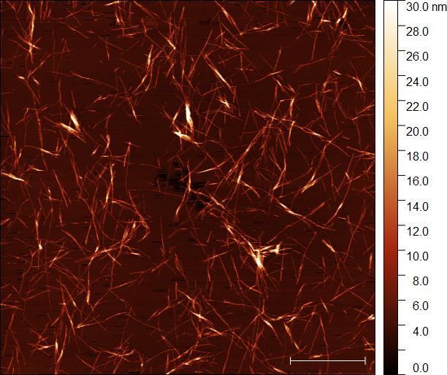
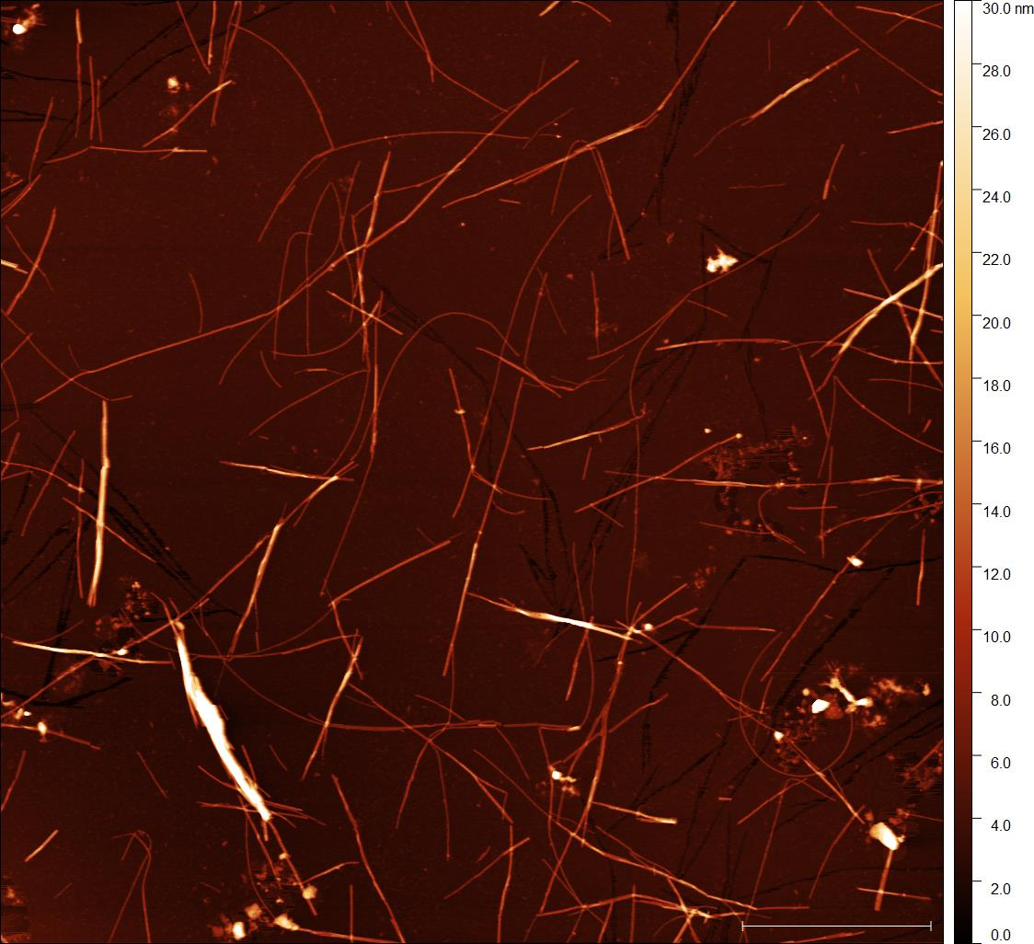
INSULIN FIBRILS MORPHOLOGY
2 um
BMIM Cl 10mM (2hod) BMIM Cl 25mM (2hod) BMIM Cl 50mM (2 hod) BMIM Cl 100mM (2hod)
HMIM Cl 50mM (7hod) HMIM Cl 100mM (7hod) OMIM Cl 10mM (7hod) OMIM Cl 25mM (7hod)

Slide 6
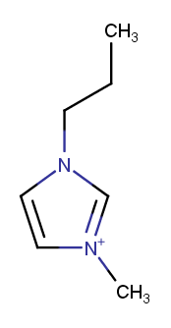
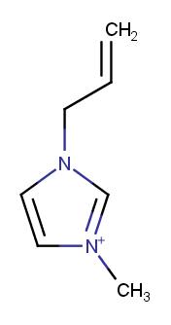
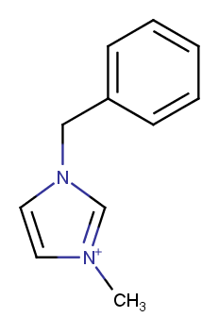
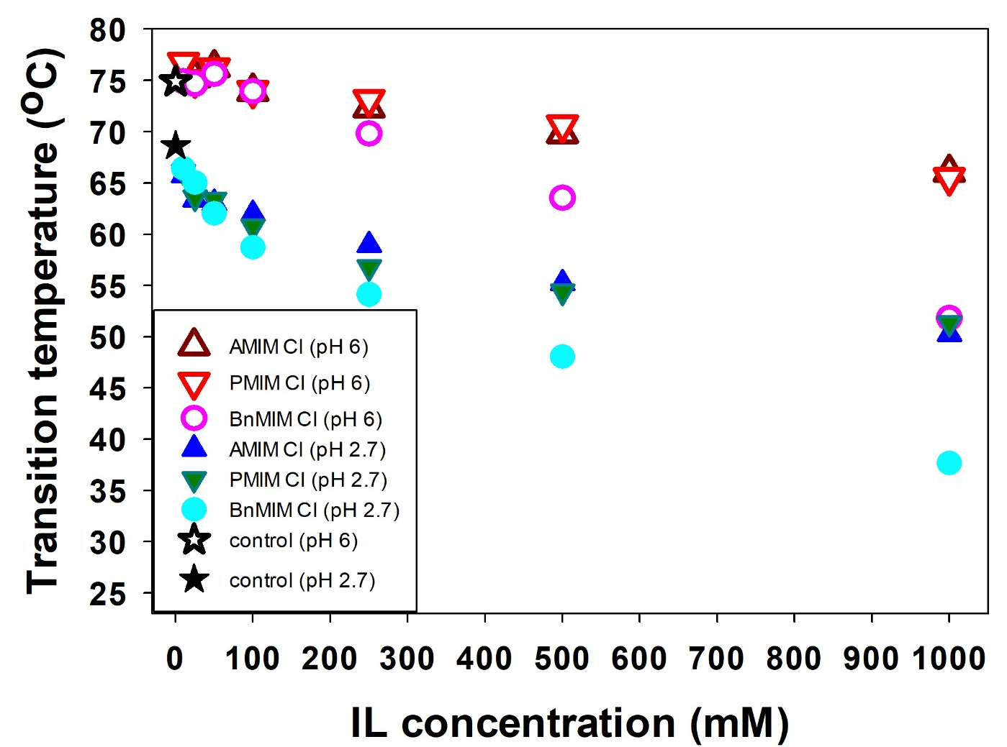
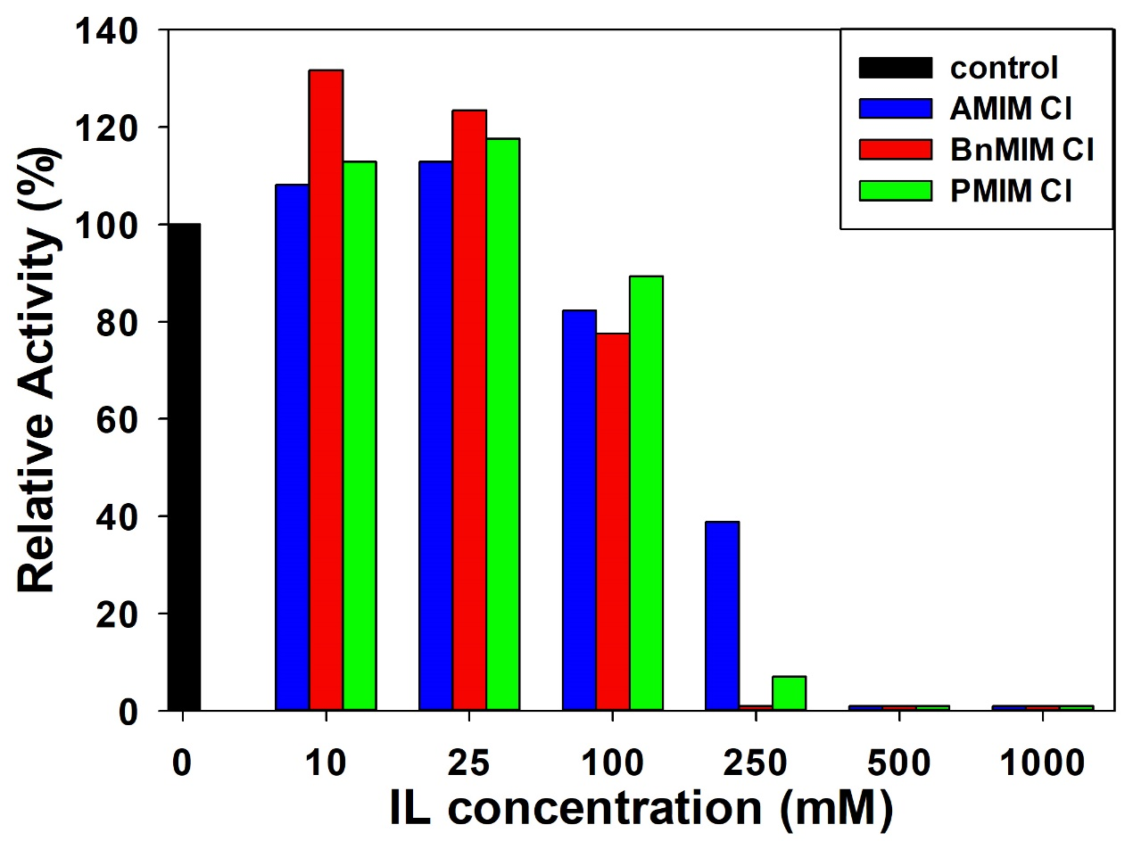
EFFECT OF SELECTED ILs ON LYSOZYME STABILITY AND ACTIVITY
SERIES OF UNDERSTUDIED ILs
BUFFERS:
2mM GLYCINE
pH 2.7
2mM PHOSPHATE
pH 6
1-propyl-3-methyl imidazolium chloride (PMIM Cl)
1-allyl-3-methyl imidazolium chloride (AMIM Cl)
1-benzyl-3-methyl imidazolium chloride (BnMIM Cl)
CALORIMETRY (DSC)
ACTIVITY - TURBIDITY ASSAY
25°C
pH 6.24

Slide 7
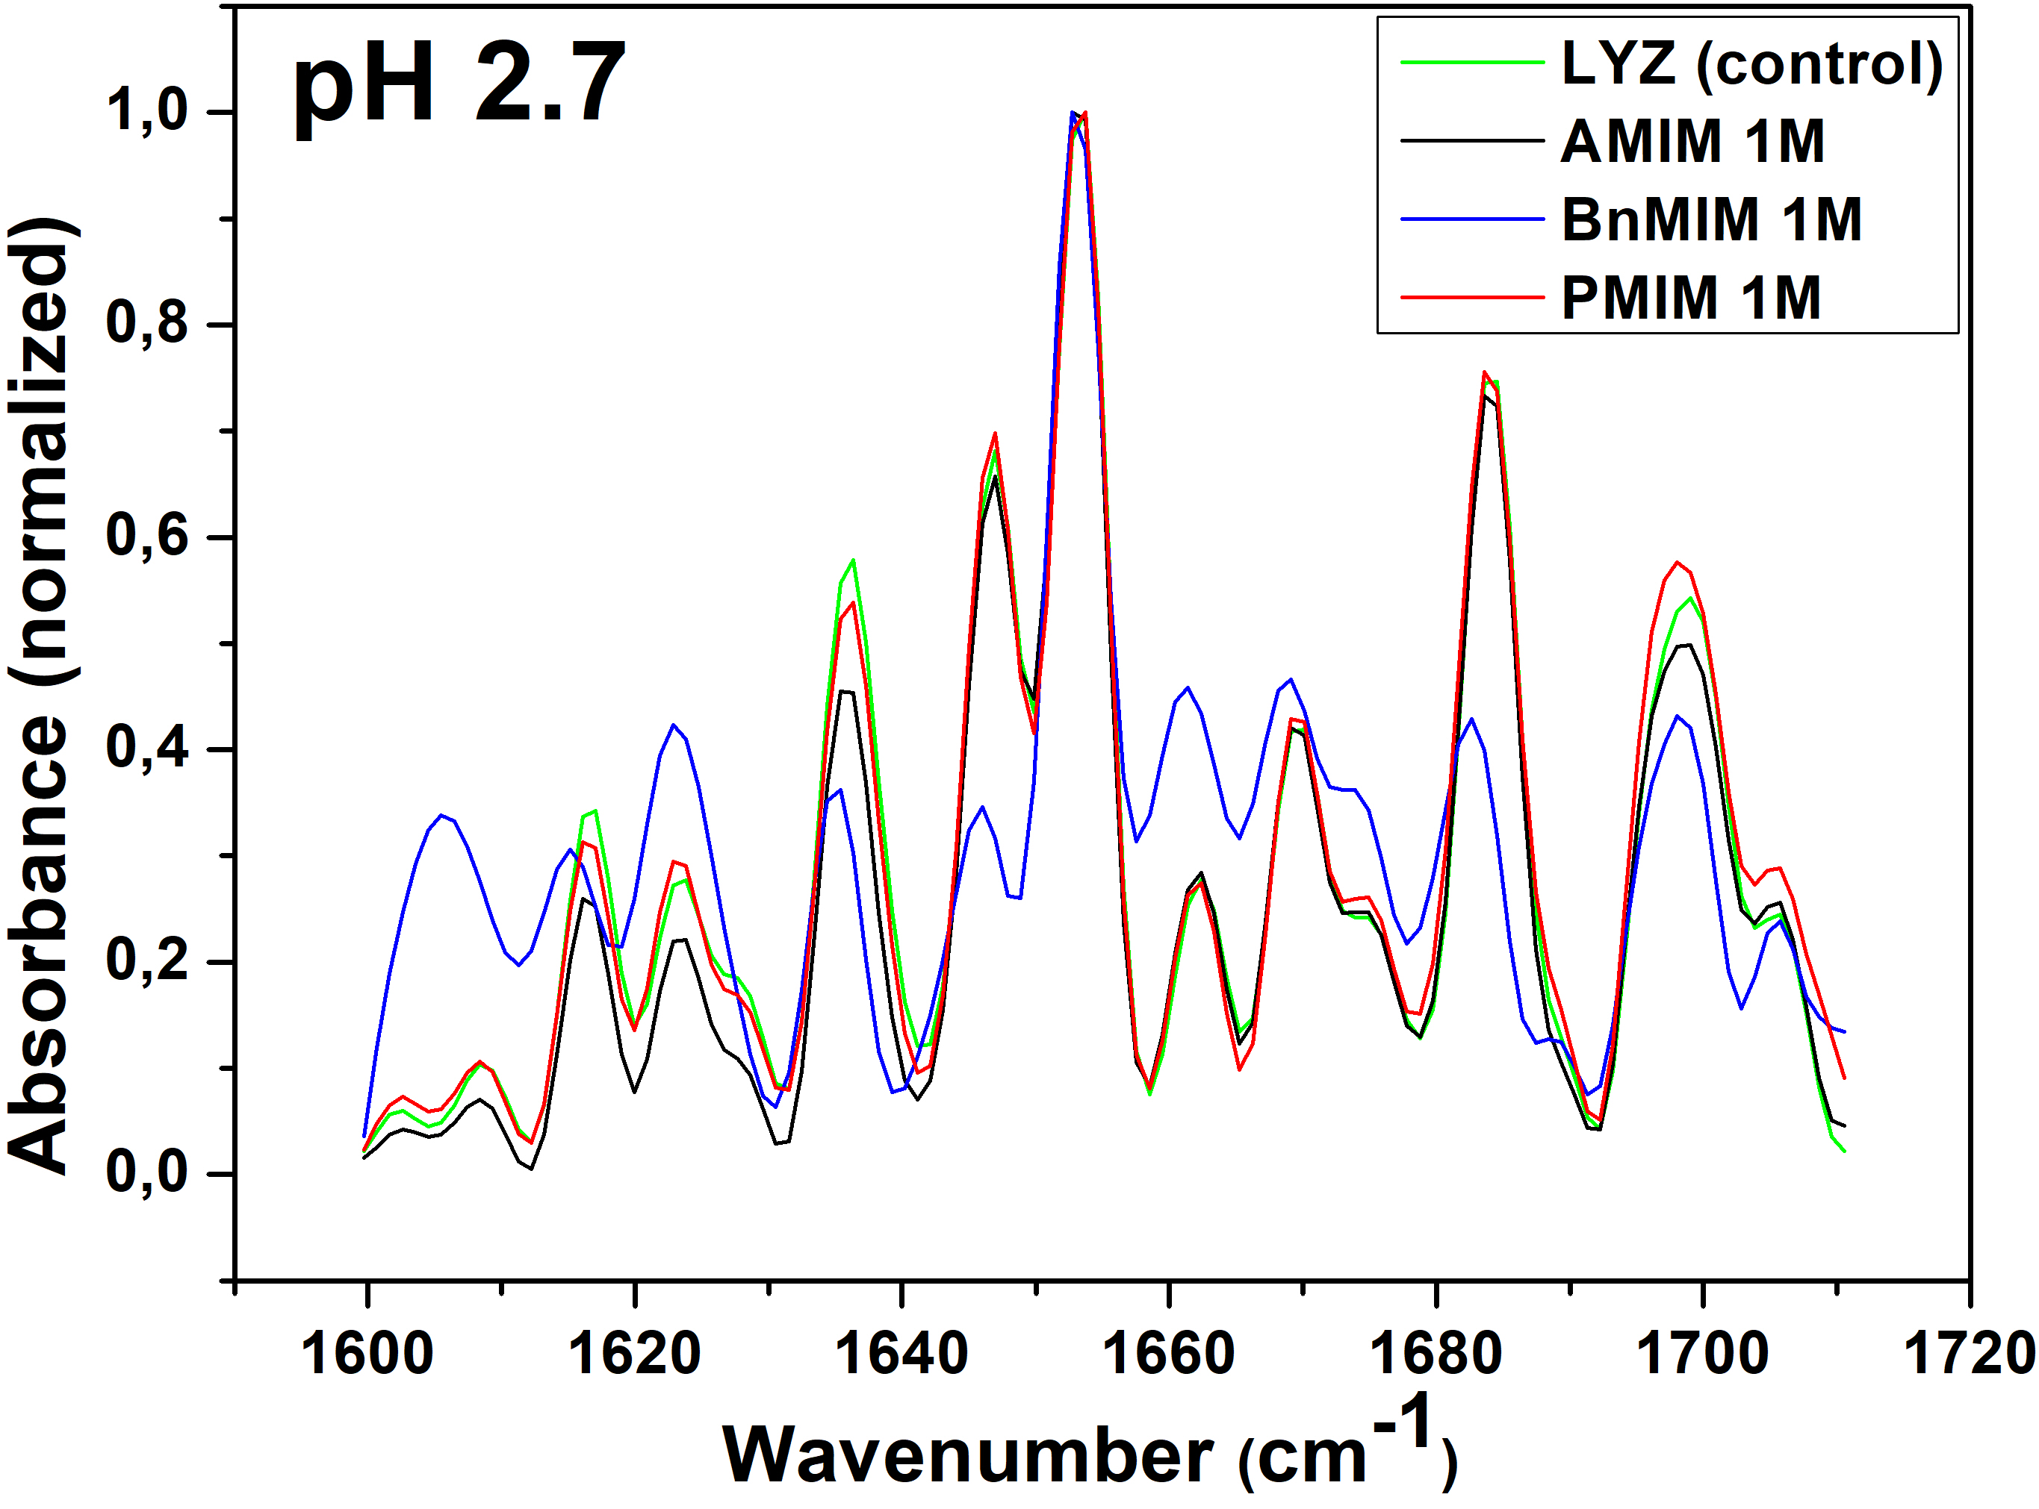
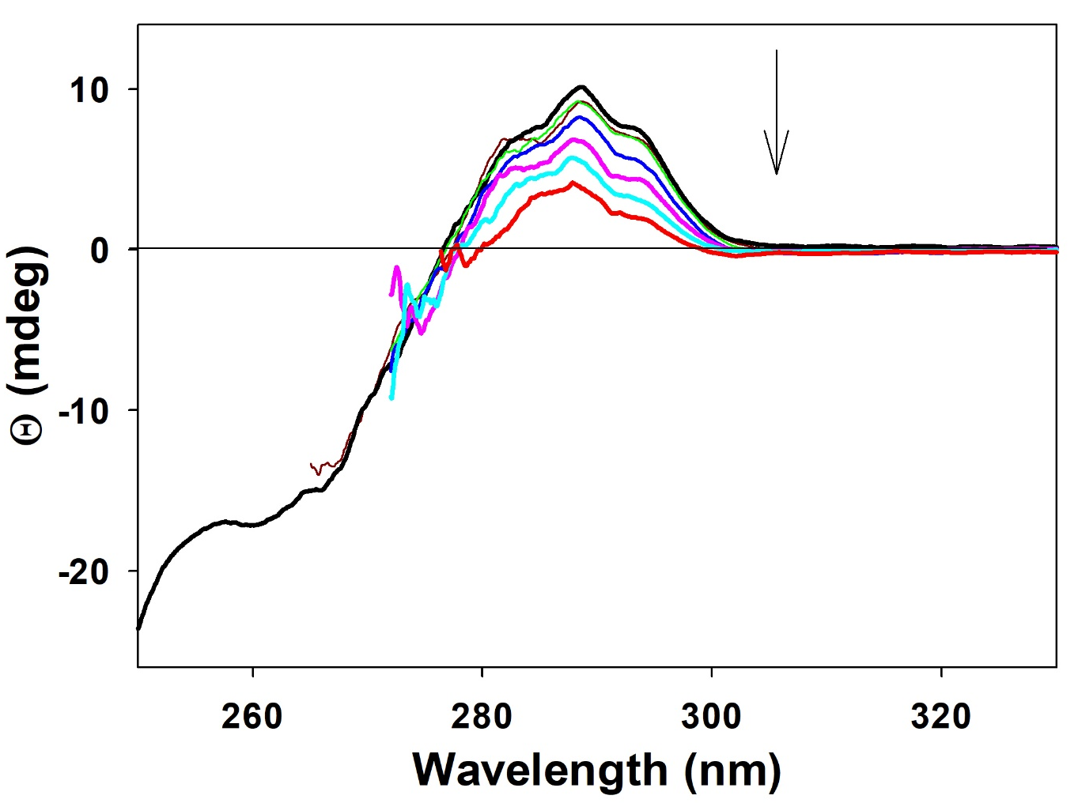
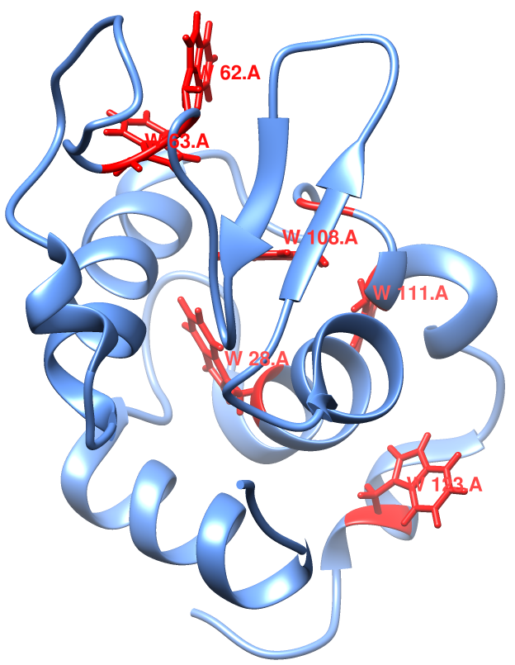
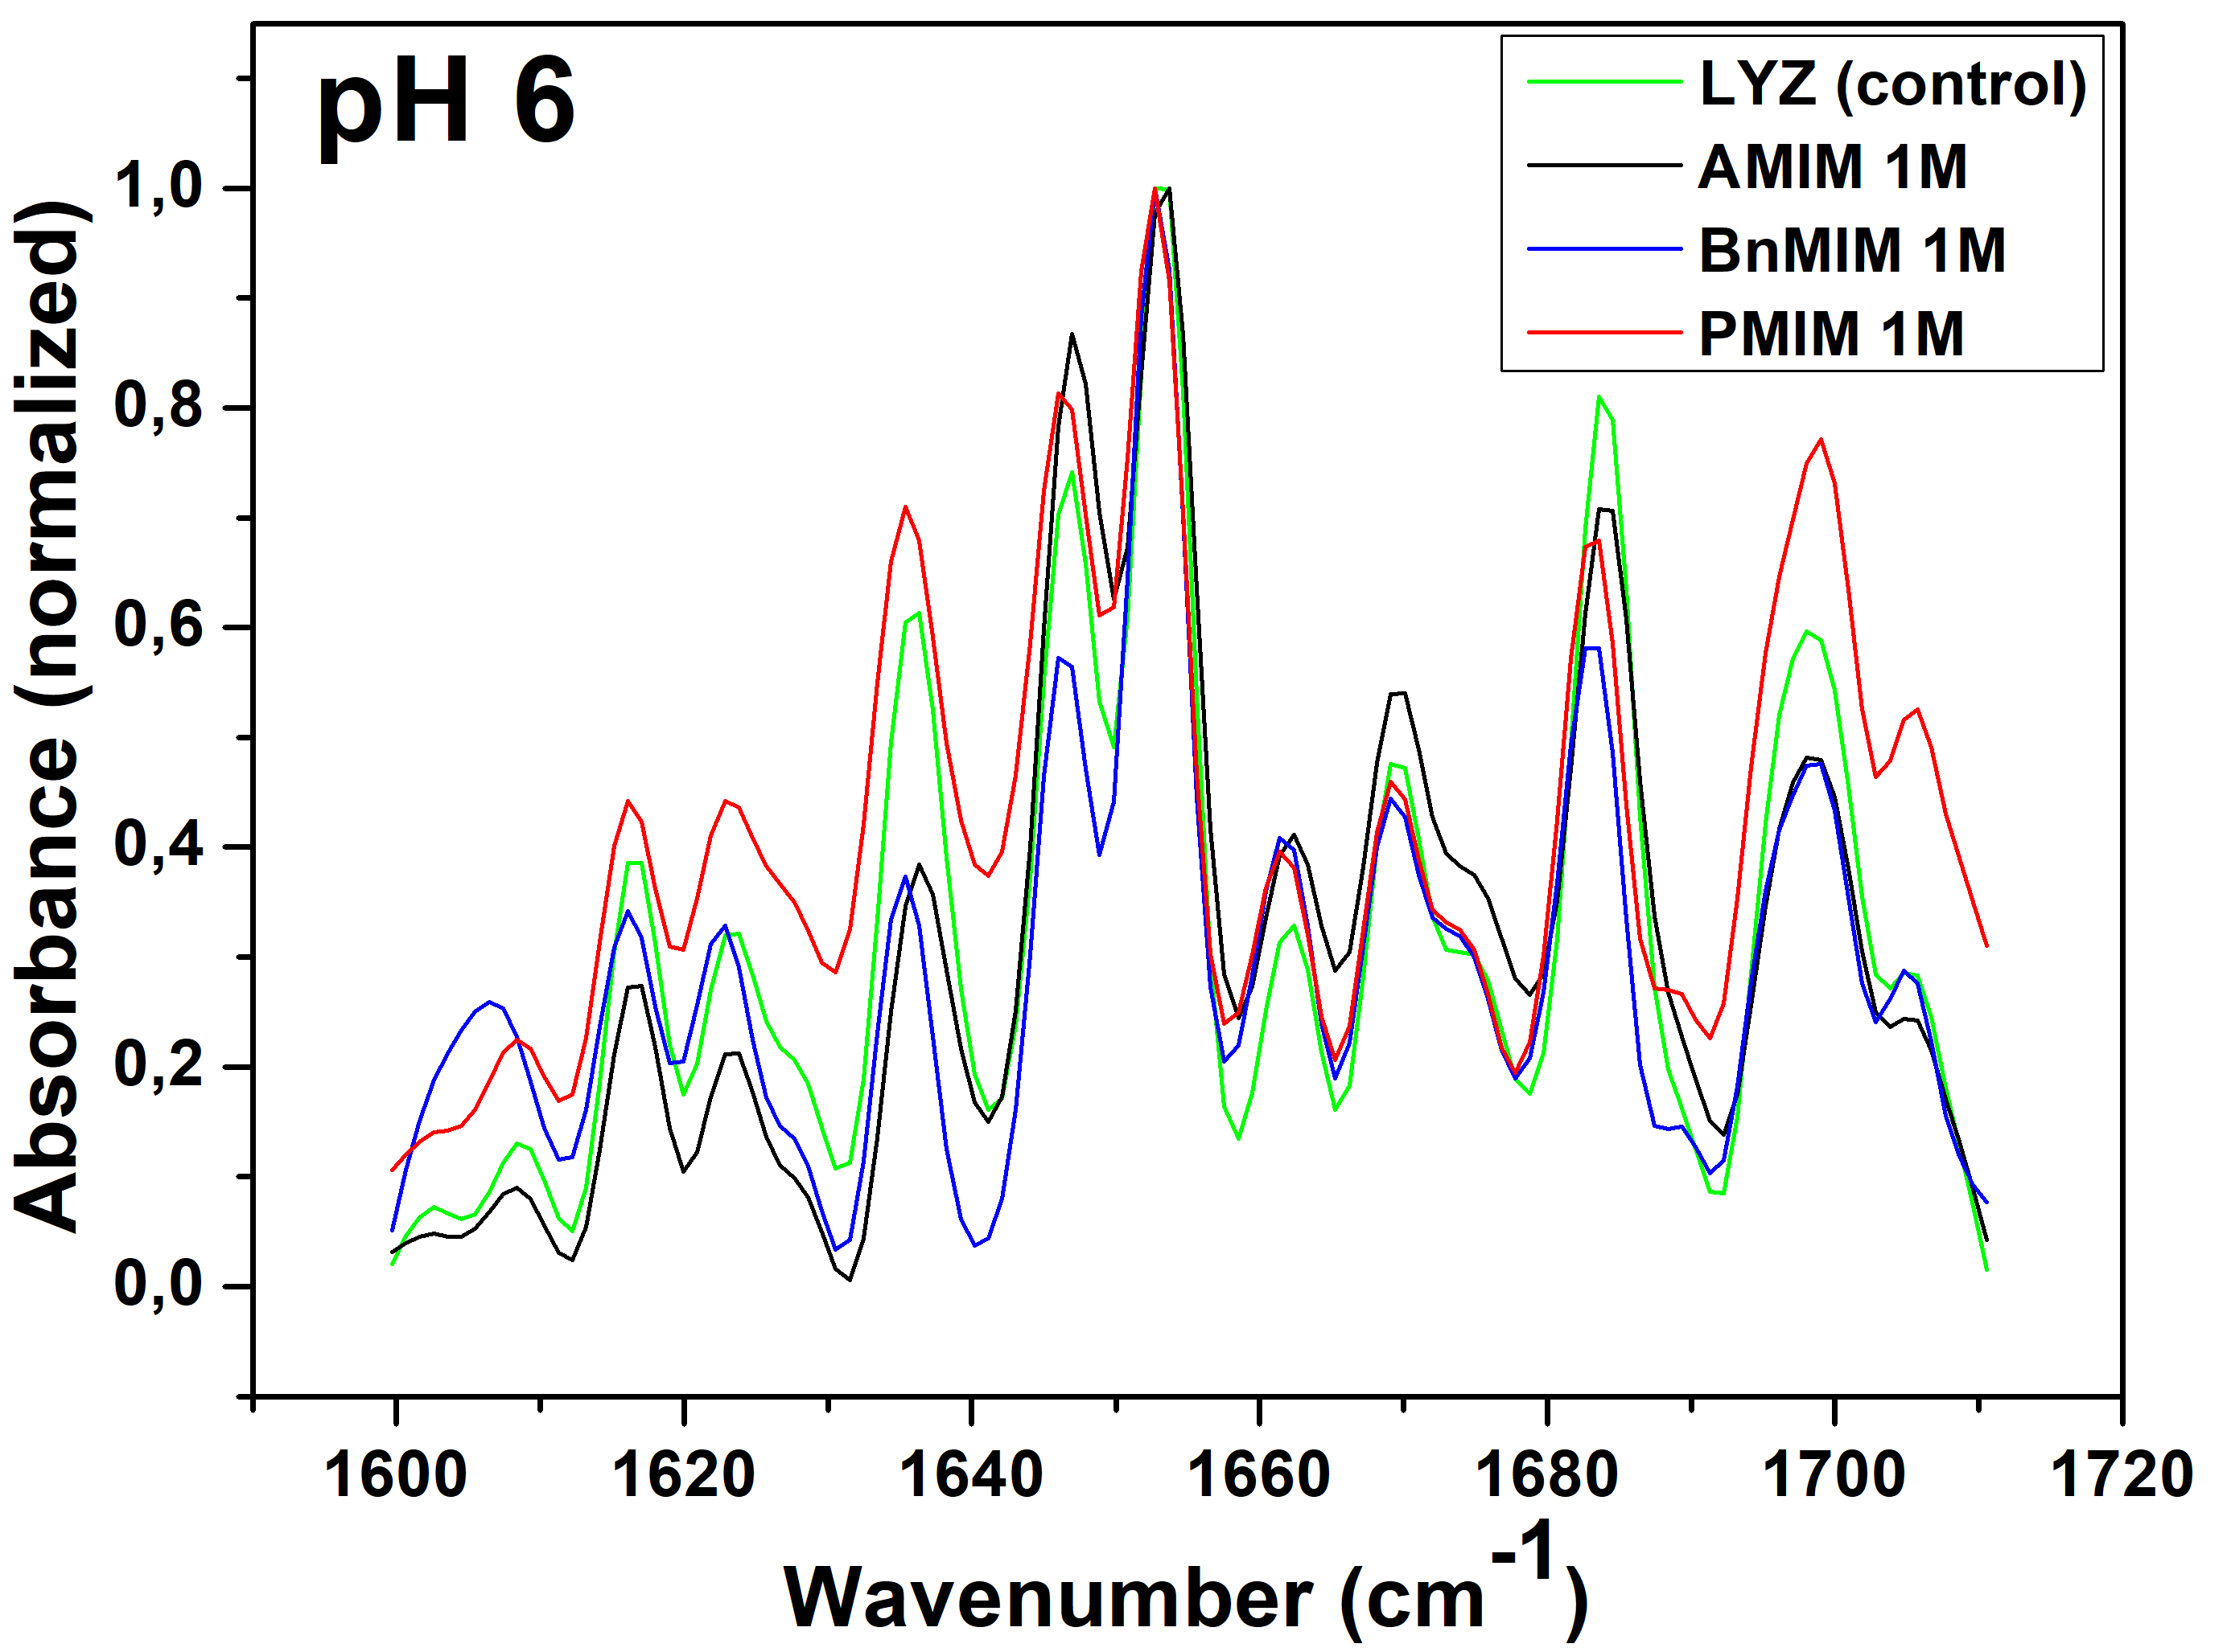
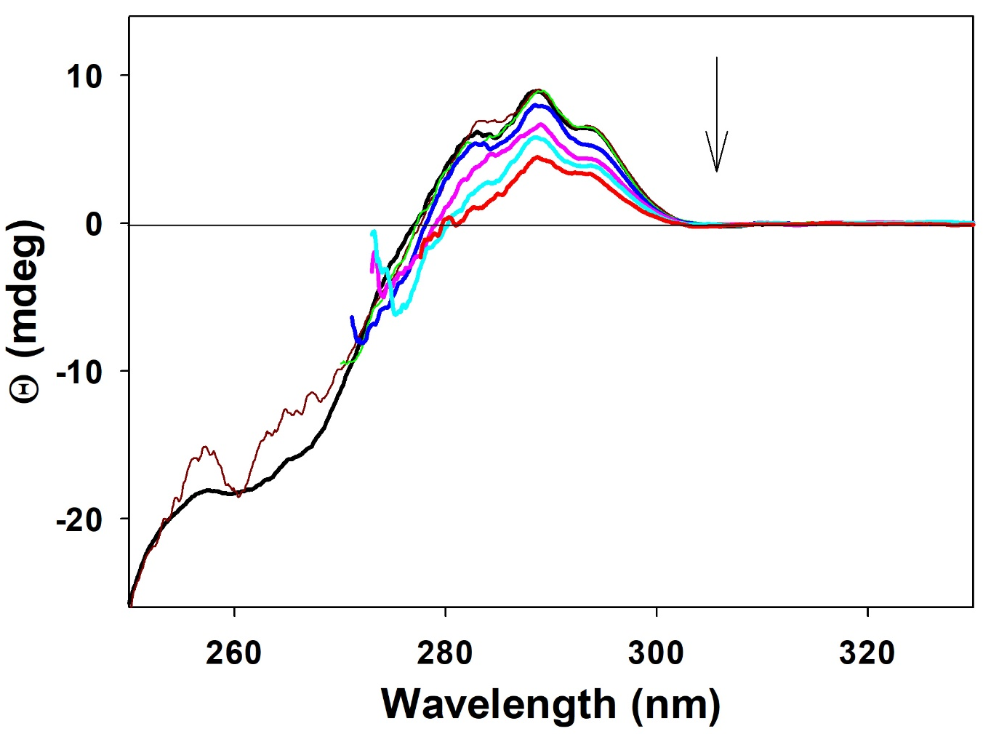
EFFECT OF SELECTED ILs ON LYSOZYME STRUCTURE
SECONDARY STRUCTURE (FTIR)
TERTIARY STRUCTURE (CD)

Slide 8
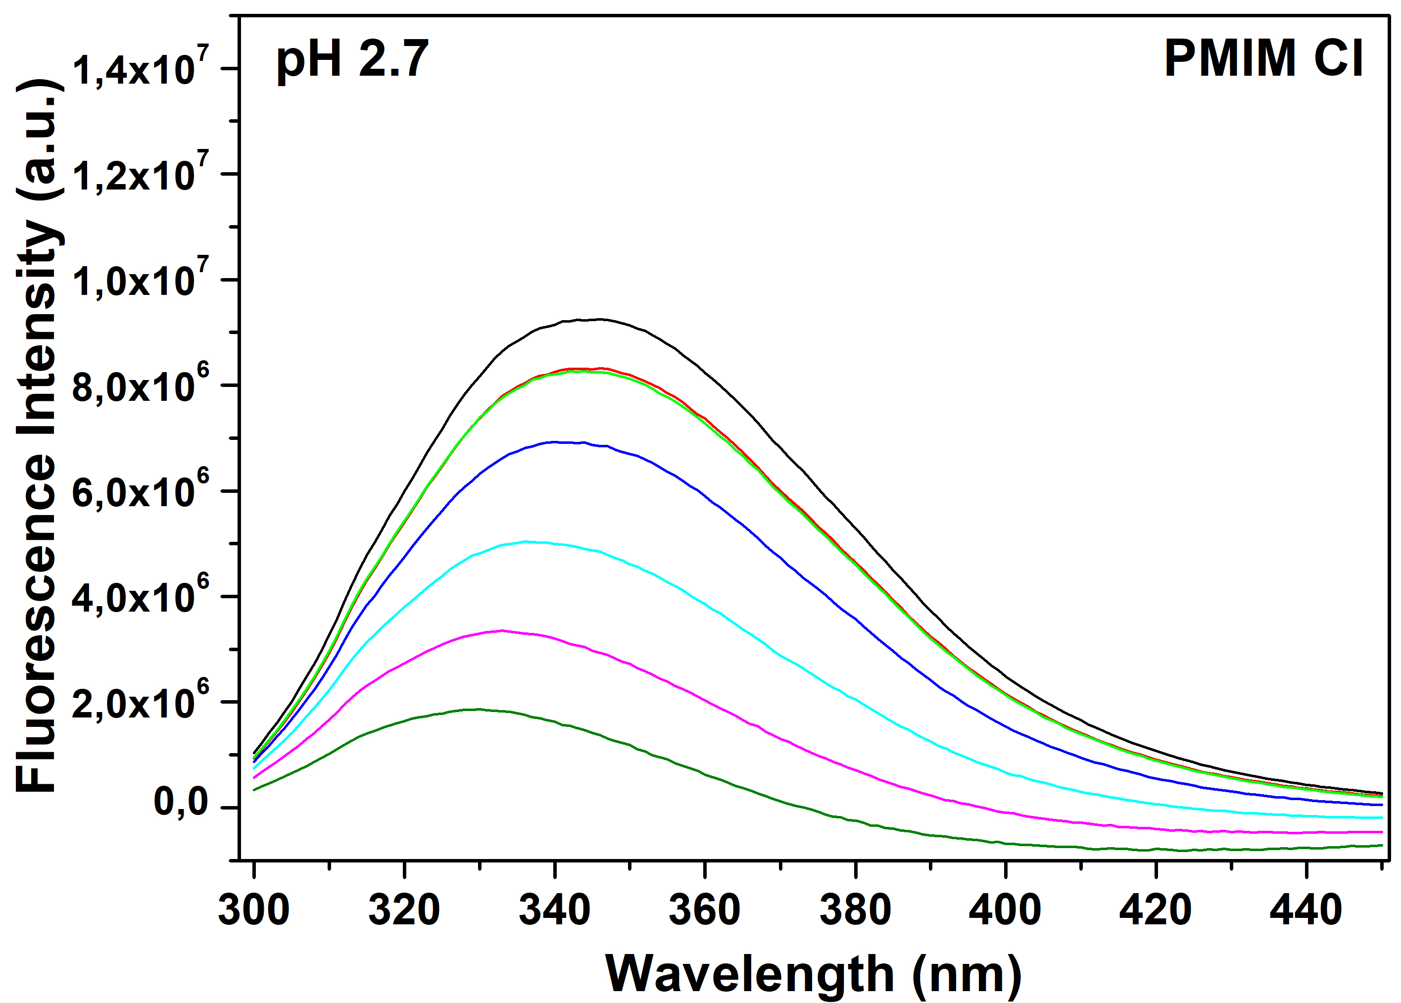
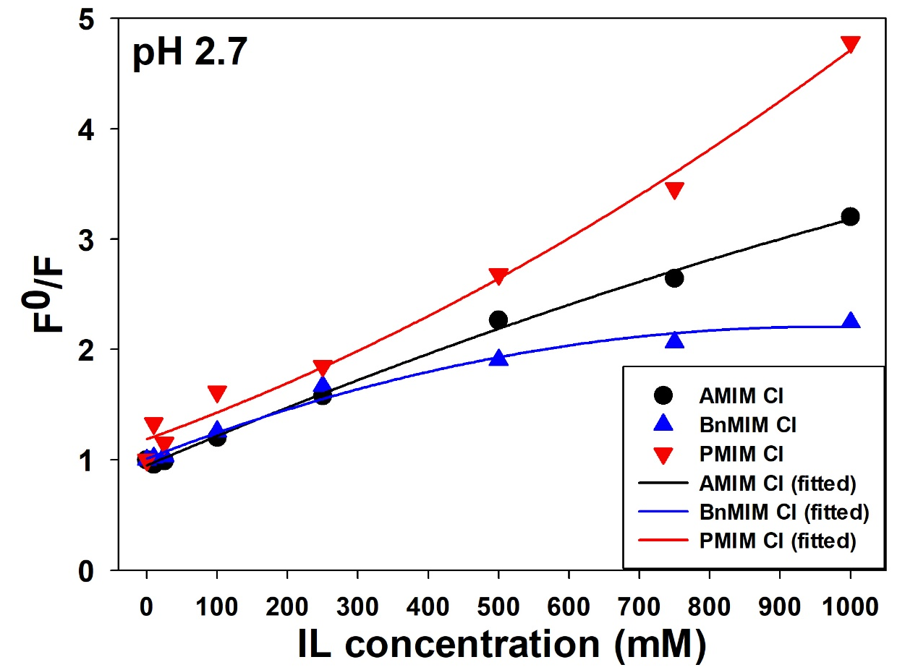
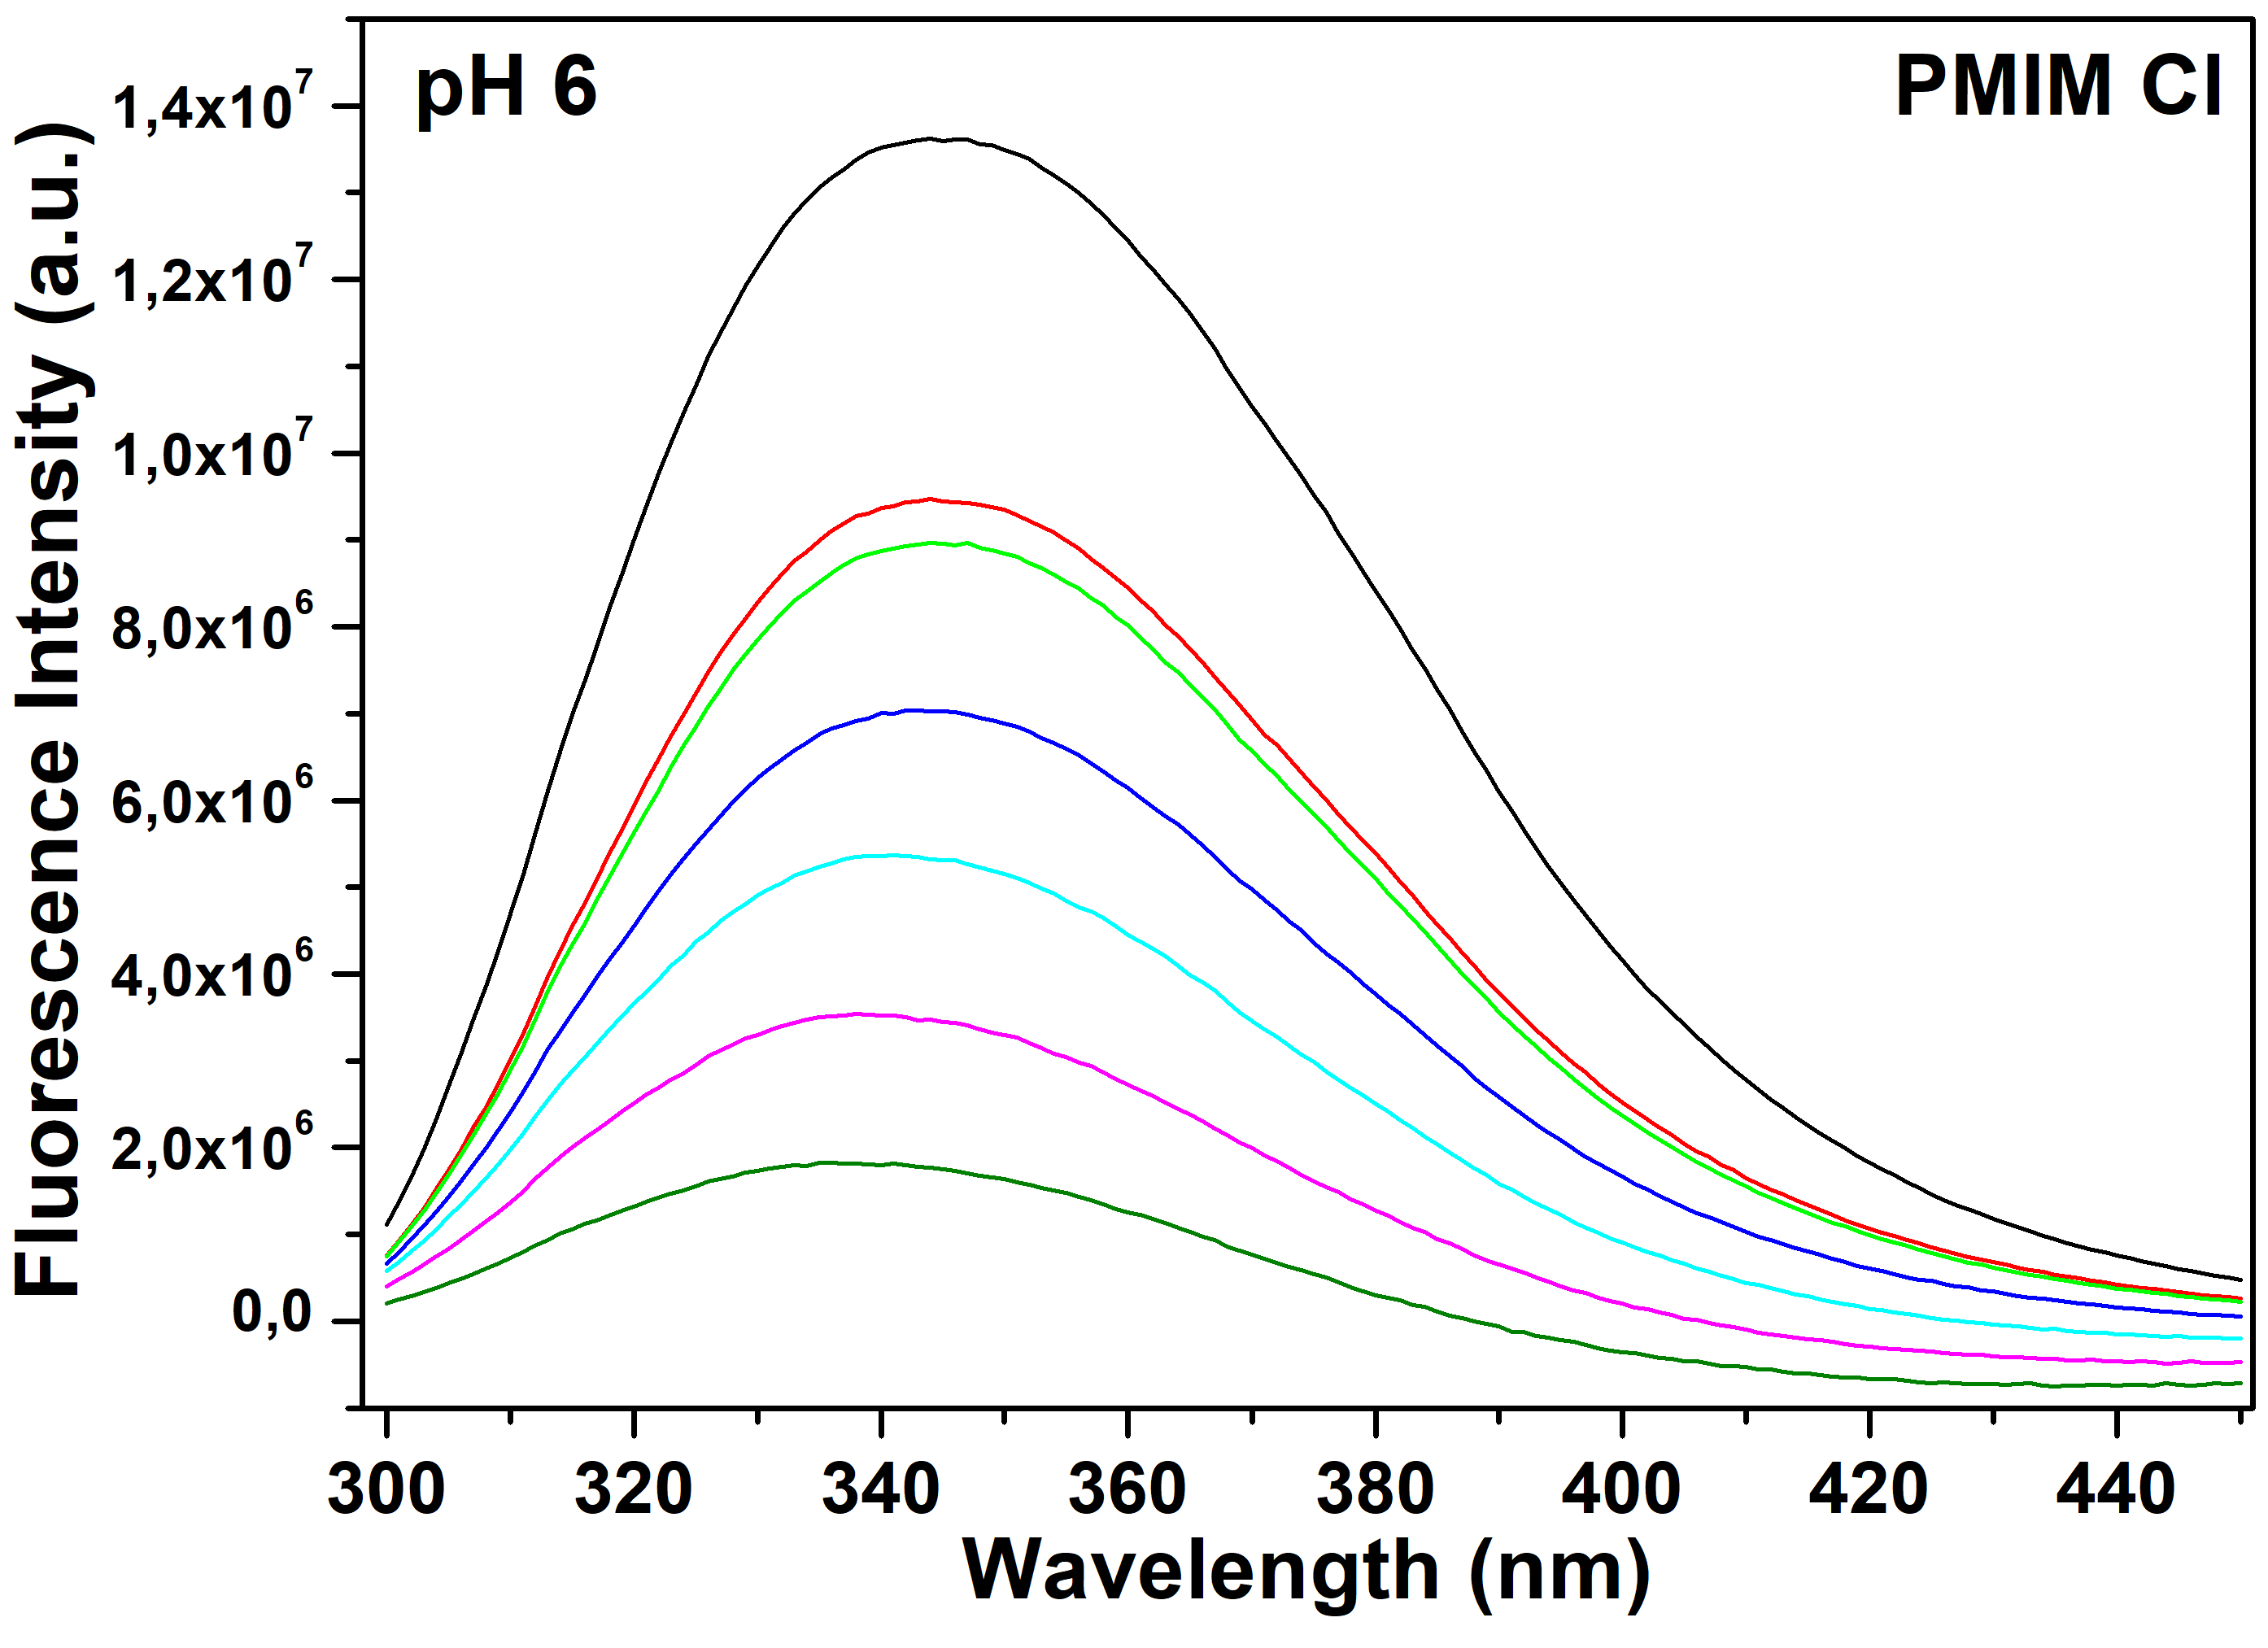
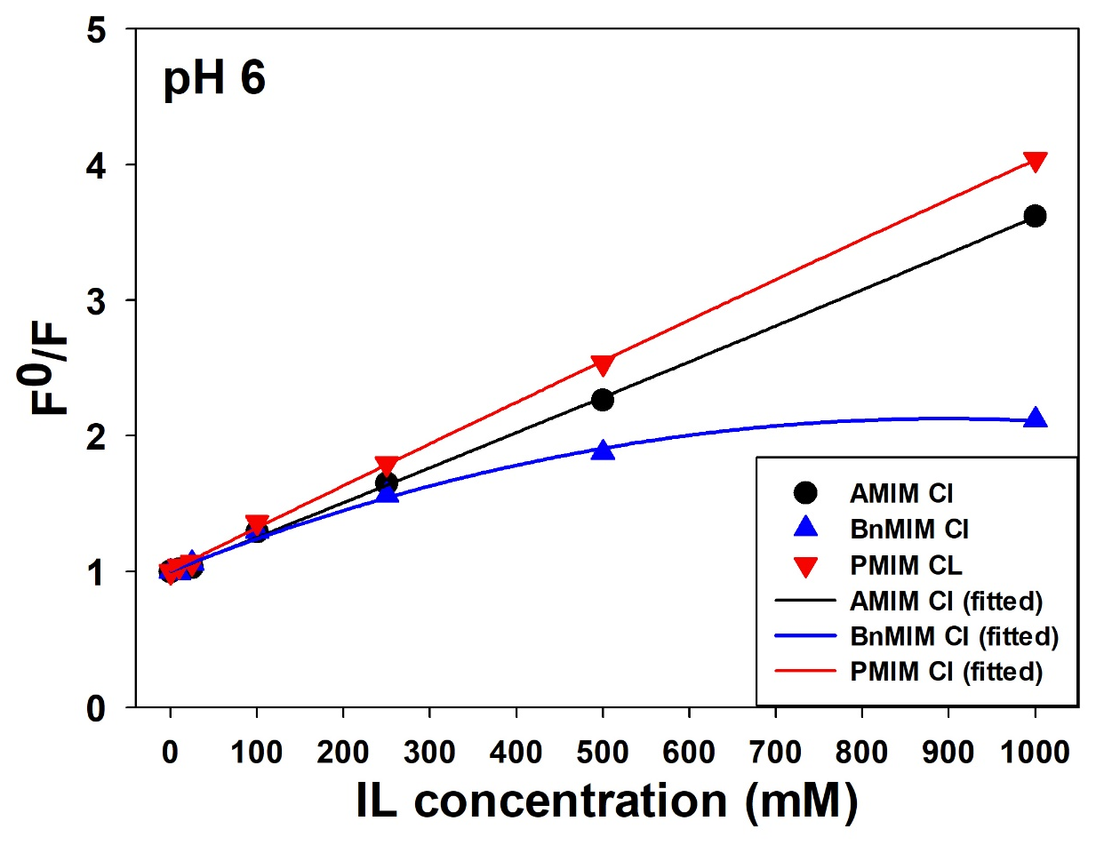
EFFECT OF SELECTED ILs ON LYSOZYME STRUCTURE
INTRINSIC FLUORESCENCE EMISSION
STERN-VOLMER PLOT

Slide 9
CONCLUSIONS
Thermal stability of LYZ depends on pH, ILs type and concentration
  slight stabilization occurs at pH6 at low concentration
  destabilization occurs with increased IL concentration
  higher cation hydrophobicity + lower pH = stronger effect
ILs induce slight changes in secondary structure (FTIR) and noticeable changes in tertiary structure (CD, fluorimetry)
Fluorescence measurements suggest the mechanism of lysozyme-ILs interactions:
  low IL concentration (dynamic queching) – collision interactions, low-range interactions
  high IL concentration (dynamic+static quenching) – formation of complex IL-TRYPTOPHAN, close interactions
The effect of ILs on lysozyme stability, activity and structure is driven by interplay of electrostatic interactions (non-specific shielding of charged groups) as well as local interactions with aromatic amino acids and hydrophobic interactions
The results of these experiments:
  will help to determine the conditions for following study of lysozyme amyloid aggregation
  underline the importance of the cation in stabilization/destabilization and aggregation of proteins
  (previously attributed only to anion)
  point out the role of specific IL-protein interactions
  contribute to the understanding of the general mechanism of IL-protein interaction

Slide 10
ACTIVITIES 2020-2021
Grant – principal investigator
SAS Grants for PhD students (2020) – successfully completed
DOKTOGRANT APP0004 – Ionic liquids as modulators of amyloid aggregation
  CONFERENCES
SKBS 2020 (regional; Trnava) - poster
EBSA 2021 (international; July 2021, Vienna) – poster, selected for oral short-talk (section „IONIC LIQUIDS, BIOMOLECULES and CELLS“)
- Effect of n-alkyl imidazolium-based ionic liquids on the kinetics of insulin fibrils formation and their morphology
PUBLICATIONS READY-TO-SUBMIT:
Fedunova D., Antosova A., Marek J., Vanik V., Bednarikova Z., Gazova Z. - Morphology of lysozyme amyloid fibrils in presence of water-miscible ionic liquids. International Journal of Molecular Sciences, Q1
Vanik V., Bednarikova Z., Gazova Z., Fedunova D. – Modulation of insulin fibrillization by imidazolium-based ionic liquids.
International Journal of Molecular Sciences, Q1
PREPARED PUBLICATIONS:
Vanik V., Gazova Z., Fedunova D: Destabilization of lysozyme in imidazolium-based ionic liquids:stability, conformation and activity studies. Journal of Molecular liquids. Q1

Slide 11
THANK YOU FOR YOUR ATTENTION

