Slide 1


Barbora Spodniaková, MSc.
Department of Biophysics
Supervisor: doc. RNDr. Zuzana Gažová, CSc.
Consultant: RNDr. Zuzana Bednáriková, PhD.
Institute of Experimental Physics, SAS, Košice
Pavol Jozef Šafárik University in Košice
Formation of protein amyloid structures and inhibition of amyloid self-assembly - impact on amyloid diseases
Seminar for doctoral students SAS, 2021

Slide 2
Aims of the dissertation work
Study of the structural modification of proteins leading to amyloid aggregation
Identification of small molecules able to reduce amyloid aggregates as an effective treatment
Determination of the structure-function relationship of the amyloid inhibitors using in vitro and in silico methods
Study of the cytotoxic effect of amyloid aggregates, effective inhibitors and their complexes

Slide 3
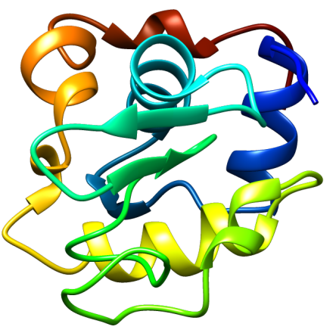
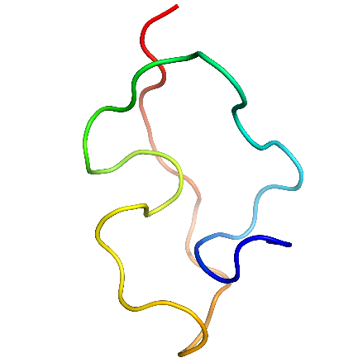
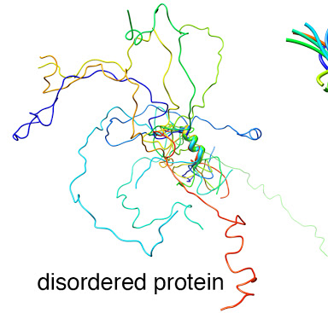
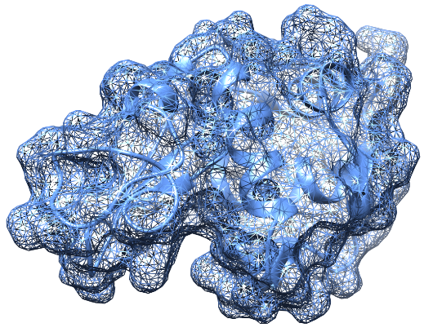
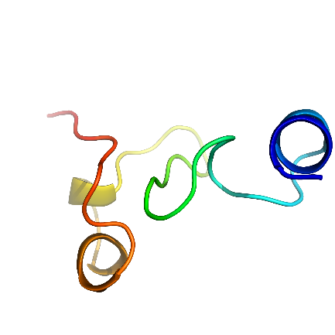
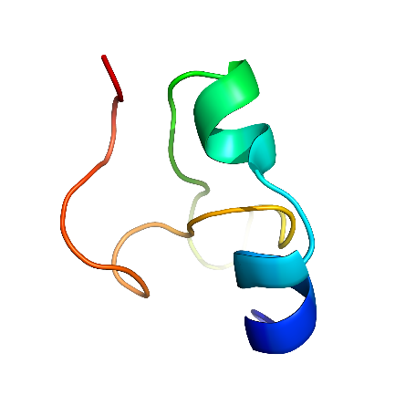
Globular vs. intrinsically disordered proteins
Structure/Disorder determined by amino acid sequence
Globular proteins (HEWL)
Intrinsically disordered proteins
(Aβ peptide)
Sequence → structure → function
Formation of hydrophobic core – nucleation – hydrophobic interactions
Stimulation of secondary and tertiary structures formation
40 % human proteome
Function – interaction with binding partner
Watson, M. et al., Essays Biochem., 2019

Slide 4
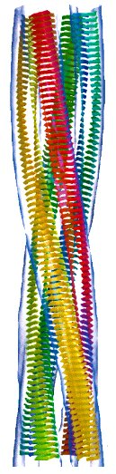
Amyloid aggregation
Formation and accumulation of ordered insoluble fibrils – more than 50 incurable diseases (Alzheimer´s disease, Parkinson´s disease, Systemic lysozyme amyloidosis, Type II. diabetes)
General property of poly/peptides
?
In vivo
Chiti et al. Annu. Rev. Biochem, 2006

Slide 5
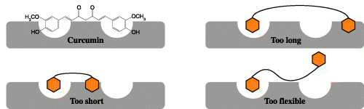
Inhibitors of amyloid aggregation
Inhibitors:
Interaction with hydrophobic residues (aromatic side chains, H-bonds, electrostatic interactions)
Multiple aromatic rings, -OH groups
Hydrophobic residues – destabilization of hydrophobic core
Linker of specific length
Molecular hybridization:
Rational design of active molecules (inhibitors)
2 or more „mother“ molecules → hybrid molecule with higher activity + desired effect
Homomers/heteromers
Curcumin
Too long
Too short
Too flexible
Reinke, A. et al. Chem Biol Drug Des CHEM BIOL DRUG DES, 2007

Slide 6
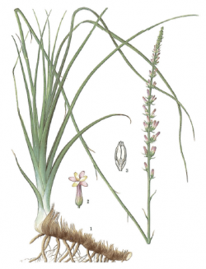
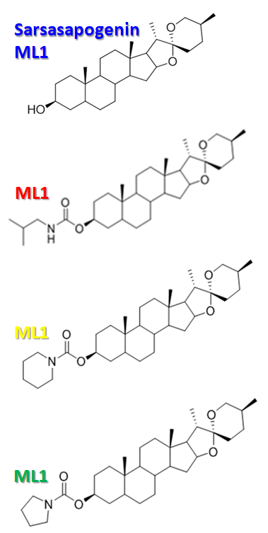
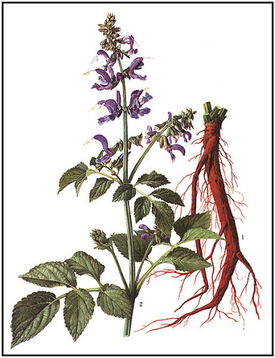
1. Extracts from Chinese herbs
School of Pharmacy, East China University of Science and Technology, Shanghai, China
Anemarrhenae asphodeloides
Salvia miltiorrhiza
Tanshinon II A
(Lipophilic extract)
ML-2
aliphatic
Sarsasapogenin
ML-1
ML-3
Salvionolic acid B
(Hydrophilic extracts)
Chinese medicine
Antibiotics
Antioxidant
Antiapoptotic
Antifungal
Extracts
Tanshinon
Salvionolic acid
piperidine
ML-4
  Chinese medicine
  Antidepressant
  Antidiabetic
  Extracts
  Sarsasapogenin (ML-1)
pyrrolidine

Slide 7
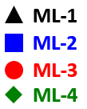

Destruction of amyloid fibrils of Aβ₄₂ peptide
1. Thioflavin T assay
concentration dependent
ML-1, ML-2, ML-3 without significant destruction effect
ML-4, tanIIA micromolar DC₅₀
Sal B the most effective
71,3 μM
0,69 μM
10,4 μM
Compound | DC₅₀ (μM)
ML-4 | 71,3
TanIIA | 10,4
Sal B | 0,69
2. Morphological analysis – Atomic force microscopy
Sal B, tanIIA – high activity
Pyrrolidine – modification (ML-4) of ML-1 enhanced activity
Notes:
IC HEWL: 20 μM, Abeta: 10 mM následne 20 μM
DC, HEWL: 20 μM Aβ: 5 μM
AFM : 100 μM

Slide 8
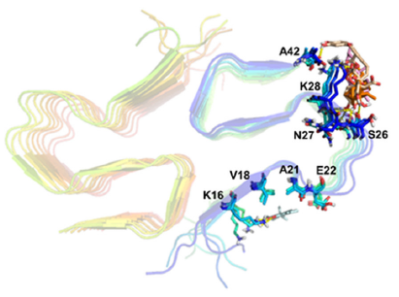
In silico analysis – Prime MM-GBSA
Binding sites + binding energies
Sal B
ML-1
ML-4
tanIIA
Compound | Amino acids in Aβ₄₂ fibril
ML-1 | K28, S26
ML-4 | K28
tanIIA | K16
Sal B | K28, S26, N27, A42
Compound | ML-1 | ML-4 | tanIIA | Sal B
ΔG_{bind} | -18.68 | -43.12 | -31.19 | -49.0011
DC₅₀values (μmol.dm⁻³) | >200 | 71.3 | 10.4 | 0.69
ML-4, Sal B – interaction in the area of salt bridges - stability (K28, A42)
tanIIA – binding to the central hydrophobic core – responsible for amyloid aggregation

Slide 9
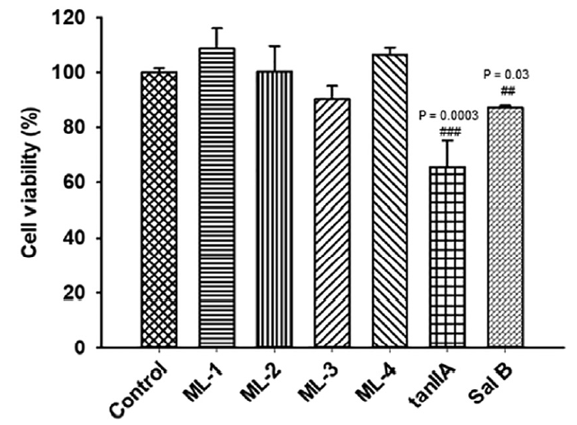
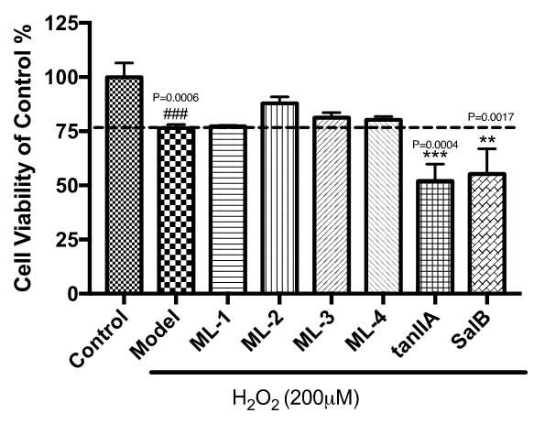
Cell viability and antioxidant capacity
Cell viability
Antioxidant capacity
WST-1 assay
Cytotoxic effect:
  tanIIA: 65 % viability
  Sal B: 82 % viability
MTT assay
H₂O₂ – ROS, intermediate in oxidative metabolism
ML-2, ML-3, ML-4 – antioxidant capacity
Notes:
Cell viability – SH-SY5Y

Slide 10
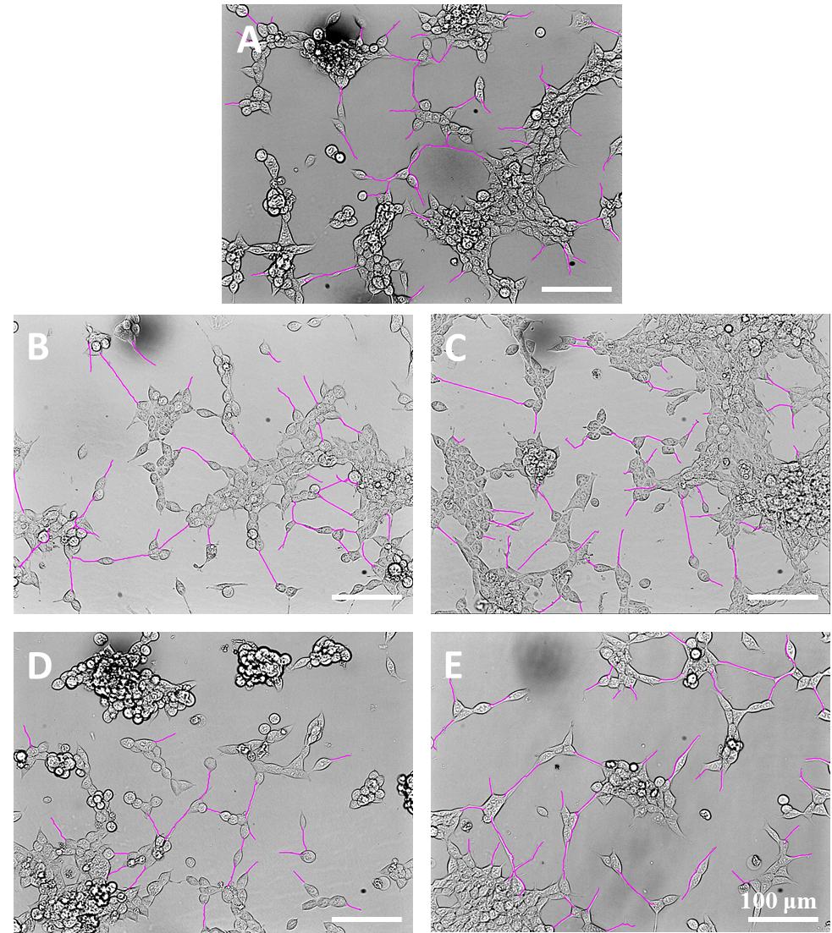
Neuritic outgrowth
Control
Loss of neuron connection - consequence of AD
Nutrition deprivation – induction of neuritic outgrowth
ML-1 and ML-4 enhanced the effect
ML-1
ML-4
1 μM
 | neuritic outgrowth (%)
 | 1 μM | 10 μM
Control | 49,6 ± 11,6 | 49,6 ± 11,6
ML-1 | 45,2 ± 15,5 | 65,7 ± 12,1
ML-4 | 53,1 ± 9,9 | 62,5 ± 10,9
Retinoic acid | 60,9 ± 9,6 | 69,8 ± 13,6
10 μM

Slide 11

2. bis-coumarin homodimers
Department of Organic Chemistry, Institute of Chemistry, Faculty of Science, P. J. Šafárik University, Košice, Slovakia
homodimers + piperazine linker with various length
  Inhibition
  Destruction
  HEWL/amyloid fibrils
  Aβ₄₂ peptid/amyloid fibrils
3C
MH3
4C
MH4
6C
Bis-coumarin homodimers
MH6
7C
MH7

Slide 12
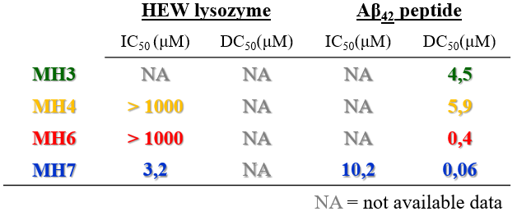
Inhibition and destruction activity of MH compounds
Concentration of MH compounds: 1 mmol.dm⁻³ – 100 pmol.dm⁻³
Inhibition
Concentration dependent effect
MH7 the most effective inhibitor for HEW lysozyme and Aβ₄₂ peptide
Fluorescence intensity (%)
Destruction
Without effect on HEW lysozyme fibrils
High effectivity to destruct amyloid fibrils of Aβ₄₂ peptide
MH7 the most effective destruction of Aβ₄₂ fibrils
Concentration (mol.dm⁻³)
Notes:
20 μM HEWL + Aβ = IC
20 μM HEWL + 5 μM Aβ = DC

Slide 13
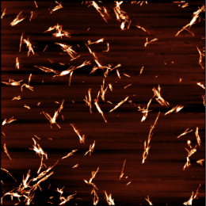
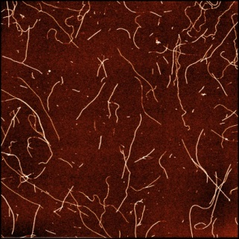
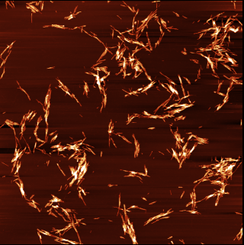
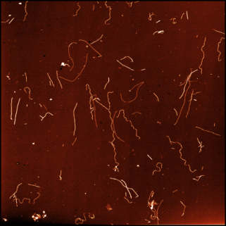
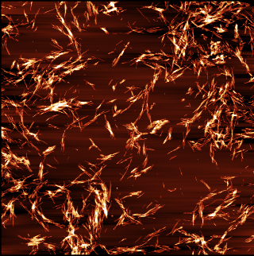
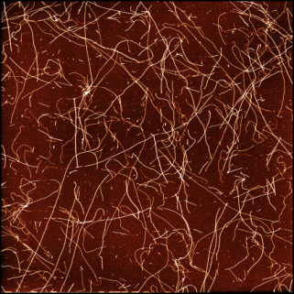
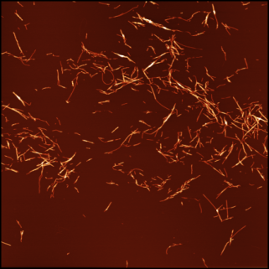
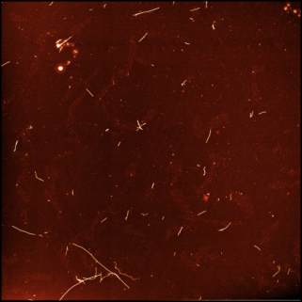
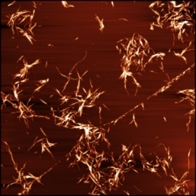
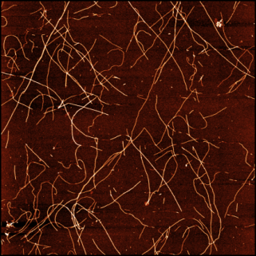
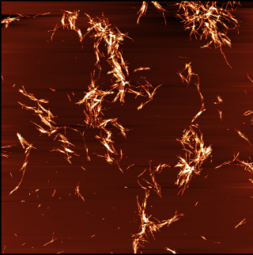
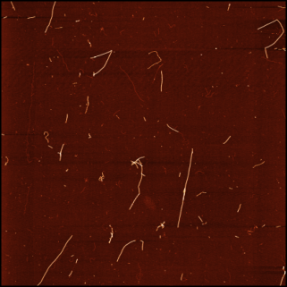
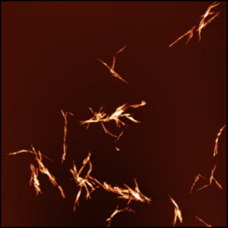
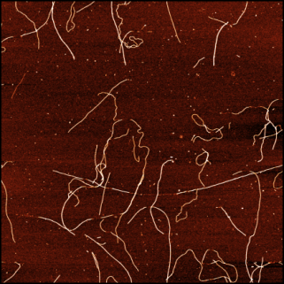
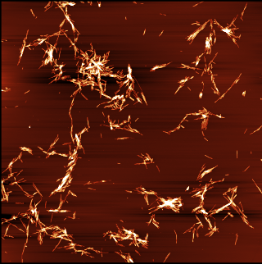
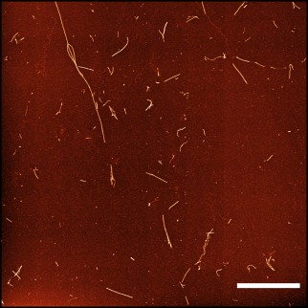
Inhibition
Destruction
AFM
HEWL
Aβ₄₂
HEWL
Aβ₄₂
HEWL control
MH3
Aβ₄₂ control
MH4
MH6
MH7
2 μm
Notes:
200 μM

Slide 14

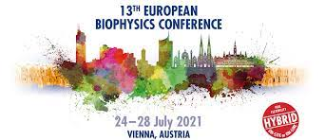
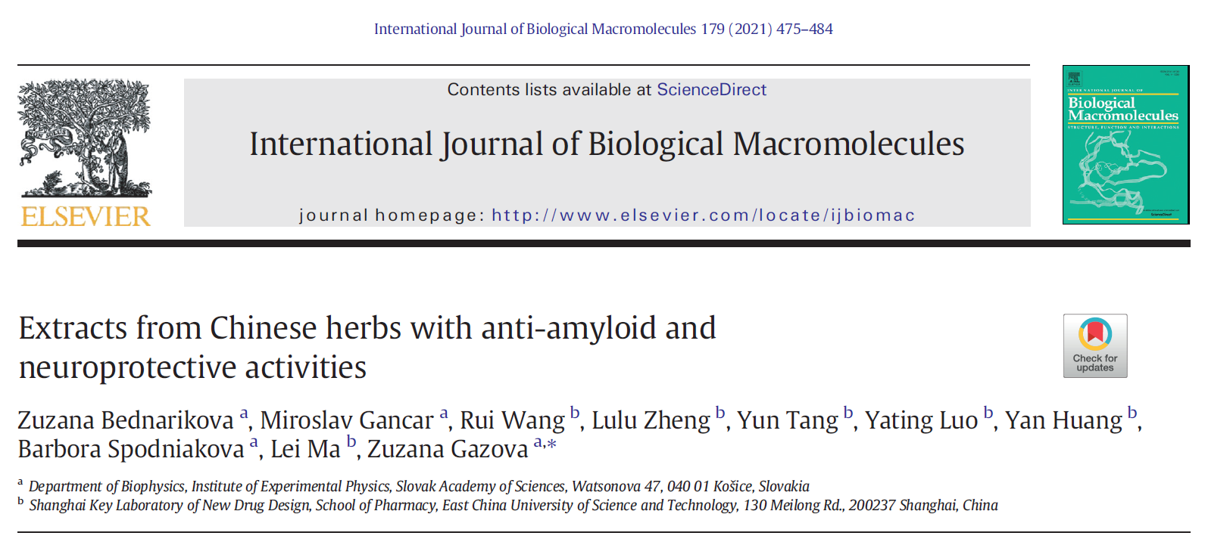

Activities
Passed courses at UPJŠ
  Biophotonics
  Cell Biology
  Selected chapters in biophysics – protein conformational disorders
Conferences
  A seminar for doctoral students dedicated to the memory of academician Boďa, 2020 + awarded presentation
  Slovak Biophysical symposium, Trnava, 2020
Abstract submitted: EBSA 2021 (Vienna, AU) + bursary
Projects: APVV-18-0284, VEGA 2/0176/21
Publication: IF: 5.162, Q1

Slide 15
Thank you for your attention!
Structure of Lysozyme

