Slide 1

Study of cooperative phenomena
in coupled electron and spin systems
RNDr. Ľubomíra Regeciová
Supervisor: RNDr. Pavol Farkašovský, DrSc.
Department: Department of Theoretical Physics IEP SAS

Slide 2
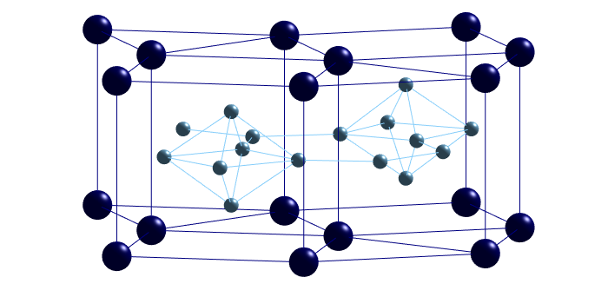
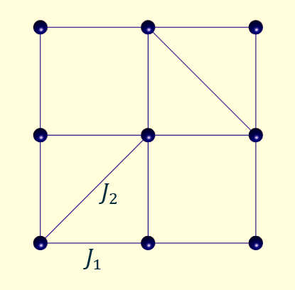
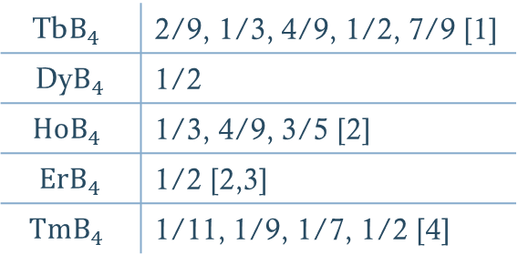
Introduction
Coupled systems
the behaviour of particles in these systems cannot be effectively described in terms of non-interacting entities
correlation effects lead to a collective behaviour of particles
physically very interesting cooperative phenomena
correct theoretical description represents a great challenge
Rare-earth tetraborides
tetragonal crystal symmetry P4/mbm with magnetic ions R³⁺ located on a lattice that is topologically equivalent to the
so-called Shastry-Sutherland lattice
observation of the fascinating sequence of magnetization plateaus with the fractional magnetization and enhanced magnetocaloric effect
$$\text{Tb}B_{4}$$ | 2/9, 1/3, 4/9, 1/2, 7/9 [1]
Dy$B_{4}$ | 1/2
$$HoB_{4}$$ | 1/3, 4/9, 3/5 [2]
$ErB_{4}$ | 1/2 [2,3]
$$TmB_{4}$$ | 1/11, 1/9, 1/7, 1/2 [4]
[1] S. Yoshi et al, Phys. Rev. Lett. 101, 087202 (2008).
[2] S. Mataš et al, J. Phys. Conf. Ser. 200, 032041 (2010).
[3] S. Michimura et al, Physica B 378, 596 (2006).
[4] K. Siemenmeyer et al, Phys. Rev. Lett. 101, 177201 (2008).
Doktorandský seminár ÚEF SAV, 16. jún 2021

Slide 3
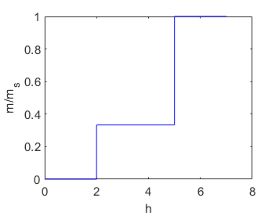
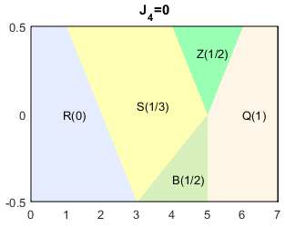
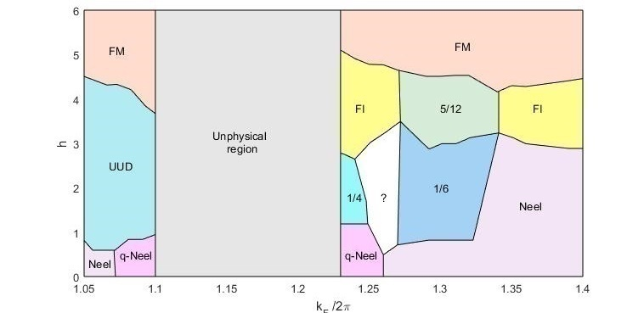
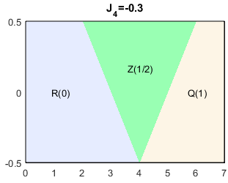
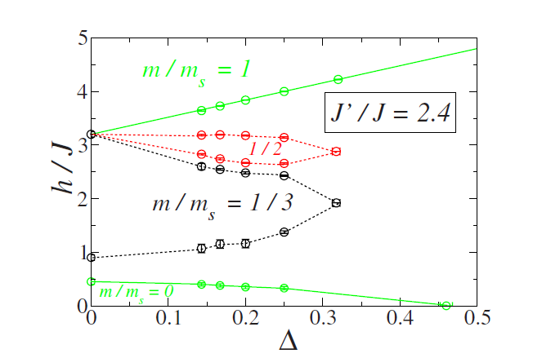
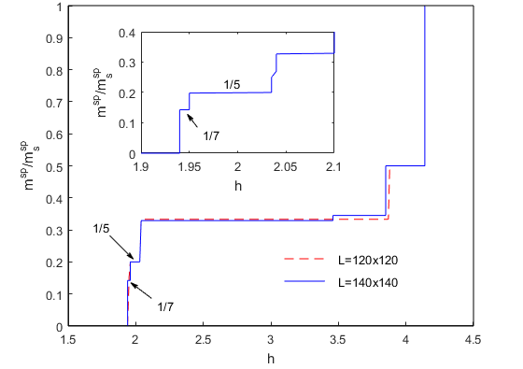
Theoretical models
Spin models
Spin-electron models
Classical Ising model
Extended Ising model with long-range interactions
Generalised Ising model with RKKY interaction
M. C. Chang et al., Phys. Rev. B 79, 104411 (2009).
J. J. Feng et al., EPL 105, 17009 (2014).
Easy axis Heisenberg model
Model based on the interacting electron and spin systems
H. Čenčariková, P. Farkašovský,
Phys. Status Solidi B 252, 333 (2015).
    Z. Y. Meng et al., Phys. Rev. B 78, 224416 (2008).
P. Farkašovský et al. Phys. Rev. B 82, 054409 (2010).
Doktorandský seminár ÚEF SAV, 16. jún 2021

Slide 4
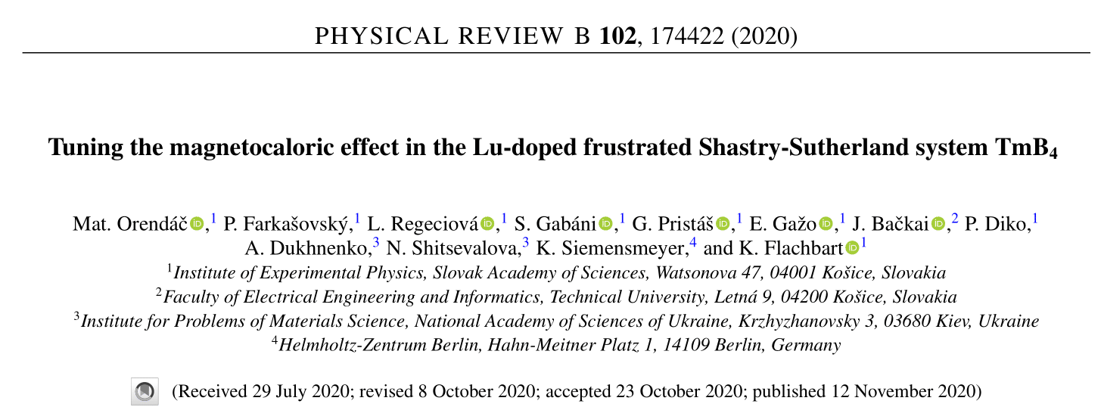
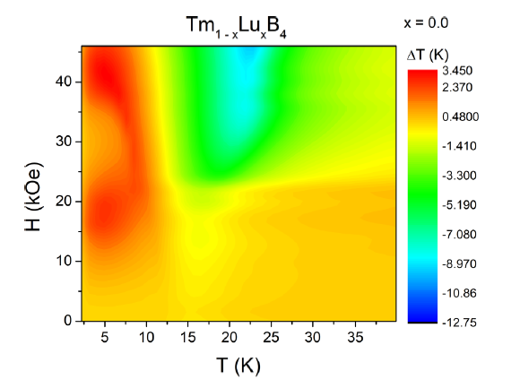
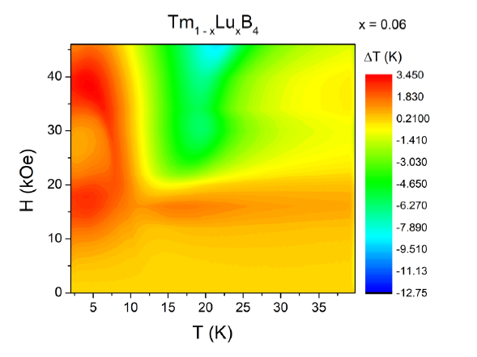
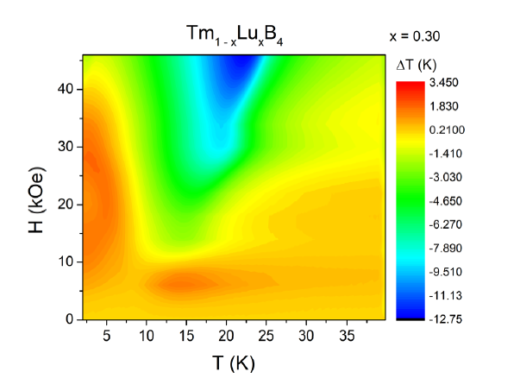
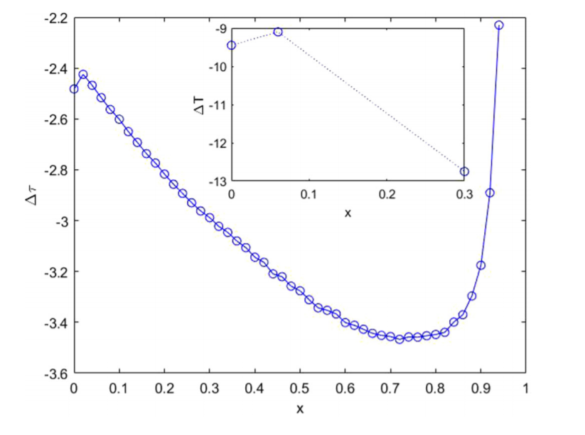
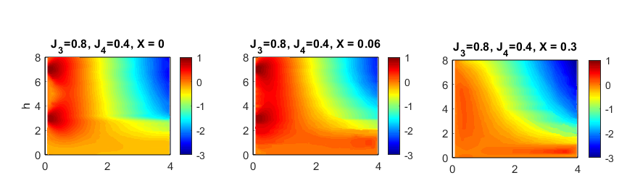
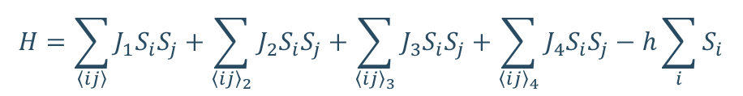
Results
Theoretical description of the MCE in Tm_{1-X}Lu_{X}B₄ systems
extended Ising model with interactions up to the fourth-next-nearest neighbors
$$H=\sum_{\left\langle ij\right\rangle }{J_{1}S_{i}S_{j}}+\sum_{{\left\langle ij\right\rangle }_{2}}{J_{2}S_{i}S_{j}}+\sum_{{\left\langle ij\right\rangle }_{3}}{J_{3}S_{i}S_{j}}+\sum_{{\left\langle ij\right\rangle }_{4}}{J_{4}S_{i}S_{j}}−h\sum_{i}{S_{i}}$$
Doktorandský seminár ÚEF SAV, 16. jún 2021

Slide 5
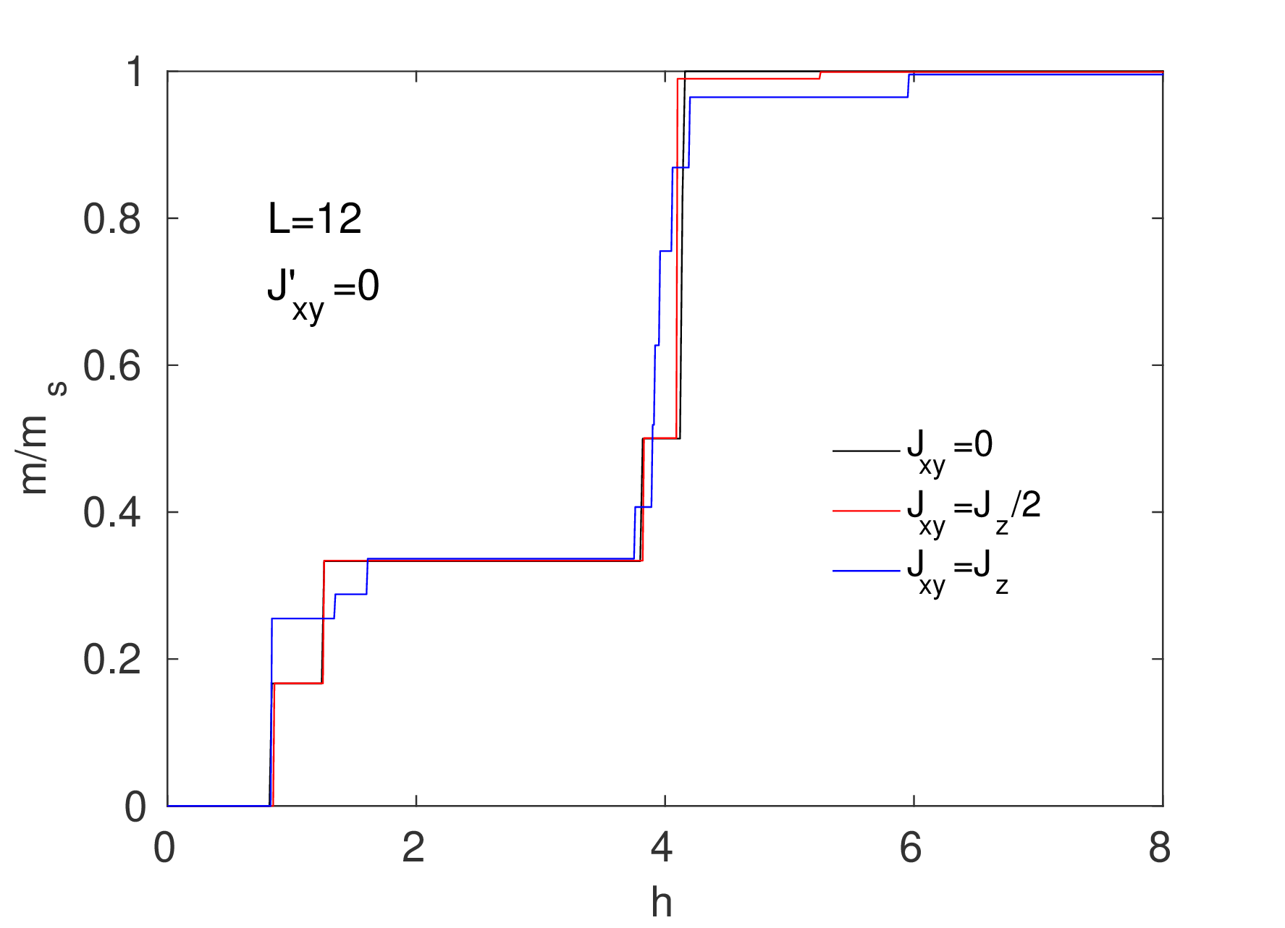
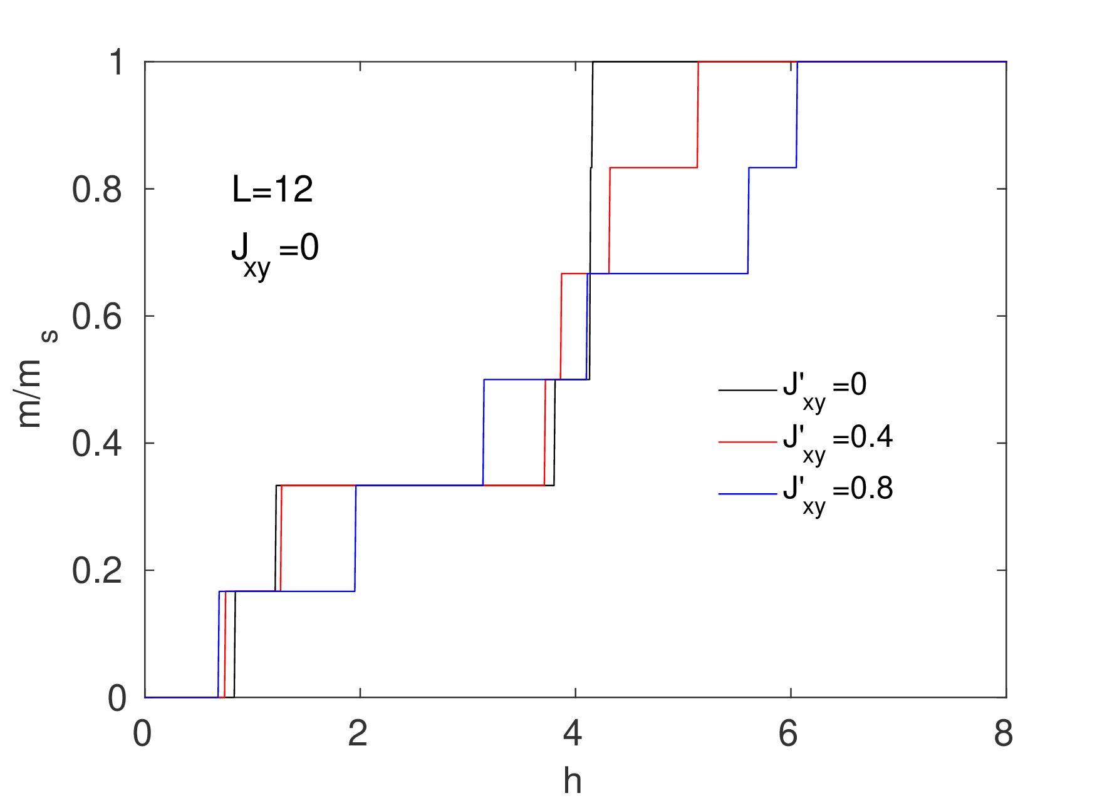
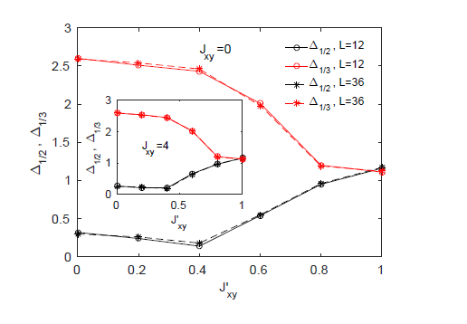
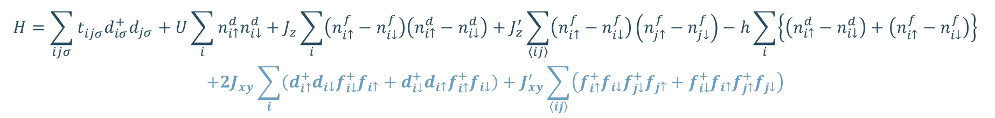
Results
The influence of double-exchange and Heisenberg interaction
$$H=\sum_{ijσ}{t_{ijσ}^{ }d_{iσ}^{+}d_{jσ}}+U\sum_{i}{n_{i↑}^{d}n_{i↓}^{d}}+J_{z}\sum_{i}{\left(n_{i↑}^{f}−n_{i↓}^{f}\right)\left(n_{i↑}^{d}−n_{i↓}^{d}\right)}+J_{z}^{′}\sum_{〈ij〉}{\left(n_{i↑}^{f}−n_{i↓}^{f}\right)\left(n_{j↑}^{f}−n_{j↓}^{f}\right)}−h\sum_{i}{\left\{\left(n_{i↑}^{d}−n_{i↓}^{d}\right)+\left(n_{i↑}^{f}−n_{i↓}^{f}\right)\right\}} \\ +2J_{xy}\sum_{i}{\left(d_{i↑}^{+}d_{i↓}f_{i↓}^{+}f_{i↑}+d_{i↓}^{+}d_{i↑}f_{i↑}^{+}f_{i↓}\right)}+J_{xy}^{′}\sum_{〈ij〉}{\left(f_{i↑}^{+}f_{i↓}f_{j↓}^{+}f_{j↑}+f_{i↓}^{+}f_{i↑}f_{j↑}^{+}f_{j↓}\right)}$$
Doktorandský seminár ÚEF SAV, 16. jún 2021

Slide 6
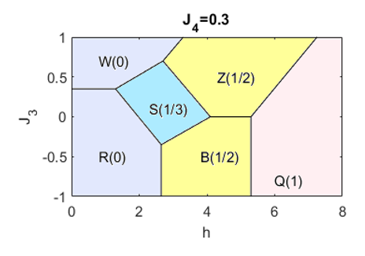
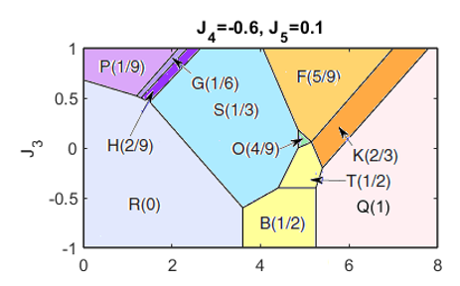
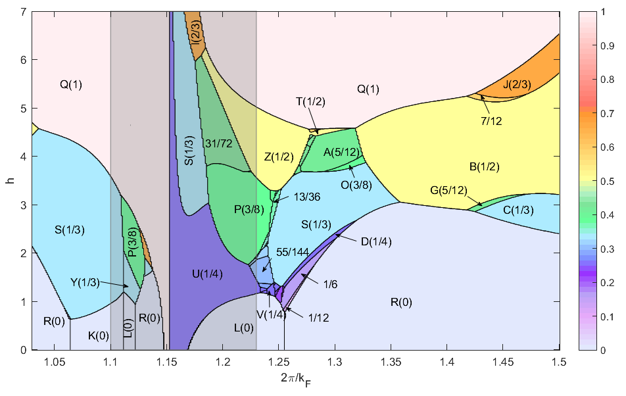
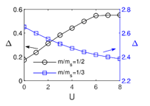
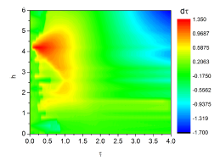
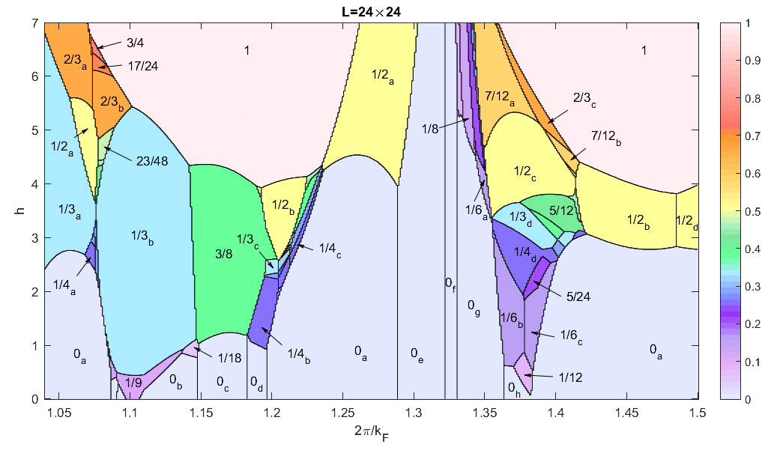
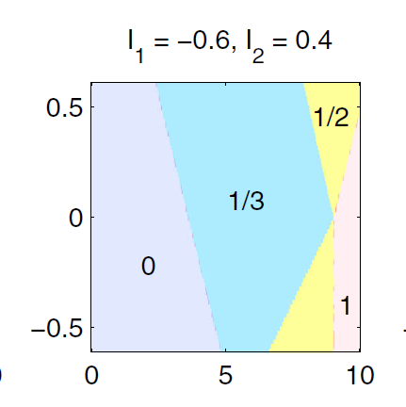
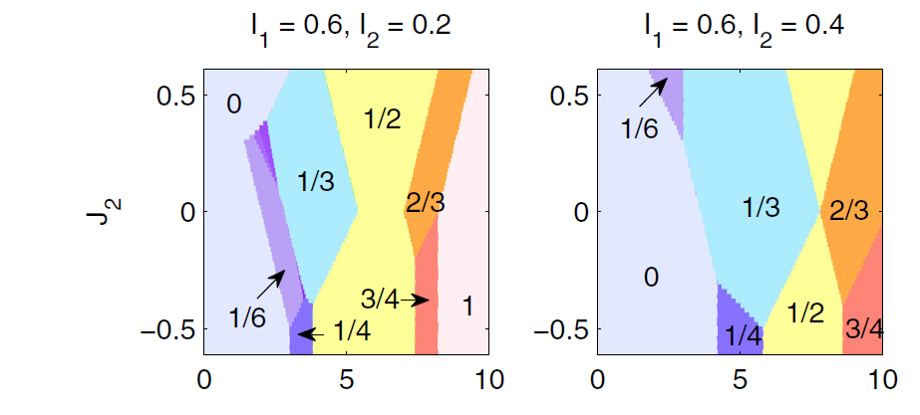
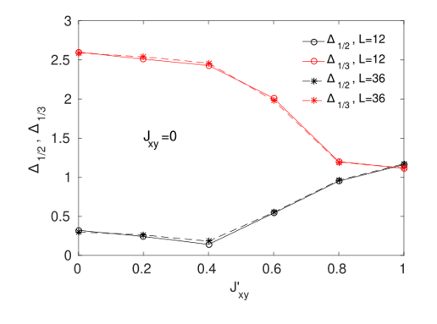

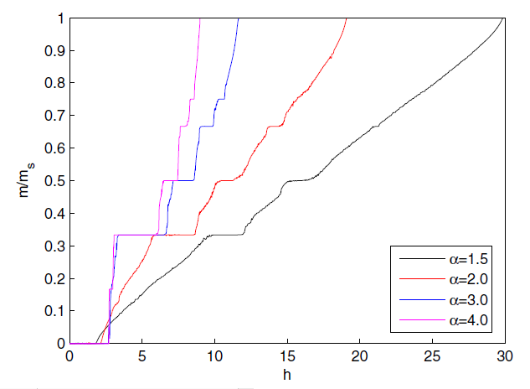
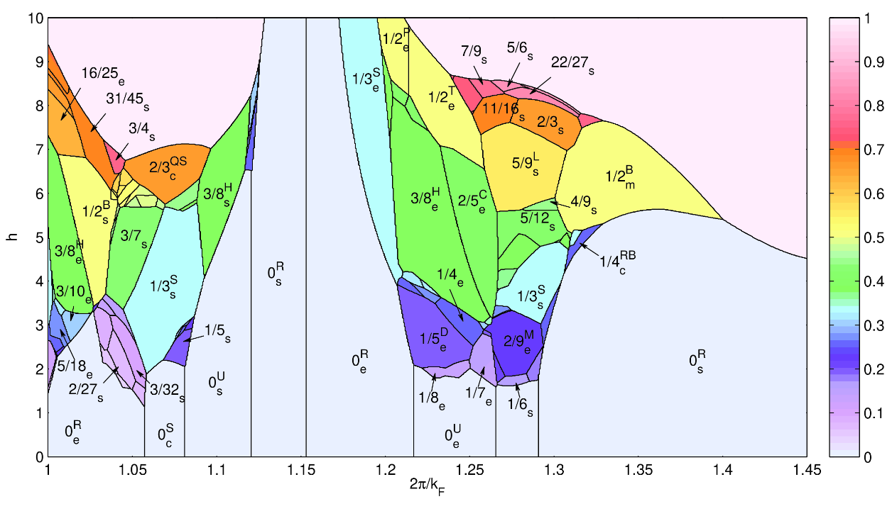
Conclusions
2D models
Spin models
Spin-electron models
Applications
Ising model with long-range interaction (up to 5th NN)
Ising model with RKKY and 3D Fermi surface on SSL
Spin-electron model with
the electron interaction
Description of rotating MCE in TmB₄
Ising model with RKKY and 2D Fermi surface on SSL
Influence of Interplane Interactions
3D models
Influence of double-exchange
and Heisenberg interaction
Theoretical description of the MCE in Tm_{1-X}Lu_{X}B₄ systems
3D Ising model with RKKY
Doktorandský seminár ÚEF SAV, 16. jún 2021

Slide 7
Publications
P. Farkašovský and L. Regeciová, Magnetization plateaus and phase diagrams of the extended Ising model on the Shastry-Sutherland lattice: effects of long-range interactions, European Physical Journal B 92, 33 (2019).
L. Regeciová and P. Farkašovský, Magnetic phase diagram of the Ising model with the long-range RKKY interaction, European Physical Journal B 92, 184 (2019).
P. Farkašovský and L. Regeciová, Influence of Interplane Interactions on Formation of Magnetization Plateaus in Generalized 3D Ising Models with Magnetically Coupled Shastry-Sutherland Layers, Journal of Superconductivity and Novel Magnetism 33, 2219 (2020).
L. Regeciová and P. Farkašovský, Formation of magnetization plateaus in the 3D Ising model with the long-range RKKY interaction: application to rare-earth tetraborides, European Physical Journal B 93, 110 (2020).
P. Farkašovský and L. Regeciová, Formation of Magnetization Plateaus in Rare Earth Tetraborides: Exact Diagonalization and Quantum Monte Carlo Studies, Journal of Superconductivity and Novel Magnetism 33, 3463 (2020).
L. Regeciová and P. Farkašovský, Influence of the Long-Range RKKY Interaction on a Formation of Magnetization Plateaus in the Generalised Ising Model on the Shastry-Sutherland Lattice, Acta Physica Polonica A 137, 625 (2020).
M. Orendáč, P. Farkašovský, L. Regeciová, K. Flachbart, S. Gabáni, E. Gažo, G. Pristáš, A. Dukhnenko, N. Shitsevalova and
K. Siemensmeyer, Microscopic Description of Rotating Magnetocaloric Effect in Frustrated Antiferromagnetic System TmB₄, Acta Physica Polonica A 137, 764 (2020).
M. Orendáč, P. Farkašovský, L. Regeciová, S. Gabáni, G. Pristáš, E. Gažo, J. Bačkai, P.Diko, A. Dukhnenko, N. Shitsevalova,
K. Siemensmeyer and K. Flachbart, Tuning the magnetocaloric effect in the Lu-doped frustrated Shastry-Sutherland system TmB4, Physical Review B 102, 17442 (2020).
L. Regeciová and P. Farkašovský, The influence of double-exchange and Heisenberg interaction on the magnetization processes in rare-earth tetraborides, Journal of Magnetism and Magnetic Materials - zaslané
Doktorandský seminár ÚEF SAV, 16. jún 2021

Slide 8
Thank you for your attention.

