Slide 1
Title of the dissertation thesis: Superfluid 3He-B as a model system for Q-bits
Study program: Physics of condensed matter
PhD Supervisor: Skyba P.
Podopryhora O. 16.06.2021

Slide 2
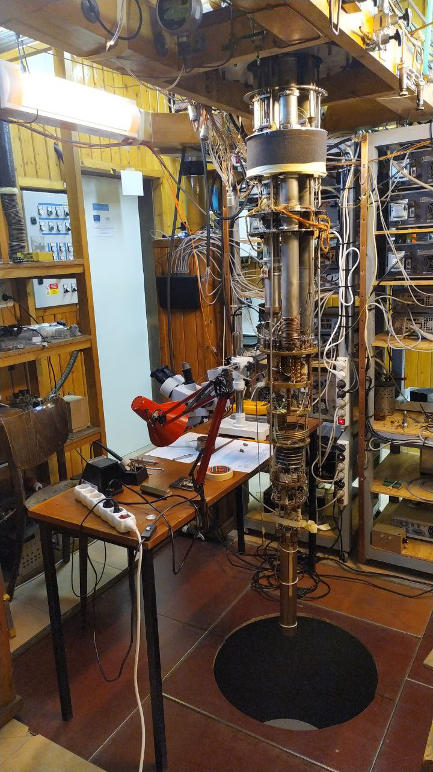
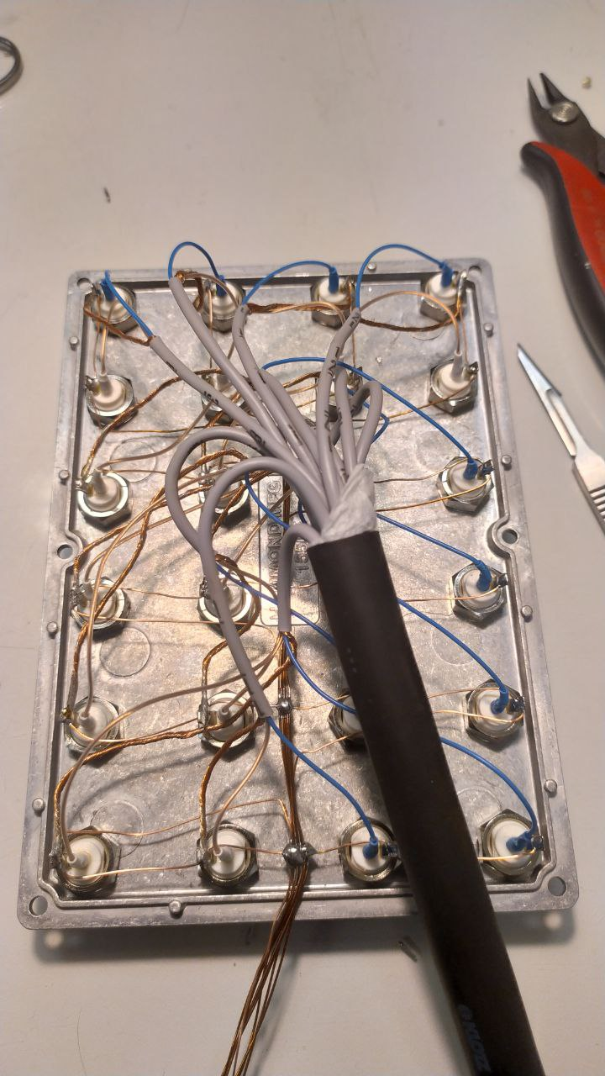
Work done
Attended lectures that were completely new to me: (Theory of Condensed Matter, Slovak Language, Low Temperature Physics, Macroskopic quantum system, Experimental methods of low temperature physics, Quantum field theory — applications in the physics of condensed matters)
Thermometry upgrade
Designing thermometers
Replacing old wiring with new one
To learn how the apparatus works

Slide 3
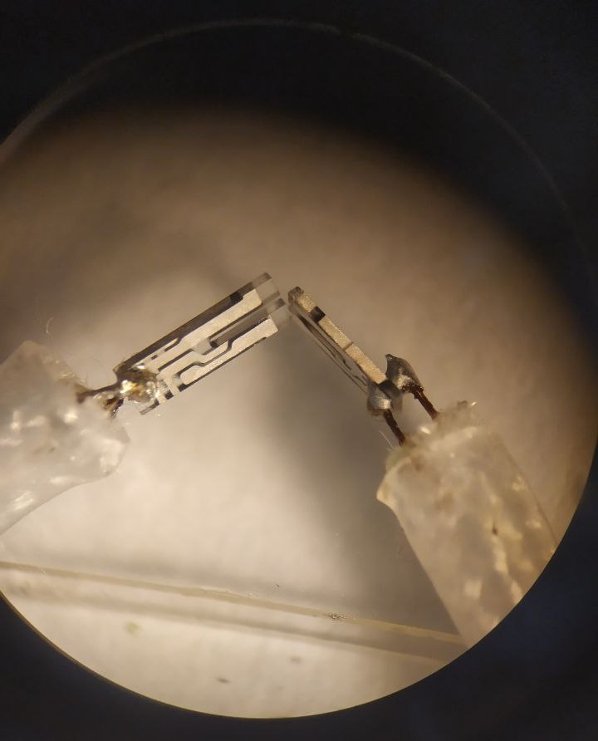
Work in progress
Studying the art of low and ultra-low temperature techniques
(June-July) Taking exams to close subjects (English Language, Experimental methods of low temperature physics, Quantum field
theory — applications in the physics of condensed matters)
Working with tuning forks and vibrating wires, and we plan their
use in He3 in the Q-bit experimental cell
Running my first experiment with superfluid 3He — learning and collecting own experience

Slide 4
Future plans
Design and construction of a experimental cell for Q-bit in superfluid 3He
Conducting the first experiments on the Q-bit in a new cell
Studying the phenomenon of homogeneously precessing domain (HPD) and other related physical phenomena in superfluid 3He

Slide 5
Thank you for your attention.

