Slide 1
Characterization and structural studies of nanomaterials
Mgr. Maksym Karpets, 2-nd year
Department of Magnetism, IEP SAS
Physical Engineering of Advanced Materials, FEI TUKE
Title of thesis: Impact of magnetic and electric field on structure of magnetic fluids
Vedúci dizertačnej práce
Supervisor: RNDr. Milan Timko, CSc.
Consultants: RNDr. Michal Rajňák, PhD. , doc. RNDr. Peter Kopčanský CSc., Dr. Viktor Petrenko
PhD student’s webinar
16.06.2021

Slide 2
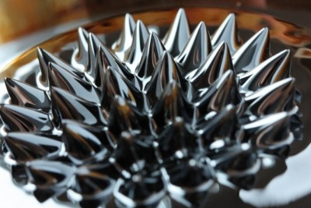
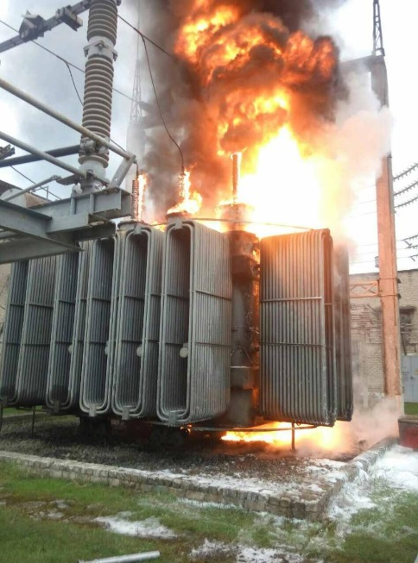
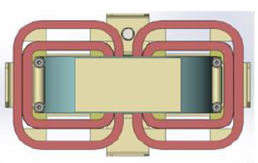
Magnetic fluids: motivation
Applications: technical and biomedical.
Examples of technical and research applications: seals, bearings, dampers, loudspeakers, stepper motors, sensors, switches.
Application potential:
ELECTRIC POWER ENGINEERING
Magnetic fluid (MF) - stable colloidal suspension: magnetic particles (5%), stabilizing component (10%), carrier liquid (85%).
cooling medium
(increased thermal conductivity, thermomagnetic convection)
electrical insulating
medium
Fire on the transformer
surfactant
structural changes of the magnetic fluid in the whole volume, as well as at the interface with the solid body under the influence of various magnetic and electric fields
magnetic
nanoparticle
Stabilizing component - surfactant: molecules with polar and non-polar part (oleic acid)
Schematic of a model transformer used to test the cooling efficiency of magnetic ferrofluid
aim

Slide 3
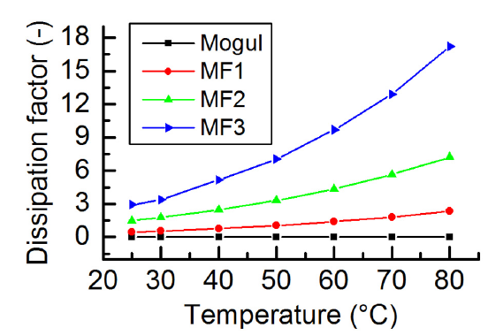
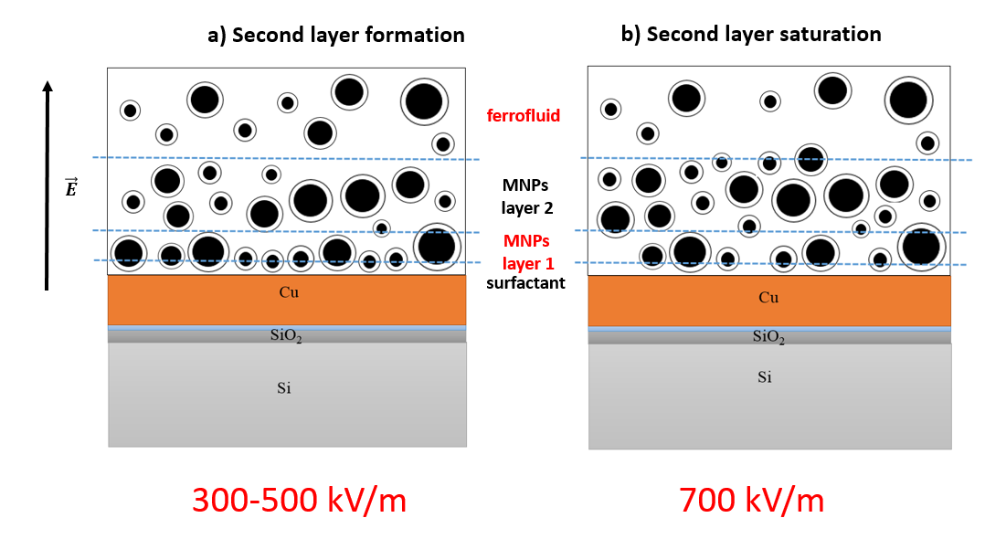
The main steps of investigation
2Fe³⁺+ Fe²⁺+ 8OH⁻ → Fe₃O₄+ 4H₂O
1. Preparation of MF samples
2. Characterization of MF samples
5. Models
4. Fitting of data
3. Scattering experiment

Slide 4
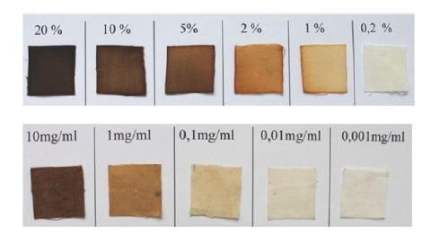
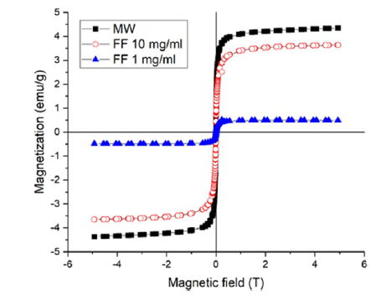
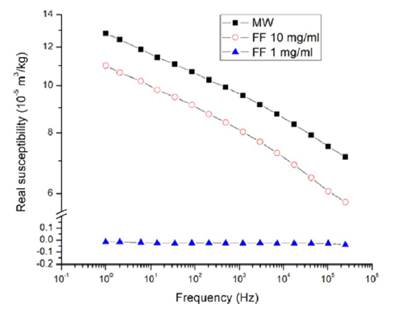
Magnetic characterization of the textiles modified with magnetic nanoparticles
Appearance of cotton textile squares modified with microwave-synthesized magnetic iron oxide particles and perchloric-acid-stabilized ferrofluid in methanol.
Magnetization curves measured at room temperature (298 K).
Real part of AC magnetic susceptibility dependent on the frequency of the external magnetic field.
For each curve, zero hystereses are found, revealing the superparamagnetic nature of the magnetic nanoparticles.
At higher frequencies, the moments of greater nanoparticles are not able to follow the field changes as the Néel relaxation time is exponentially dependent on the magnetic anisotropy energy and therefore on the nanoparticle volume as well.
Safarik, I.; Prochazkova, J.; Schroer, M. A.; Garamus, V. M.; Kopcansky, P.; Timko, M.; Rajnak, M.; Karpets, M.; Ivankov, O. I.; Avdeev, M. V.; Petrenko, V. I.; Bulavin, L.; Pospiskova, K. Cotton Textile/Iron Oxide Nanozyme Composites with Peroxidase-like Activity: Preparation, Characterization, and Application. ACS Appl. Mater. Interfaces 2021, 13 (20), 23627–23637. https://doi.org/10.1021/acsami.1c02154.

Slide 5
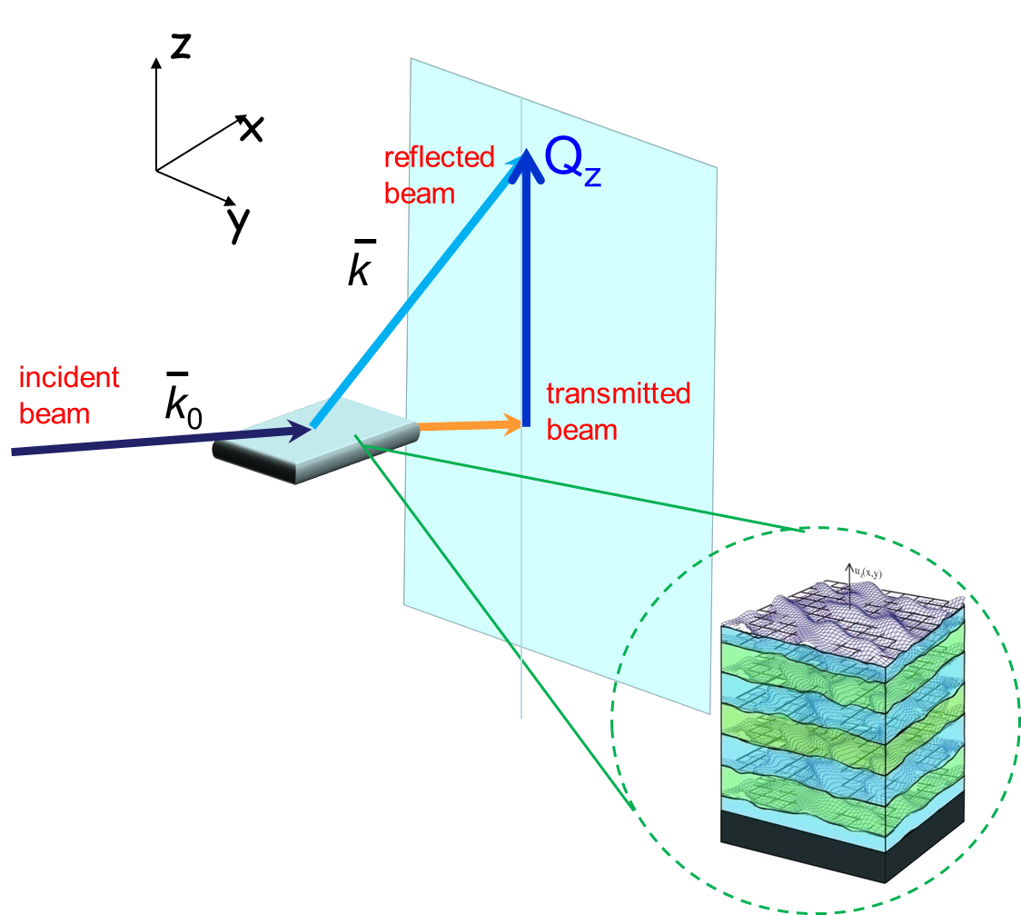
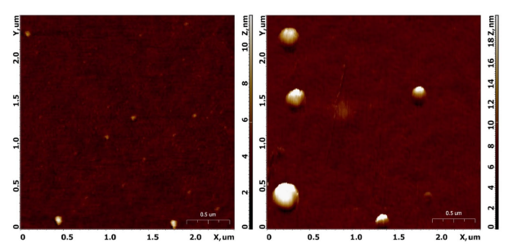
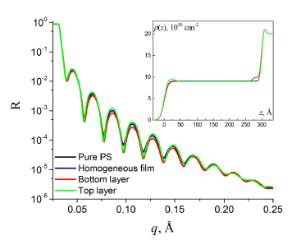
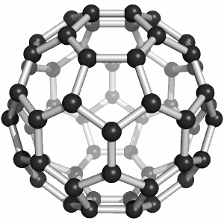
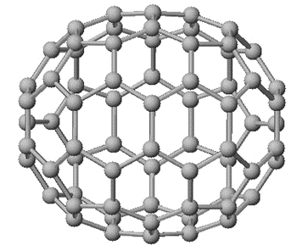
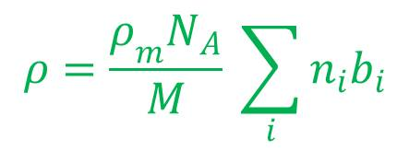
Neutron and X-ray reflectometry of thin films
of polymer nanocomposites
AFM images of polystyrene-fullerene C60 (left) and C70 (right) thin film .
$$R\left(\vec{Q}\right)=\frac{I_{ref}}{I_{0}}$$
$$\vec{Q}=\vec{k}−{\vec{k}}_{0}$$
Comparison of reflectivity curves for different models considered and the corresponding SLD profiles (inset) of a model PS-fullerene thin film.
Scattering length density (SLD):
for neutrons
Fullerene C₆₀
Fullerene C₇₀
Reflectometry is a powerful method for examining the nanometric structure of the surface and interfaces of various materials.
Tropin, T. V.; Karpets, M. L.; Kosiachkin, Y.; Gapon, I. V.; Gorshkova, Y. E.; Aksenov, V. L. Evaluation of Fullerenes C ₆₀ /C ₇₀ Layers in Polystyrene Thin Films by Neutron and X-Ray Reflectometry. Fullerenes, Nanotubes and Carbon Nanostructures 2021, 1–6. https://doi.org/10.1080/1536383X.2021.1901276.

Slide 6
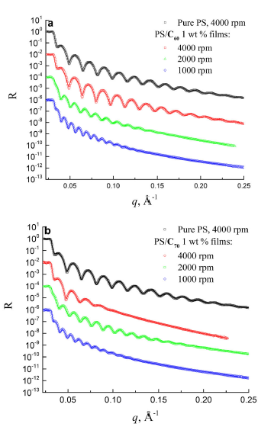
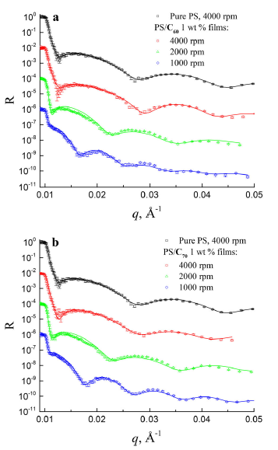
Neutron and X-ray reflectometry of thin films
of polymer nanocomposites
Fit results for the experimental data for 1 wt % PS-fullerene thin films: H – film thickness (error <1 nm), h –layer thickness, σ – layer roughness.
The formation of a nanoparticles-enriched layer at the substrate surface is observed for both
C60 and C70 macromolecules (0.7-5 nm).
X-ray (left) and neutron (right) reflectometry measurements of thin films of the 1 wt % polystyrene-fullerene nanocomposites prepared at different spinning rates (a – C60, b – C70).
Tropin, T. V.; Karpets, M. L.; Kosiachkin, Y.; Gapon, I. V.; Gorshkova, Y. E.; Aksenov, V. L. Evaluation of Fullerenes C ₆₀ /C ₇₀ Layers in Polystyrene Thin Films by Neutron and X-Ray Reflectometry. Fullerenes, Nanotubes and Carbon Nanostructures 2021, 1–6. https://doi.org/10.1080/1536383X.2021.1901276.

Slide 7
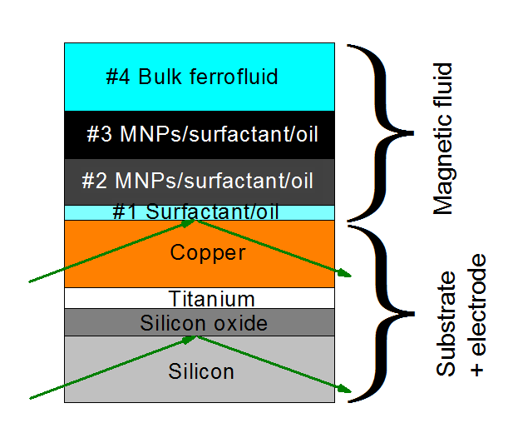
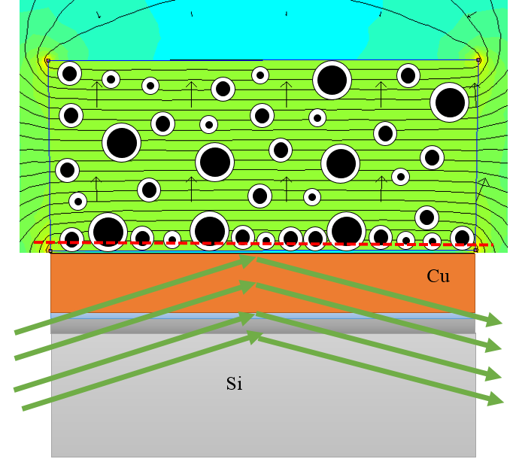
Simulation of neutron reflectivity (NR) experiment for magnetic fluid in electric field
Color scale of the simulated electric flux density
Sketch of the stack assumed for the fits of the neutron reflectivity data.

Slide 8
Neutron reflectivity results for magnetic fluid in electric field
SLD for 0 kV/m
SLD with electric field
NR data taken when applying electric field from 0 kV/m to 700 kV/m
At the electrode surface in the absence of electric field we observed only wetting MNPs layer (about 16.3 nm thick) which was doubled and more concentrated when applying electric field. From electric field intensity of 500 kV/m an additional MNPs layer was detected by comparing the measured SLDs of MF components.

Slide 9
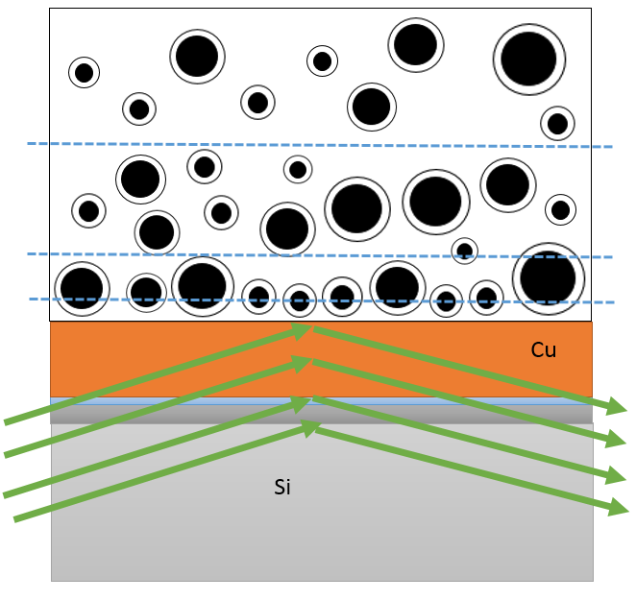
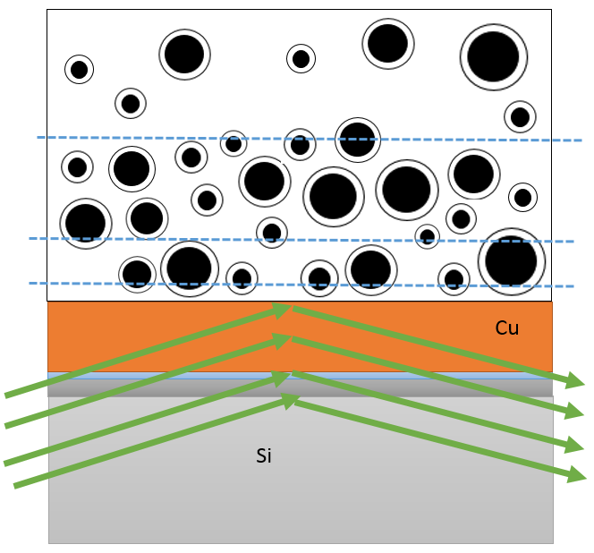
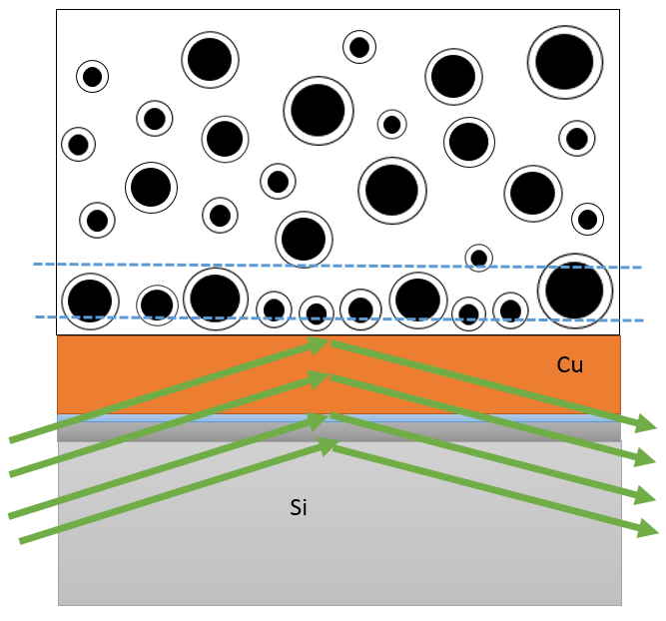
Models of nanoparticles layering in magnetic fluids under electric field
(a)
Wetting layer
(b)
Second layer formation
(c)
Second layer saturation
ferrofluids
MNPs
layer 2
MNPs
layer 1
surf.
0-100 kV/m
300-500 kV/m
700 kV/m
Schematic drawing of NP-ordering determined from the results of NR. (a) Wetting layer in an electric field of 0-100 kV/m, (b) double layer on top of the wetting layer in EF of 300-500 kV/m, and (c) more dense double layer on top of the wetting layer in EF of 700 kV/m.

Slide 10
Relaxation experiment for magnetic fluid in electric field
NR data taken after 3, 6 and 9 hours of switching off
Profiles of SLD taken after 3, 6 and 9 hours of switching off.
Residual electric field influences NP assembling even some time after switching the field off!

Slide 11
Publications in 2021
Karpets, M.; Rajnak, M.; Petrenko, V. I.; Gapon I.; Avdeev, M. V.; Bulavin, L.; Timko, M.; Kopcansky, P. Electric field-induced assembly of magnetic nanoparticles from dielectric ferrofluids on planar interface. . ACS Appl. Mater. Interfaces 2021 – in peer review
Safarik, I.; Prochazkova, J.; Schroer, M. A.; Garamus, V. M.; Kopcansky, P.; Timko, M.; Rajnak, M.; Karpets, M.; Ivankov, O. I.; Avdeev, M. V.; Petrenko, V. I.; Bulavin, L.; Pospiskova, K. Cotton Textile/Iron Oxide Nanozyme Composites with Peroxidase-like Activity: Preparation, Characterization, and Application. ACS Appl. Mater. Interfaces 2021, 13 (20), 23627–23637. https://doi.org/10.1021/acsami.1c02154.
Tropin, T. V.; Karpets, M. L.; Kosiachkin, Y.; Gapon, I. V.; Gorshkova, Y. E.; Aksenov, V. L. Evaluation of Fullerenes C ₆₀ /C ₇₀ Layers in Polystyrene Thin Films by Neutron and X-Ray Reflectometry. Fullerenes, Nanotubes and Carbon Nanostructures 2021, 1–6. https://doi.org/10.1080/1536383X.2021.1901276.
Karpets, M.; Timko, M. Characterization and SANS study of transformer oil-based magnetic fluids . SCYR 2021, Nonconference Proceedings of Young Researchers, TUKE, Košice, 2021, ISBN: 978-80-553-3904-7, pp.125-126. – prize of the Association of Slovak Scientific and Technological Societies (SES)

Slide 12
PhD studies 2020/2021
Defense of written work on the dissertation exam: 09.03.21.
Completed study subjects :
Research activities 2
Subject specialization
Teaching activities:
6 hours per week at the Department of Physics (FEI TUKE)
Participation in projects:
APP0140 - Impact of magnetic and electric field on structure of magnetic fluids (SAS grants for PhD students)
APVV 18-0160 - Nanofluids in electrical engineering
VEGA 2/0011/20 - Structure and dynamics of magnetic fluids in an electric field
VEGA 2/0016/17 - Macroscopic anisotropic composites based on liquid crystals and magnetic nanoparticles
Another courses completed:
Advanced English – Conversation (TUKE)
Trainings of good scientific practice (SAS)

Slide 13
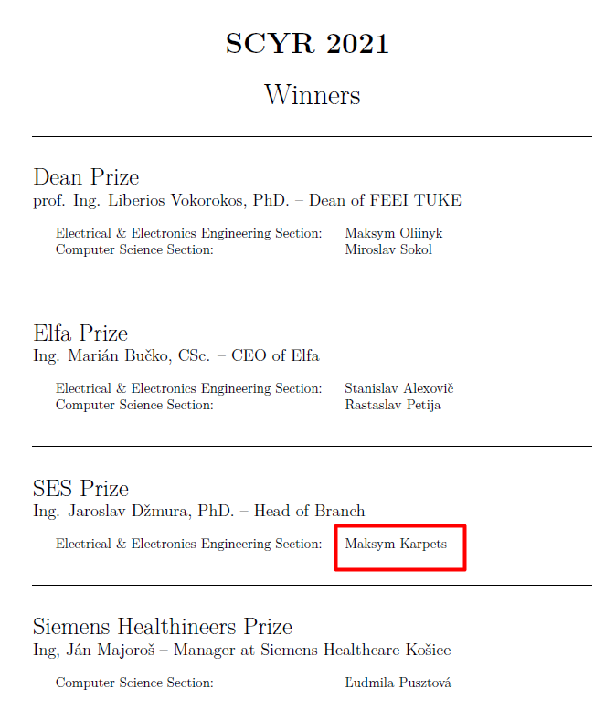
Presentation of results 2020/2021 (online)
Conferences:
21-th Scientific Conference of Young Researchers SCYR-2021 (Kosice, Slovakia, April 9, 2021) – oral presentation + article in nonconference proceedings - prize of the Association of Slovak Scientific and Technological Societies (SES)
The International Conference “Condensed Matter Research at the IBR-2” CMR@IBR2-2020 (Dubna, Russia, October 12-16, 2020) – poster
725. WE-Heraeus-Seminar “Magnetic Small Angle Neutron Scattering – from Nanoscale Magnetism to Long‐Range Magnetic Structures” (Germany, 31 May - 03 June 2021) - poster
Schools:
School HERCULES 2021 “Higher European Research Course For Users Of Large Experimental Systems” (Grenoble, France, 22 February - 26 March, 2021) – poster
4-th International Summer School and Workshop "Complex and Magnetic Soft Matter Systems: Physico-Mechanical Properties and Structure“ (Timisoara, Romania, April 19 - 23 2021) - oral presentation

Slide 14
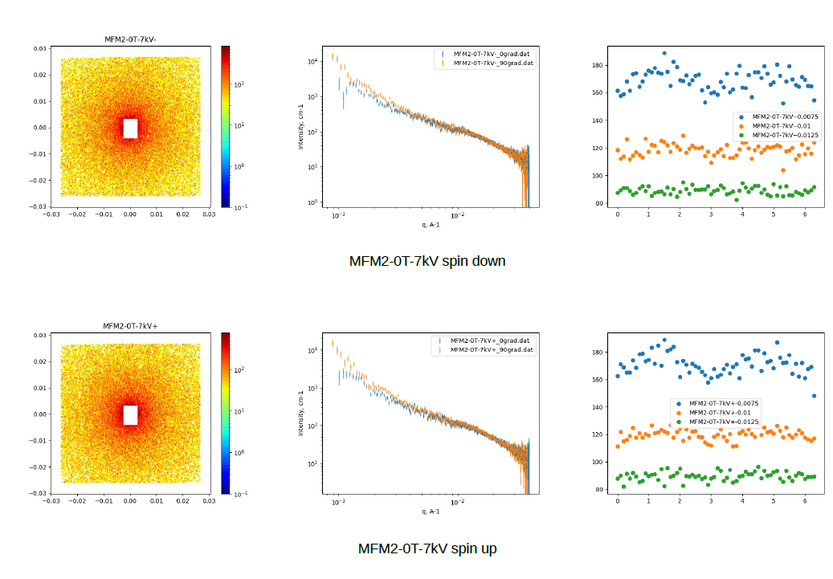
Next steps
Treatment of SANSPOL data of anisotropy on 2D scattering map in magnetic fluid in both electric and magnetic field
New X-ray and neutron scattering experiments of magnetic fluid and magnetoferritin in different conditions based on the current accepted proposals:
“SAXS on a magnetic fluid in an external electric field” - European Molecular Biology Laboratory – BioSAXS (P12), Hamburg (Germany)
“Flow effect on structure of transformer oil-based ferrofluids (TOFF) under electric field by neutron reflectometry” – JINR (GRAINS), Dubna (Russia)
“Identifying the composition of magnetoferritin during Verwey transition” – HRFD (GRAINS), Dubna (Russia)
“Temperature effect on structure of transformer oil-based ferrofluids (TOFF) under magnetic field by neutron reflectometry” – JINR (GRAINS), Dubna (Russia) – in resubmission

Slide 15
Acknowledgment
RNDr. Milan Timko, CSc.
RNDr. Michal Rajňák, PhD.
doc. RNDr. Peter Kopčanský, CSc.
Dr. Victor Petrenko
Staff of Department of Magnetism (IEP SAS)
Staff of Department of Physics (FEI TUKE)
Thanks for paying attention

