Slide 1
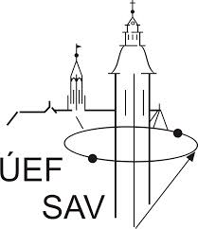
PhD Seminar
Evaluation of
anti-amyloid and anti-oxidative activity
of naked and surface-modified
CeO₂ nanoparticles
Supervisor: K. Šipošová, PhD.
Consultant: A. Musatov, DrSc.
Biophysics, 4-1-12

Slide 2
Activities during the academic year 2020/2021
Research Activities:
i) Study of Bioactivity of CeO₂-nanoparticles (CeO₂-NPs)
evaulation of: a) pseudo-enzymatic activity - „catalase-" and "superoxide dismutase-like"
activity of CeO₂-NPs;
b) effect of CeO₂-NPs on insulin amyloid aggregation
ii) Preparation of surface-modified CeO₂-NPs
iii) Examination of the detergent´s effect on amyloid aggregation
Others:
Completed of all exams (study part of PhD)
Preparation for dissertation exam and for defense of rigorous thesis
Participation at the conference
Participation in preparation of publications
PhD seminar, 16th June 2021

Slide 3
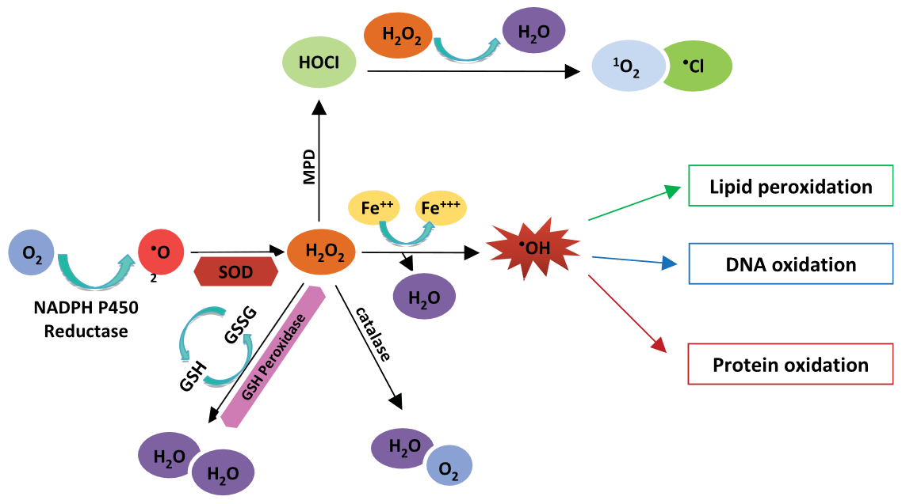
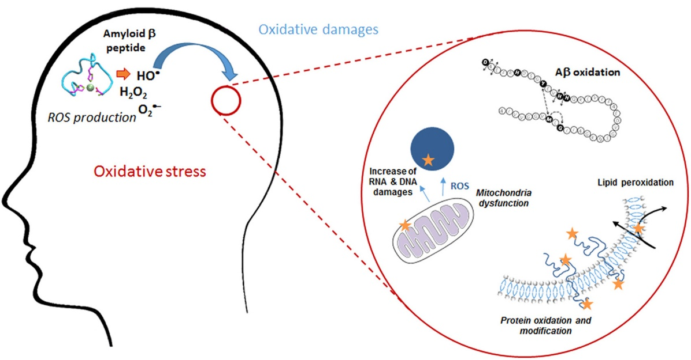
Interplay between oxidative stress, aging and neurodegenerative diseases
Loss of protein homeostasis is a common feature of aging and diseases that are characterized by the appearance of nonnative protein aggregates in various tissues (Lévy, 2019)
One of the currently accepted theories is that oxidative stress is associated with aging processes and age-related neurodegenerative disorders, which are characterized by amyloid aggregation of proteins (Lévy, 2019; Butterfield, 1997)
several pathways linking
oxidative stress
neurodegenerative diseases
!!! the exact mechanism is unknown
PhD seminar, 16th June 2021

Slide 4

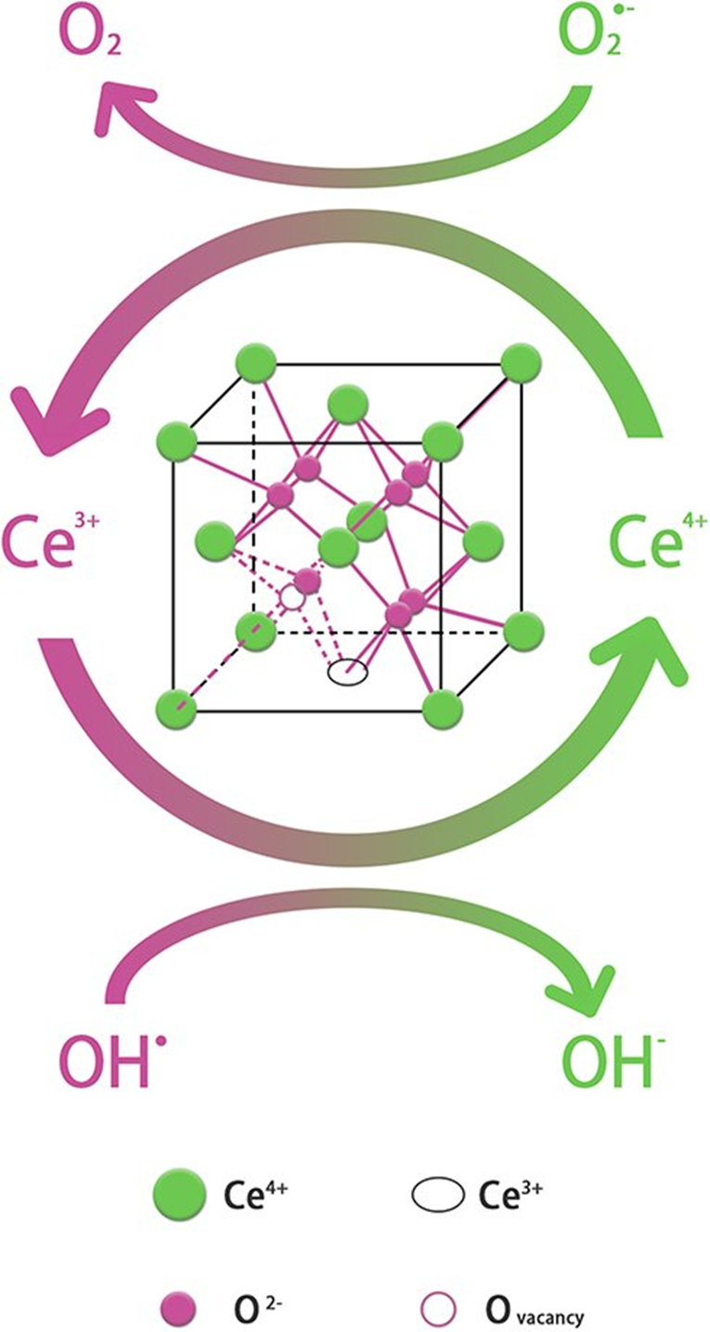
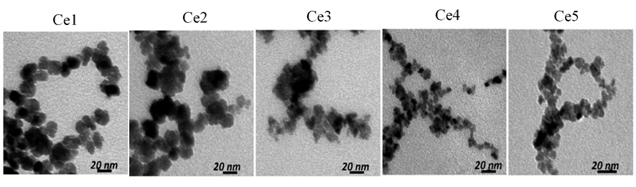
CeO₂ Nanoparticles for biomedical applications
shielded 4f-electrons and low redox potential of the Ce^{4+/}Ce³⁺ redox couple (~1.52 V)
attractive optical, magnetic, and chemical properties
In collaboration with team of prof. Belous (Institute of Inorganic Chemistry NAS, Ukraine)
a new CeO₂-NPs were prepared by controlled synthesis:
i) precipitation aqueous-alcoholic solutions: dd-H₂O+Isopropanol (IPA) in precisely determined ratios
particles Ce1 – Ce5
ii) precipitation in a reverse microemulsion in the presence of Triton X-100 (CeO₂)
CeO₂ NPs | d_{TEM} [nm] | w Ce³⁺ [%] | ζ-potential [mV]
 |  |  | H₂O | 100 mM NaCl, pH 1.6 | + Insulin pH 1.6
Ce1 | 13,4±2,3 | 23 | +40,9 | +33,4 | +24,9
Ce2 | 8,0±0,8 | 30 | +41,5 | +35,3 | +28,9
Ce3 | 5,6±0,6 | 35 | +41,6 | +37,8 | +25,3
Ce4 | 3,5±0,4 | 38 | +42 | +36,9 | +29,5
Ce5 | 2,8±0,4 | 44 | +42,9 | +35,7 | +28,1
CeO₂ | 5-6±1 | 28 | +46,9 | +36 | +26
X-ray diffraction (XRD) crystallographic analysis confirmed formation of fluorite Fm3m structure
XPS analysis allow to estimate the percentage of Ce³⁺ ions on the surface of CeO₂-NPs
correlation between size and Ce³⁺/Ce⁴⁺ on the surface demonstrated
PhD seminar, 16th June 2021
SHLAPA Y.; TIMASHKOV I.; VELTRUSKÁ K.; ŠIPOŠOVÁ K.; GARČÁROVÁ I.; MUSATOV A.; SOLOPAN S.; KUBOVČÍKOVÁ M.; BELOUS A. Nanotechnology, 32, 31, 315706. 2021.

Slide 5
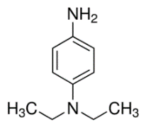
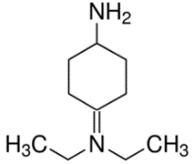

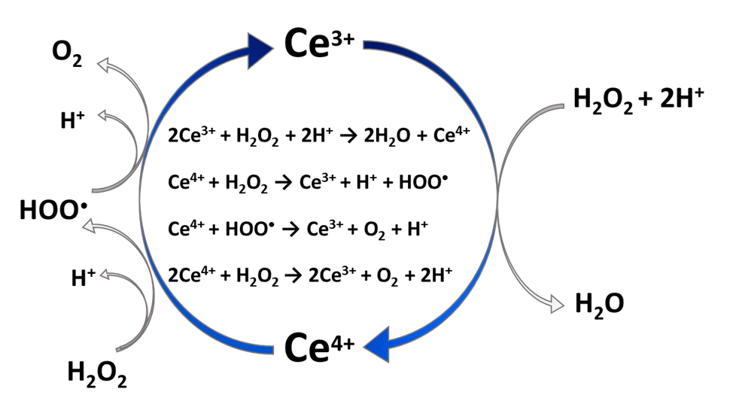
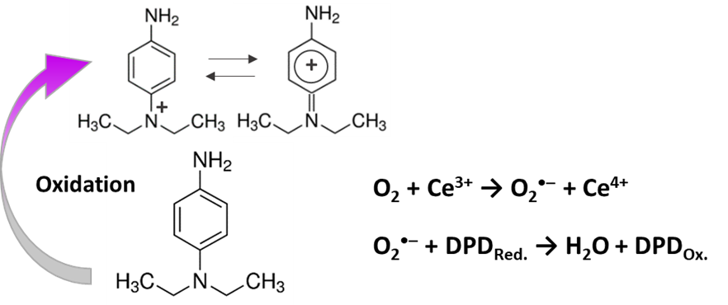
Bioactivity of CeO₂-NPs Pseudo-enzymatic activity
Catalase-like Activity
Catalytic activity of CeO₂ NPs led to oxidation of N,N, Diethyl-p-phenylenediamine sulfate salt (DPD)
+
+
catalase-like activity
Oxidation
“true” catalase-like activity obtained by subtraction of kinetic curves without H₂O₂ from the kinetic curves with H₂O₂
Catalese like reaction
Oxidase like reaction
PhD seminar, 16th June 2021
SHLAPA Y.; TIMASHKOV I.; VELTRUSKÁ K.; ŠIPOŠOVÁ K.; GARČÁROVÁ I.; MUSATOV A.; SOLOPAN S.; KUBOVČÍKOVÁ M.; BELOUS A. Nanotechnology, 32, 31, 315706. 2021.

Slide 6
Bioactivity of CeO₂-NPs Pseudo-enzymatic activity
Superoxid Dismutase Activity
monitored using commercial SOD kit at two concentration of Ce1-Ce5: 50 and 75 µg/ml
SOD activity of CeO₂ NPs
 | 50 µg/mL |  | 75 µg/mL
 | % | U/mL | % | U/mL
Ce1 | 15.4±3.4 | 0.69±0.023 | 12.5±8.4 | 0.56±0.047
Ce2 | 18±4.9 | 0.81±0.04 | 13.7±8.1 | 0.61±0.05
Ce3 | 14.4±3.5 | 0.64±0.022 | 13.9±4.5 | 0.62±0.028
Ce4 | 18.4±4.3 | 0.83±0.03 | 25±3.6 | 1.18±0.05
Ce5 | 30.3±2.2 | 1.5±0.033 | 33±3.1 | 1.67±0.052
SOD activity depends on size ⇒ the highest SOD-activity exhibited by the smallest, Ce5 nanoparticles (~ 2.8 nm)
SOD-activity is related to the content of Ce³⁺ ions – directly involved in reduction of O₂⁻ anion to H₂O₂
PhD seminar, 16th June 2021

Slide 7
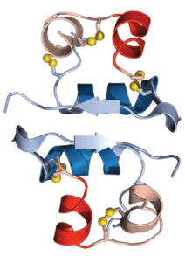
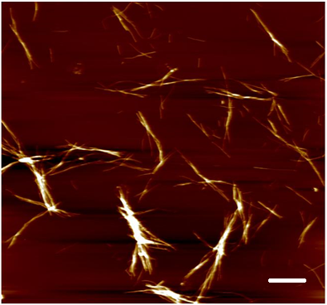
Bioactivity of CeO₂-NPs Anti-amyloidogenic activity
native proteins
amyloid fibrils
CeO₂-NPs
QUANTIFICATION of Anti-Amyloid Activity
CeO₂ NPs | 1200 rpm |  | 500 rpm
 | IC₅₀ in µg/mL
 | ThT | ANS | ThT | ANS
Ce1 | 350±20 | 200±15 | 400±18 | 126±4
Ce2 | 310±10 | 200±10 | 390±15 | 140±8
Ce3 | 275±25 | 270±20 | 355±20 | 103±4
Ce4 | 165±15 | 95±6 | 183±9 | 70±4
Ce5 | 155±7 | 90±5 | 198±4 | 50±1.5
PDB 1GUJ (Ivanova, PNAS, 2009)
effect on amyloid fibril formation
Inhibiting Activity
effect on pre-formed amyloid fibrils
DisAssembly Activity
IC₅₀ values
IC₅₀ – CeO₂ concentration caused a half maximal inhibition of protein amyloid aggregation
DC₅₀ – CeO₂ caused a half maximal disassembly of amyloid fibrils
PhD seminar, 16th June 2021

Slide 8
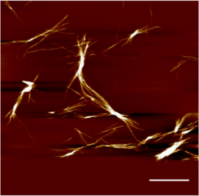
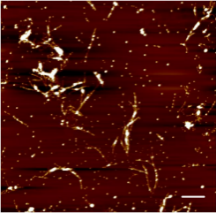
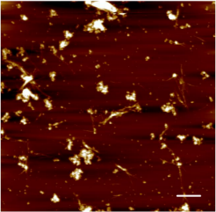
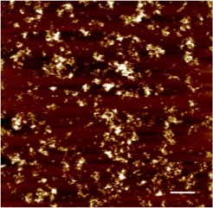
Bioactivity of CeO₂-NPs Anti-amyloidogenic activity
Time Dependence of Fibrils Formation
The kinetics of insulin fibrillation in the presence of Ce1 particles (A) and in the presence of Ce5 (B) were monitored by fluorescent ThT analysis. The insulin concentration in the samples was always 25 µM.
AFM Study of Anti-Amyloid Activity
Insulin fibrils (control)
1:0.02
1:0.8
1:2
PhD seminar, 16th June 2021

Slide 9

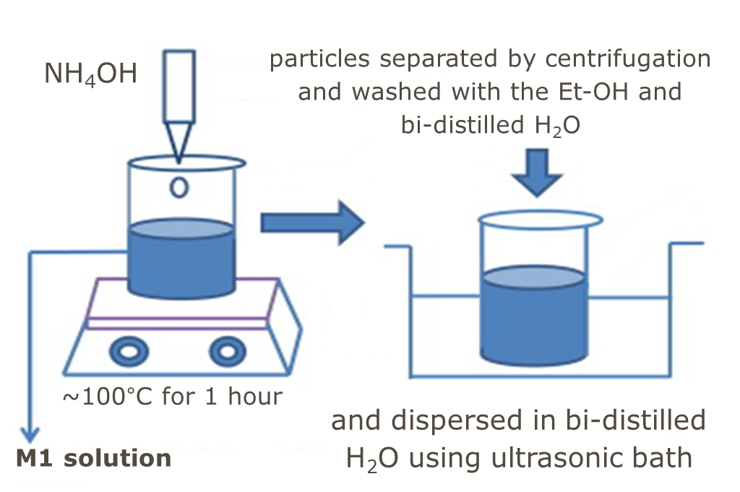

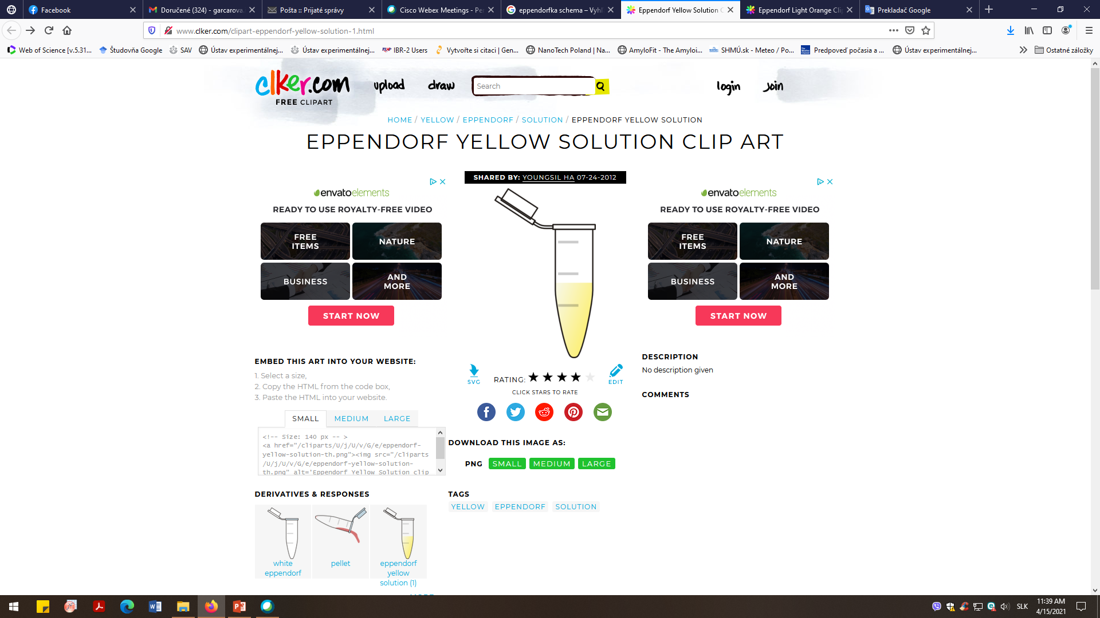

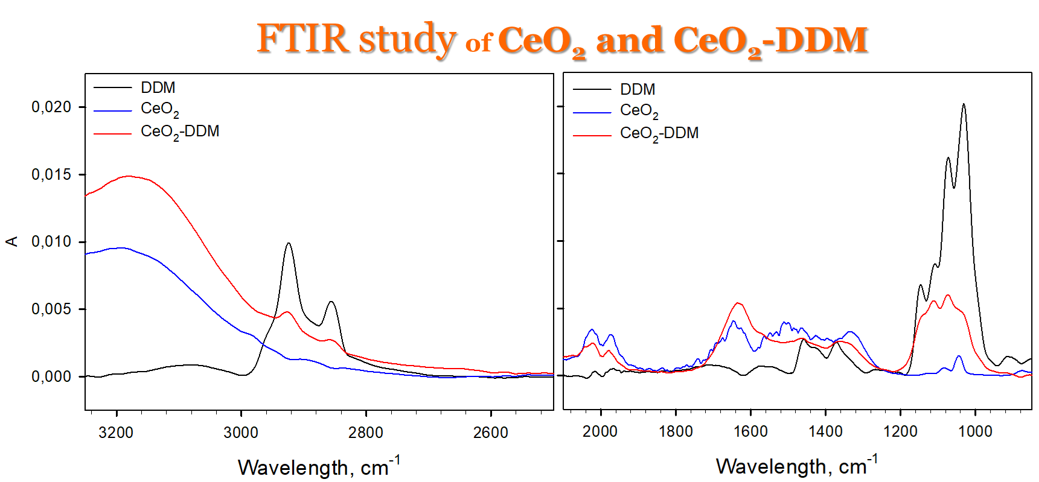
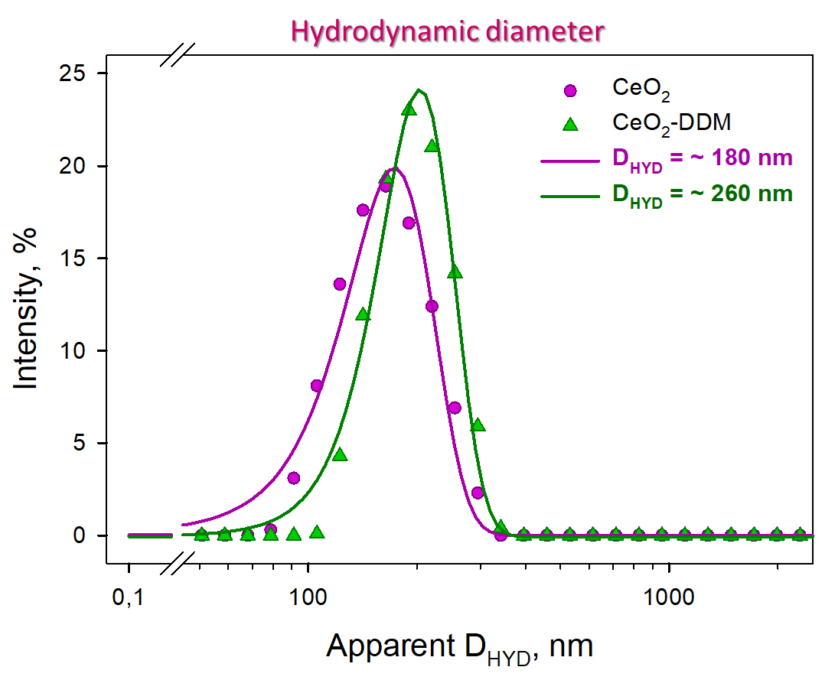
Preparation of surface-modified CeO₂-NPs
CeO₂ Synthesis*
Coating Using Detergent Dodecyl Maltoside, DDM
24 hod./laboratory temperature
after incubation - particles separated by centrifugation and washed with MilliQ water (7x)
naked CeO₂
Characterization of CeO₂ and CeO₂-NPs@DDM
Absorbance
Bamd area/mA.cm⁻²
Zeta-potential of naked CeO₂ ζ = + 29.7 mV and ζ of surface-modified CeO₂ ζ = + 22.1 mV
Wavenumber, cm⁻¹
DDM adsorbed on CeO₂-NPs: 10 mM DDM per 24 mg/mL CeO₂-NPs
PhD seminar, 16th June 2021
* SIPOSOVA K.; HUNTOSOVA V.; SHLAPA Y.; a kol. ACS Appl. Bio. Mater. 2019, 2, 5, 1884–1896.

Slide 10
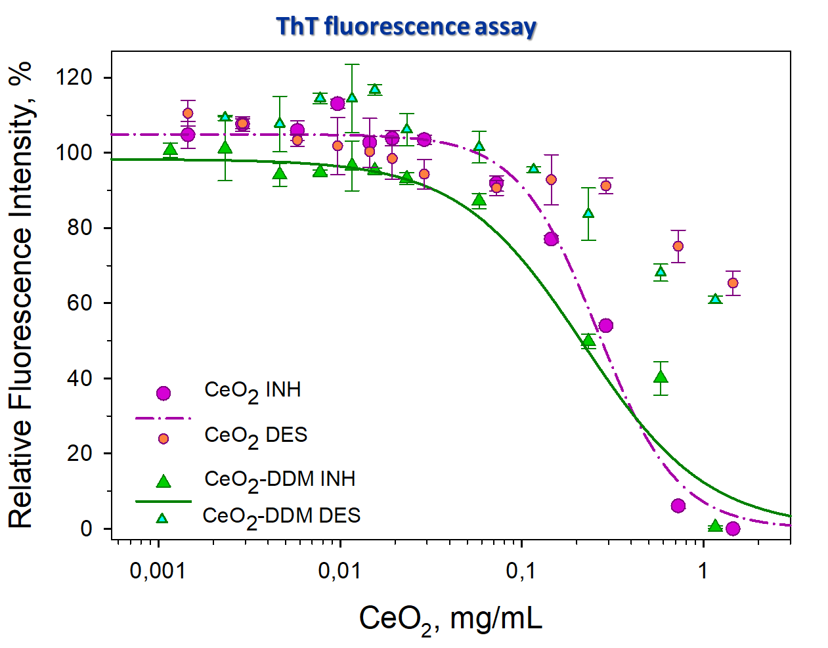
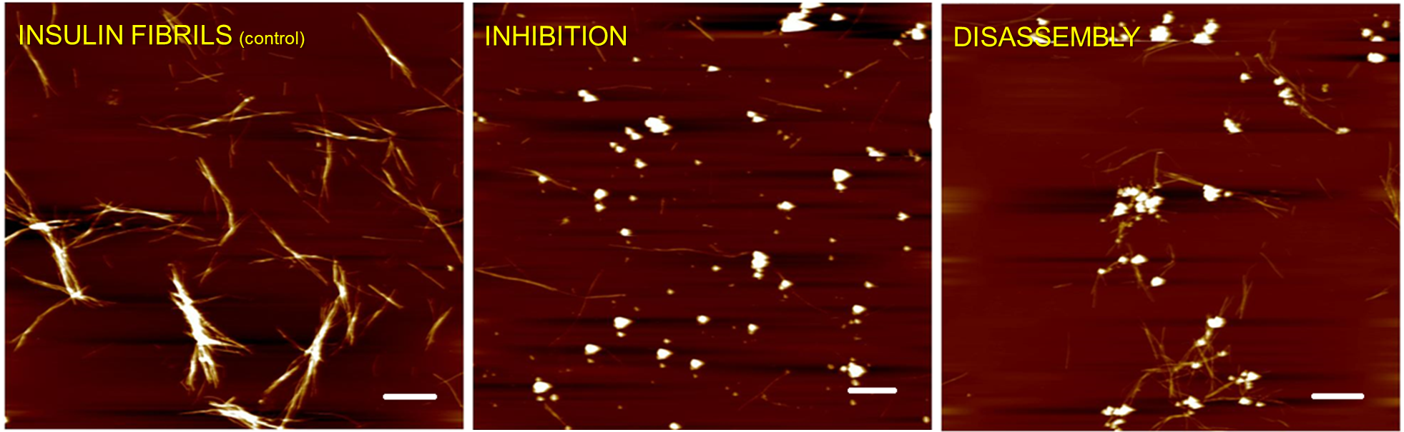
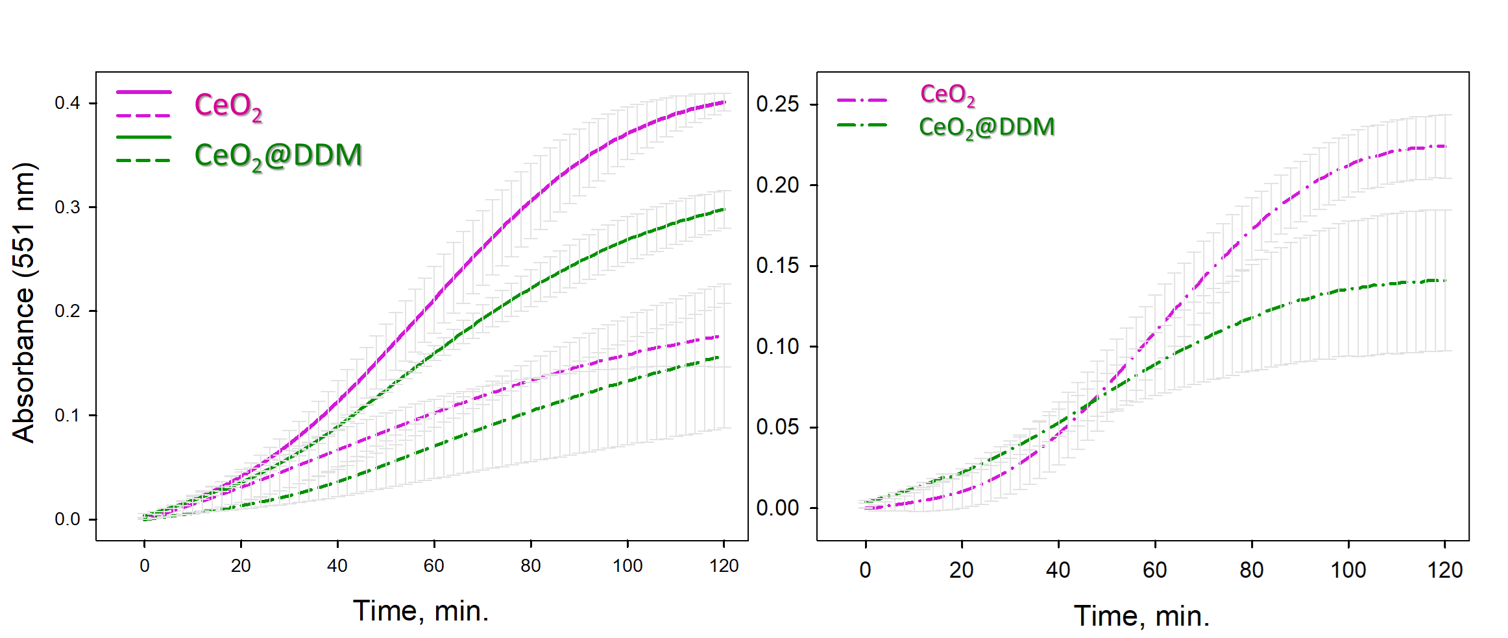
Bioactivity of surface-modified CeO₂
Anti-Amyloid Activity
AFM Visualization of CeO2-DDM effect on insulin amyloid aggregation
CeO₂-NPs@DDM at 1:2 ratios (protein:NPs).
IC₅₀ [µg/mL] | CeO₂ | CeO₂-DDM
 | ~ 300 + 10 | ~ 260 + 17
Pseudo-Enzymatic Catalase Activity
Catalase-like activity - monitored using DPD assay
Left panel: Oxidation of DPD by CeO₂-NPs in the presence (solid lines) and absence of H₂O₂ (dashed lines)
The “true” catalase-like activity of H₂O₂ decomposition by CeO₂-NPs (right)
PhD seminar, 16th June 2021

Slide 11
Summary:
PhD seminar, 16th June 2021

Slide 12
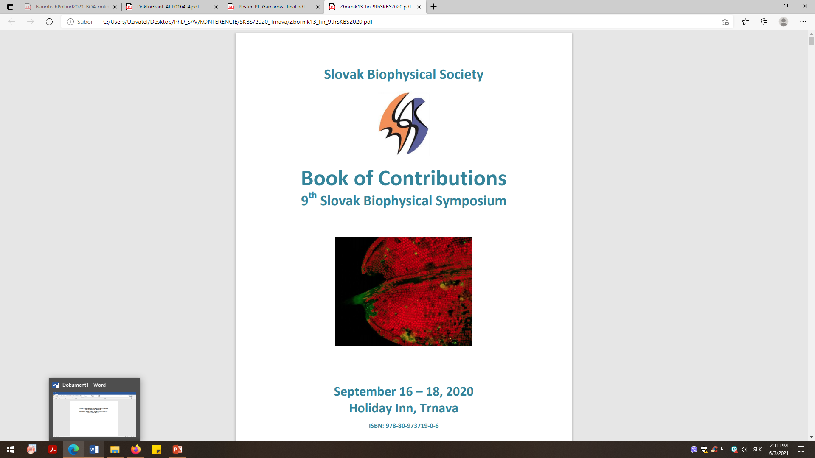
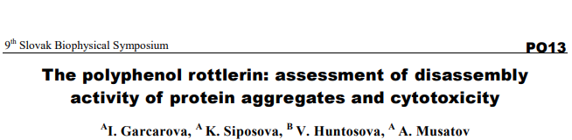

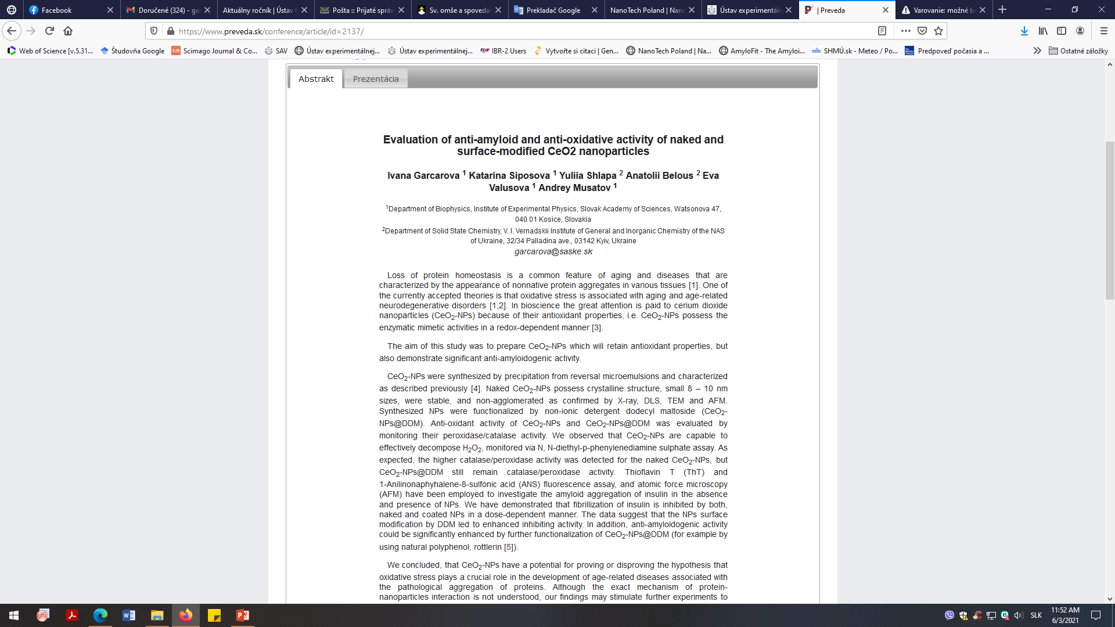

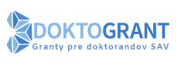
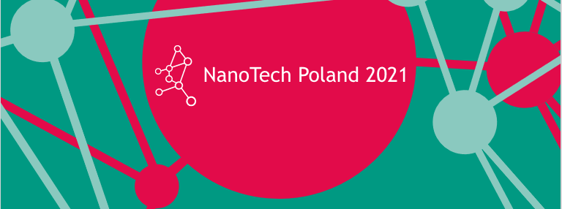
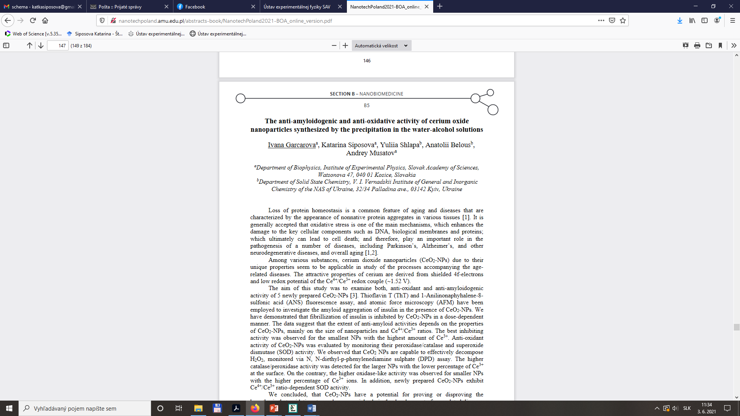


Publications:
  SHLAPA, Yulia** - TIMASHKOV, Illia - VELTRUSKÁ, Kateřina - ŠIPOŠOVÁ, Katarína - GARČÁROVÁ, Ivana - MUSATOV, Andrey - SOLOPAN, Sergii - KUBOVČÍKOVÁ, Martina - BELOUS, Anatolii. Structural and physical-chemical characterization of redox active CeO2 nanoparticles synthesized by precipitation in water-alcohol solutions. In Nanotechnology, 2021, 32, 31, 315706.
Conferences:
Grants:
Grant Programme for SAS PhD Students, No. APP0164. "Study of anti-oxidant and enhanced anti-amyloid activities of cerium nanoparticles for biomedical applications"
G-5683 "Novel Composites Based on Cerium Oxide Nanoparticles and Carbon Enterosorbents for Acute Radiation Sickness Therapy"
VEGA-2/0009/17 "Functional and Structural Insights into the Phospholipid-Protein Interaction during Oxidative Stress"
APVV-19-0324 "The Development of Translationally Relevant Regenerative and Reparative Strategies After Spinal Cord Trauma"

Slide 13

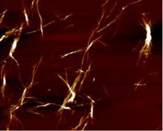
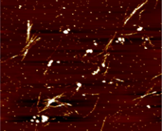
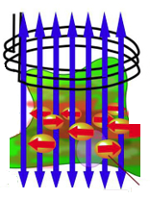
Future Plans:
ferromagnetic
Anti-AMYLOIDOGENIC Activity
core/shell
Fe₃O₄@CeO₂
Magnetic Delivery
Anti-OXIDANT Activity
. . .
H₂O₂ + 2H⁺
O₂ + H₂O₂
2 O₂⁻ + 2 H⁺
H₂O
AC magnetic Field HyperThermia
„pseudo“ SOD activity
„pseudo“ catalase/peroxidase activity
PhD seminar, 16th June 2021

Slide 14
Thank You for Your Attention

