Slide 1
Geometrically Frustrated Magnetic Systems under High Pressure
Július Bačkai
first year PhD student

Slide 2
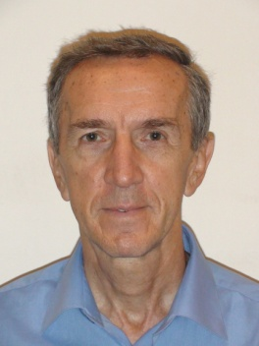
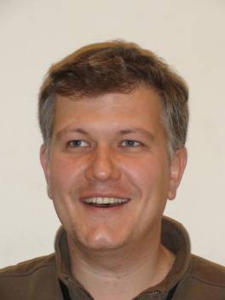
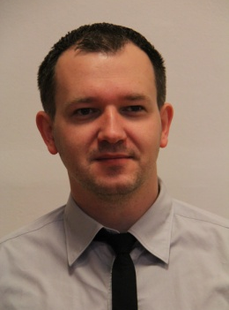
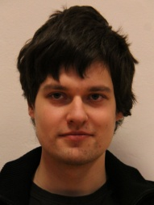
Workplace
Centre of Low Temperature Physics
working in laboratory
doctoral thesis
Technical University of Košice FEI
diploma thesis: frustrated metallic magnetic systems
teaching
Materials under extreme conditions
K. Flachbart
S. Gabáni
E. Gažo
G. Pristáš
M. Orendáč

Slide 3
Publications
J.Bačkai et al., Superconducting phase diagram of LuB₁₂ and Lu_{1-X}Zr_{X}B₄ (x ≤ 0.45) down to 50 mK. Acta Phys. Pol., vol137 (2020)
G. Pistáš et al., Magnetic phase diagram of geometrically frustrated magnetic system ErB₄ under high pressure. Phys. Soc. of Jap. 011093 (2020)
Mat. Orendáč et al., Tuning the magnetocaloric effect in the Lu-doped frustrated Shastry-Sutherland system TmB₄. Phys. Rev. B. 102, 174422 (2020)

Slide 4
Projects
GRANT NUMBER | PRINCIPAL INVESTIGATOR | GRANT TITLE | DURATION
APVV-17-0020 | Slavomír Gabáni | Frustrated metallic magnetic systems | 2018-2022
DAAD-57452699 | Slavomír Gabáni | Metallic geometrically frustrated systems | 2019-2020
VEGA 2/0032/20 | Gabriel Pristáš | Magnetic frustration and superconductivity in 2D and 3D borides | 2020-2023
M-ERA.NET | S. Z. Karashanov K. Flachbart | Theoretical and Experimental Study of Transition Metal Oxyhydride Nanomaterials for Superconductivity and Photocatalysis | 2019-2022

Slide 5
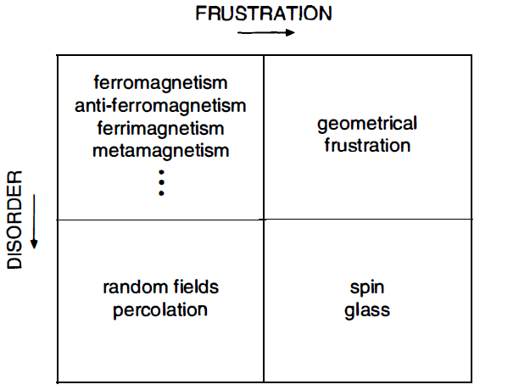
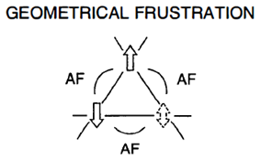
Geometrically frustrated systems
Geometrically frustrated systems
Supersolid phase
Skyrmion crystals

Slide 6
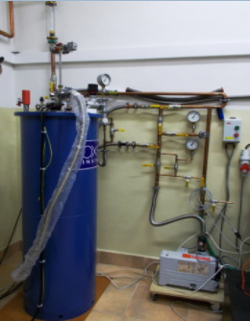
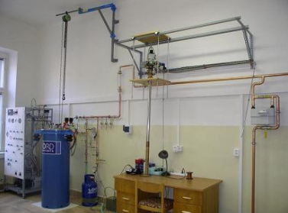
Experimental methods
⁴He Cryostat
T = 1.5 K
B = 8 T
³He-⁴He dilution refrigerator
T = 50 mK
B = 10 T

Slide 7
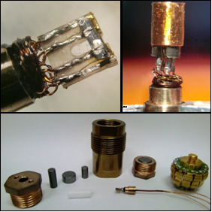
Experimental methods
Piston cylinder cell
maximum pressure ≈ 3 GPa
resistivity, ac magnetic susceptibility

Slide 8
Experimental results
Phase diagram of HoB₄
P0 ≈ atmosphere
P5 ≈ 3 GPa
Evolution of T_{n} with increasing pressure

Slide 9
Conclusion
Investigation of TmB₄, ErB₄, HoB₄
Resistivity measurement
Heat capacity
Magnetization
Phase diagrams
Influence of pressure on superconductivity

Slide 10
Thank you for your attention

