Slide 1
Microwire from Heusler Alloy with Room Temperature Martensitic Transformation
By: Limpat Nulandaya
Supervisors:
assoc. prof. Ing. Ondrej Milkovič, PhD.
prof. RNDr. Rastislav Varga, DrSc.

Slide 2
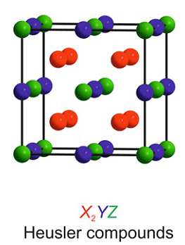
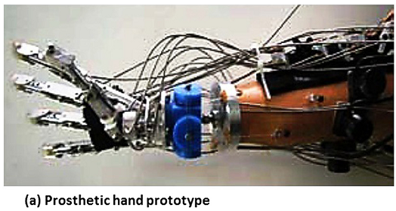
Heusler Alloy and Application
The general formula is X₂YZ
Various elements combination can be produced.
The crystal structure is cubic with space group number is 225
Materials and Design, 2014, 56, p1078-1113.
Progress in Solid State Chemistry, 2011, 39, p1-50.

Slide 3
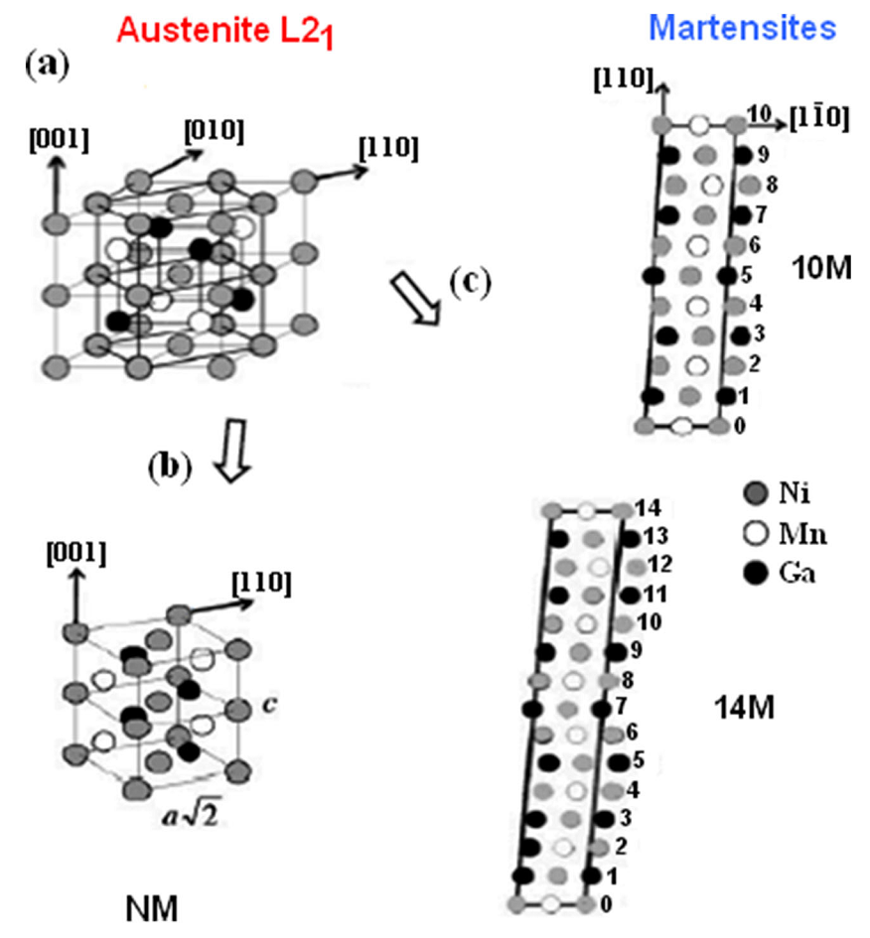
Martensitic Transformation
Austenite Phase: cubic
Martensite Phase:
Tetragonal
10M
14M
For shape memory material, the transformation is preferred at around room temperature
The International Journal of Advanced Manufacturing Technology, 2019, 103, p2761-2772.

Slide 4
Ni₂FeGa and Taylor-Ulitovsky Method
Ni-Fe-Ga
Taylor-Ulitovsky
Ni-Fe-Ga is cost effective than Ni-Ti
Fe is easier to get the desire composition than Mn due to higher evaporation point
has ferromagnetic property which is good for sensor
Allows to produce few kilometres of microwire in a short time
Glass coating for biocompatibility and chemical protection
IEEE Transaction on magnetics, 2018, p1-5.

Slide 5
Experimental
Nickel
50% (mol)
SIMAX
glass
Arc Furnace
Taylor-Ulitovsky method
Iron
25% (mol)
Master
Alloy
Microwire
Gallium
25% (mol)

Slide 6
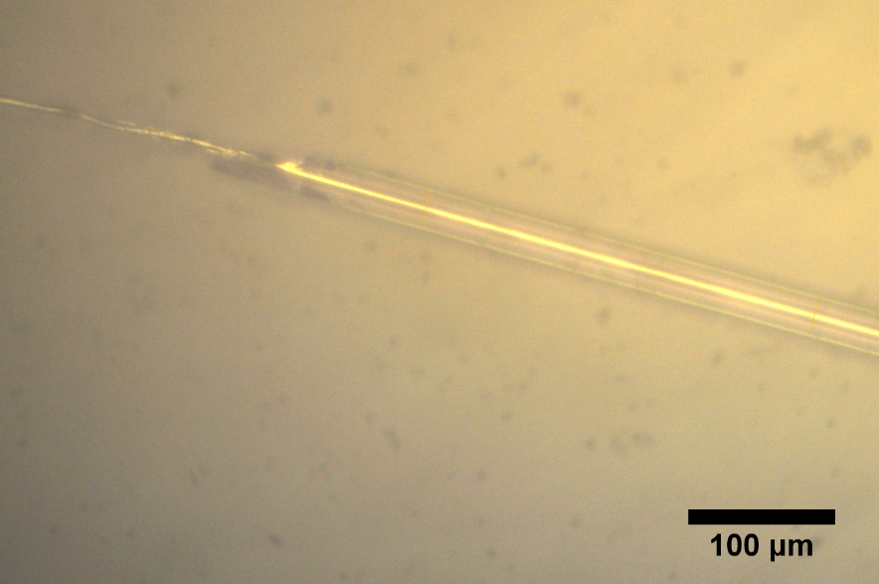
Microwire Observation
The optical microscope shows the metallic core and total diameter
Nominal Composition | Core Diameter (μm) | Total Diameter (μm)
Ni₅₀Fe₂₃Ga₂₇ | 4.4 | 27.7
Ni₅₀Fe₂₅Ga₂₅ | 3.2 | 23.0
Ni₅₀Fe₂₇Ga₂₃ | 10.3 | 36.8

Slide 7
Chemical Composition by EDX
The EDX results show the chemical composition of metallic core.
Nominal Composition | EDX composition
Ni₅₀Fe₂₃Ga₂₇ | Ni_{49.5}Fe_{22.3}Ga_{28.2}
Ni₅₀Fe₂₅Ga₂₅ | Ni_{50.3}Fe_{25.2}Ga_{24.4}
Ni₅₀Fe₂₇Ga₂₃ | -

Slide 8
X-Ray Diffraction Pattern
The XRD patterns at room temperature show the present phase of the material.
The potential candidate are Ni₅₀Fe₂₅Ga₂₅

Slide 9
Temperature Dependence Magnetization
There is a significant magnetic moment due to the martensitic transformation.
In the low magnetic field
the austenite formation by heating is start from around 260K and end at around 370K.
the martensite formation by cooling is start from slightly lower than 370K and end at around 260K.
In the high magnetic field, the transformation is more clearly seen
the austenite formation by heating is start from around 311K and end at around 327K.
the martensite formation by cooling is start from around 311K and end at around 276K.

Slide 10
Magnetic Saturation and Hysteresis
Magnetic saturation and hysteresis are decreasing by increasing the temperature.
The maximum magnetic saturation is 2.6934 emu at 55K.

Slide 11
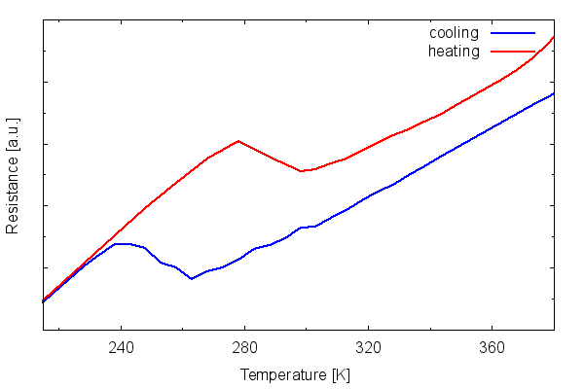
Temperature Dependence Resistivity
the austenite formation by heating is start from around 280K and end at around 300K.
the martensite formation by cooling is start from slightly lower than 260K and end at around 240K.

Slide 12
Conclusions and Future Works
Research Method 2
Microwire can be produced from Ni₂FeGa heusler alloy by Taylor-Ulitovsky method.
The martensitic transformation is around room temperature based on magnetic and resistivity measurements.
The future works will be:
Micrograph analysis by SEM
Mechanical analysis

Slide 13
References
Materials and Design, 2014, 56, p1078-1113.
Progress in Solid State Chemistry, 2011, 39, p1-50.
The International Journal of Advanced Manufacturing Technology, 2019, 103, p2761-2772.
IEEE Transaction on magnetics, 2018, p1-5.

Slide 14
Thank You
Research Method 2

