Slide 1

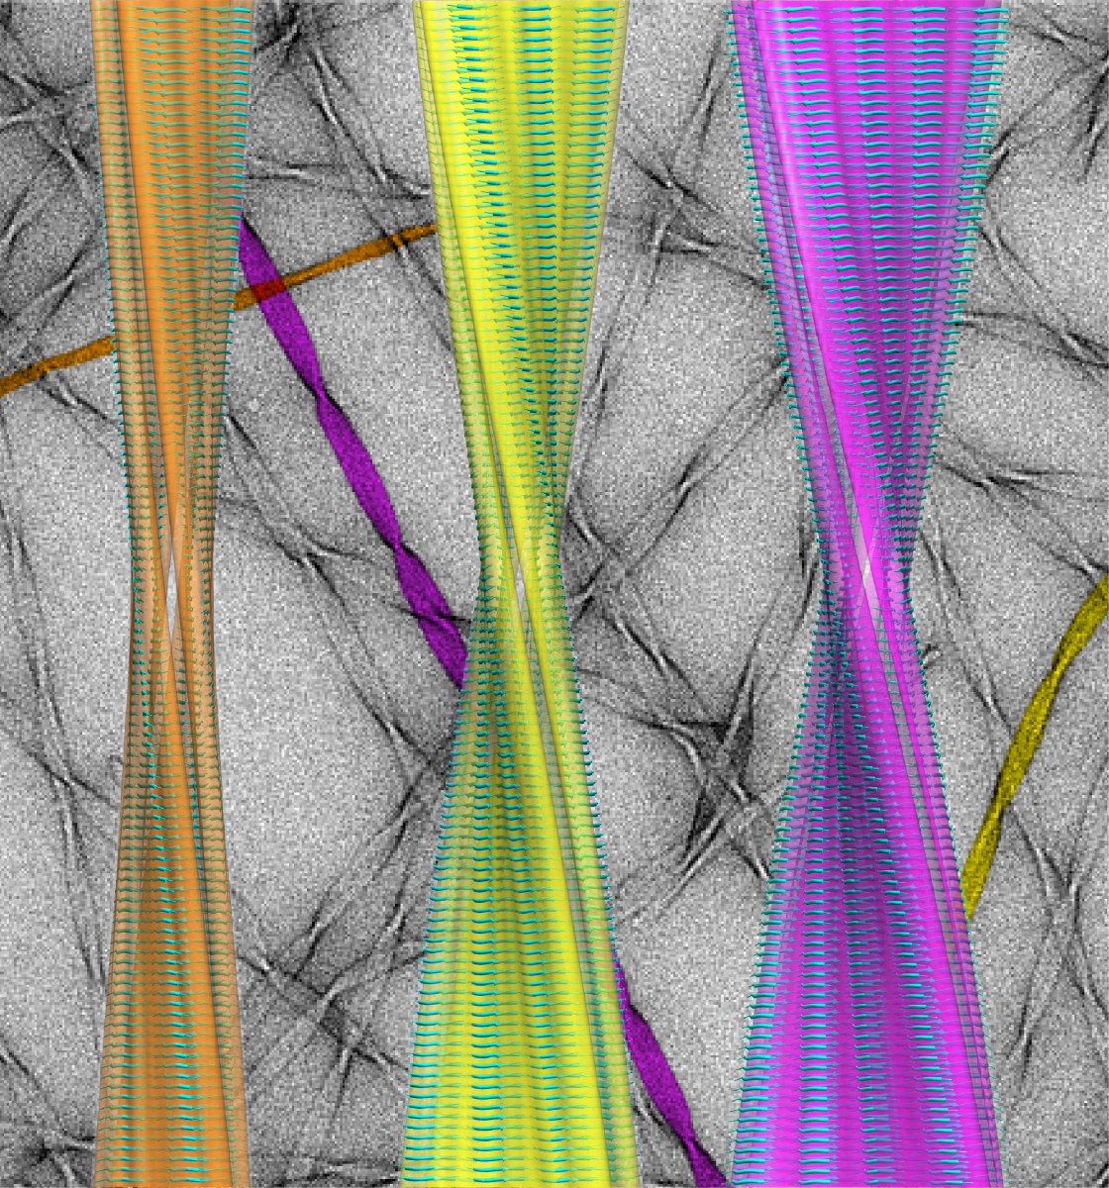
Structural phenomena in complex systems containing nanoparticles
Institute of experimental Physics SAS, Košice
Doktorandský seminár
2018
Jozefína Majorošová

Slide 2
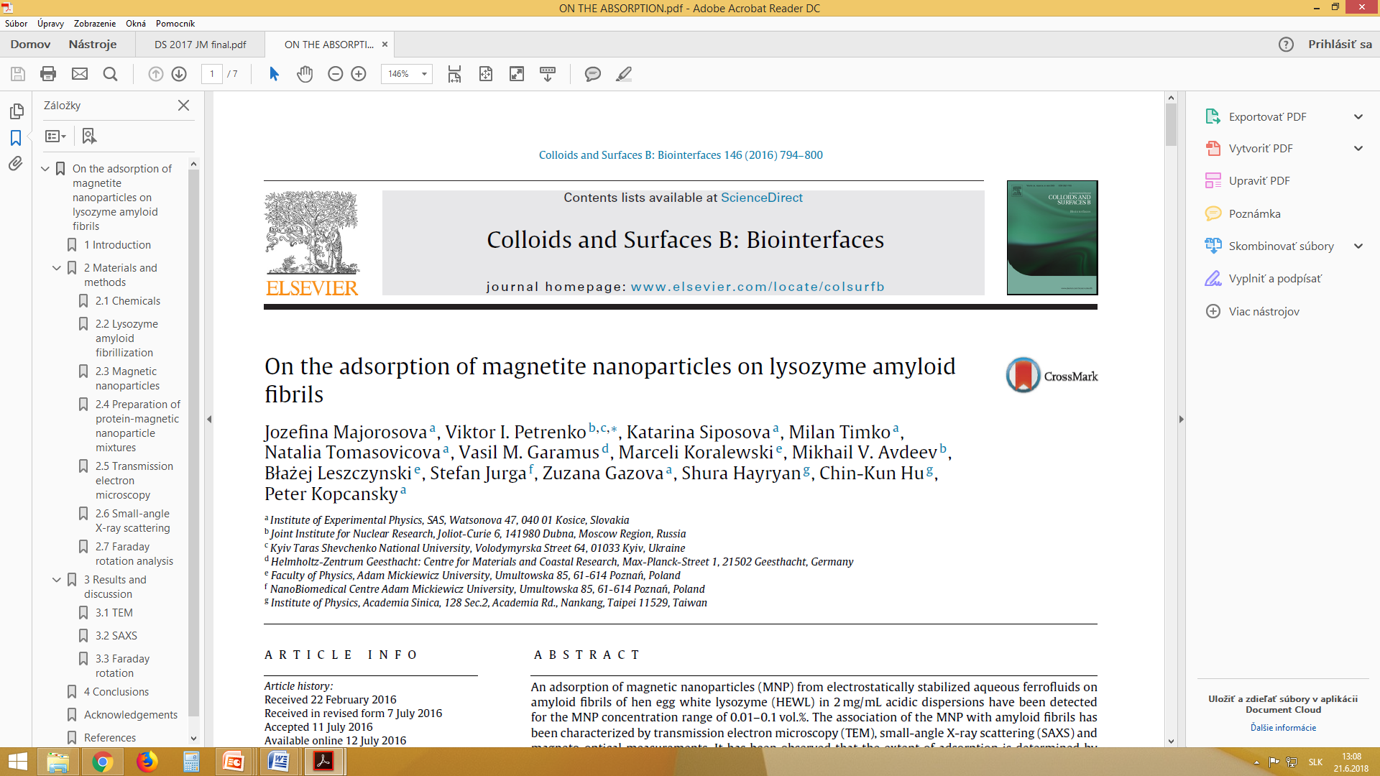
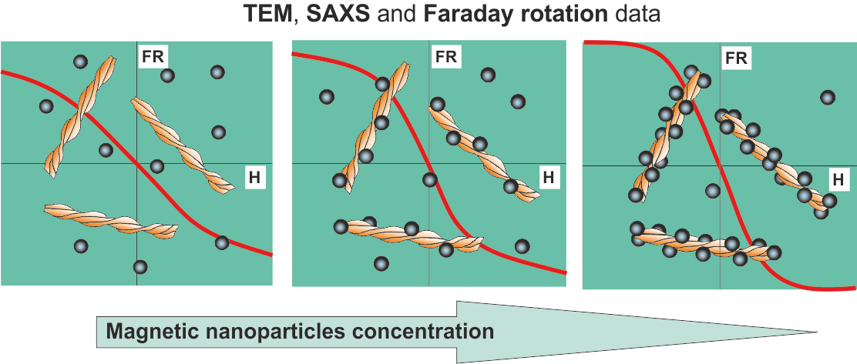
Adsorption of MNPs on amyloid fibrils follows the bulk particle concentration
in mixed solutions and affects their magnetic properties

Slide 3
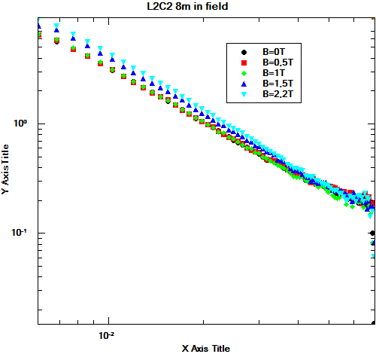
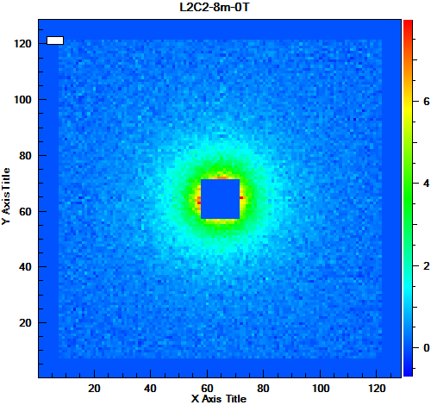
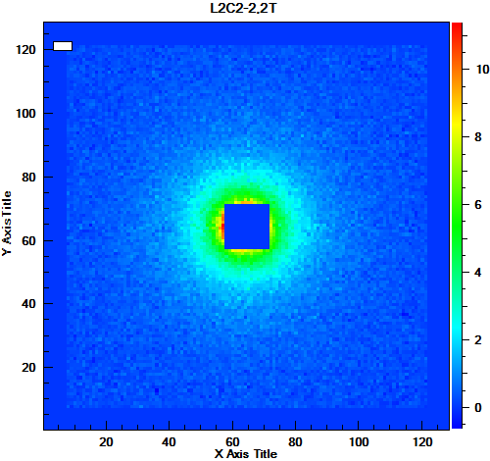
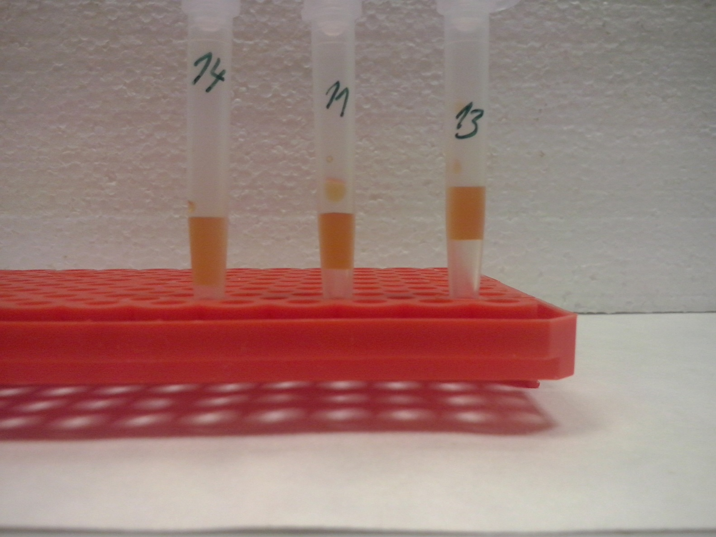
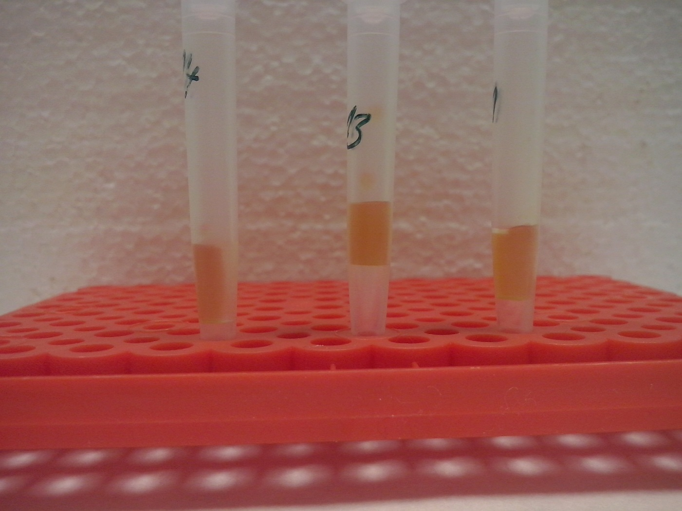
Results: SANS
0 T
2,2 T
2D scattering patterns
Experimental scattering curves of lysozyme fibrils dopped with MNP of concentration 10⁻³ measured in external magnetic fields up to 2,2T

Slide 4
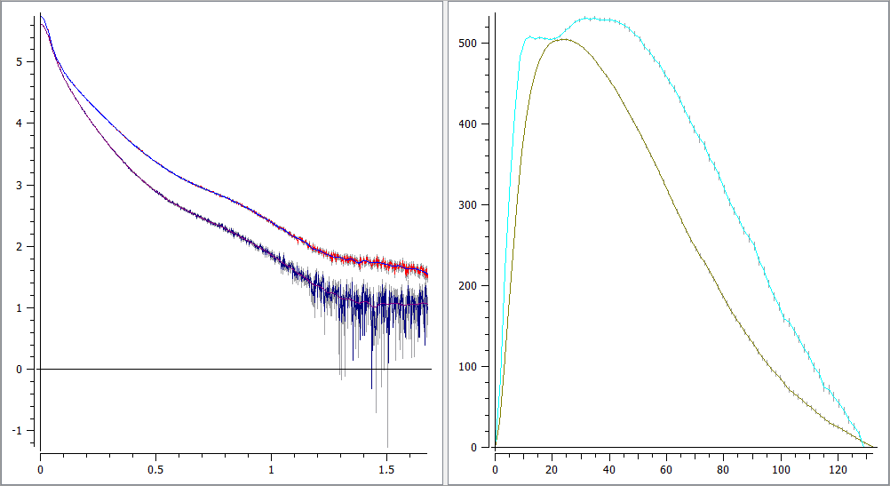
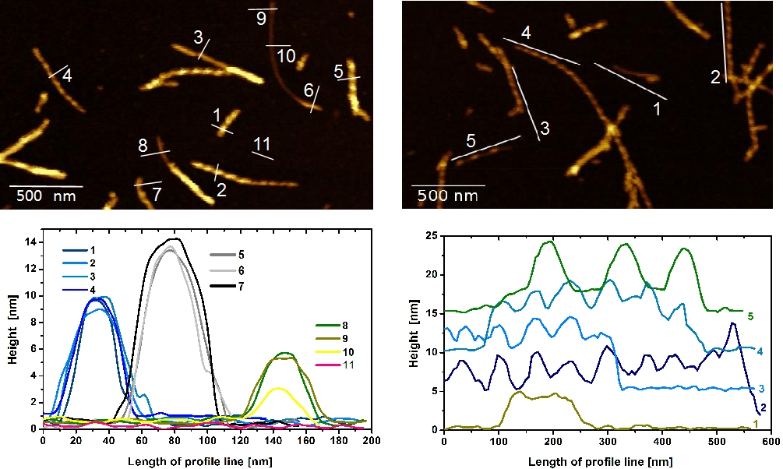
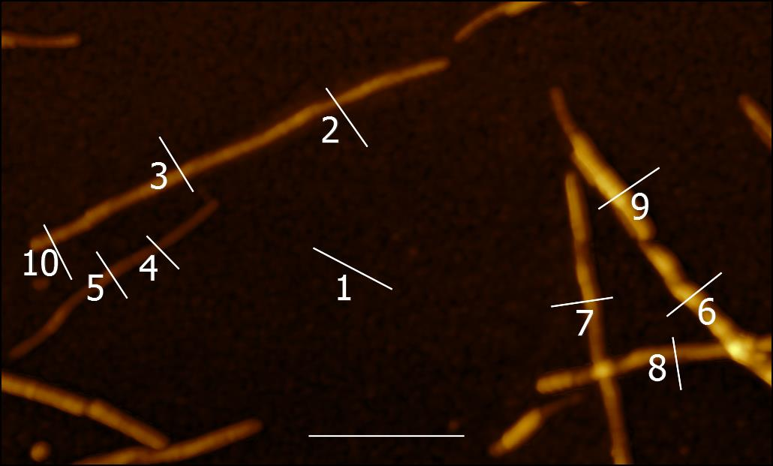
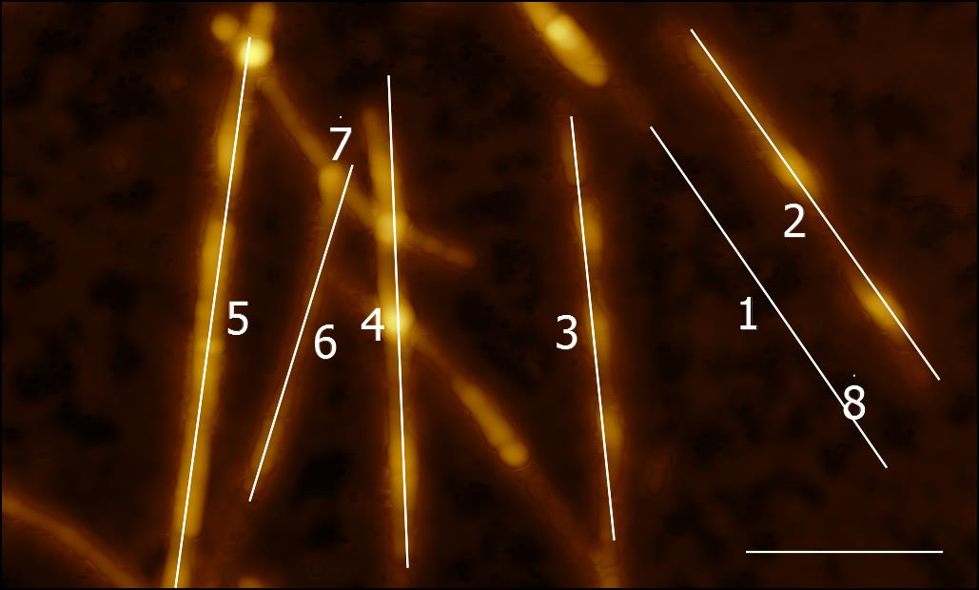
Comparison LAF5 and LAF10
LAF 10
LAF 10
-LAF5 and LAF10 are fibril like
-the structure is different:
LAF5 - more elongated,
LAF10 - two characteristic lengh scales inside.
LAF 5
LAF 5
p(r)
LAF5
LAF10

Slide 5
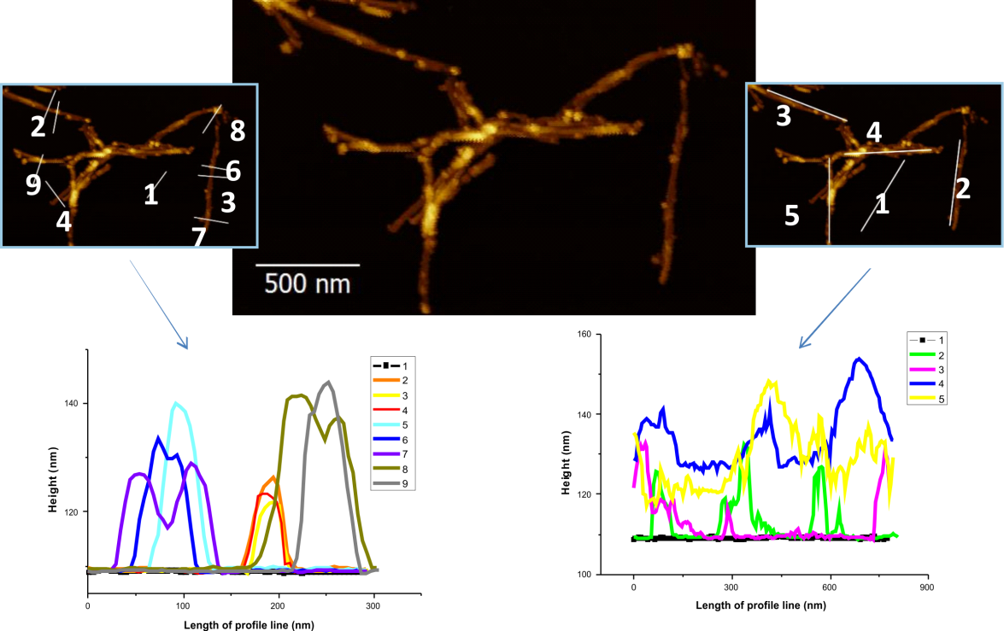
LAF5 + MNP-2,5 mg/ml
AFM

Slide 6
MNPs addition
Addition of MNPs indicative of decoration of MNPs on fibrils
LAF 5
LAF 10

Slide 7
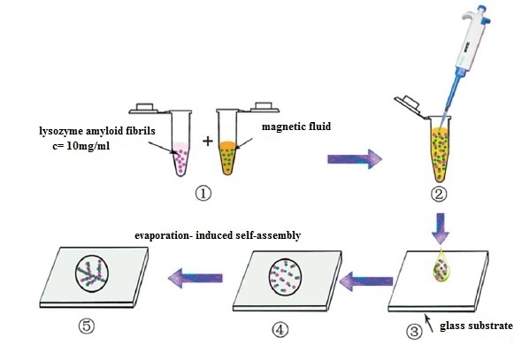
Self-ssembly of the mixture: LAF with MF

Slide 8
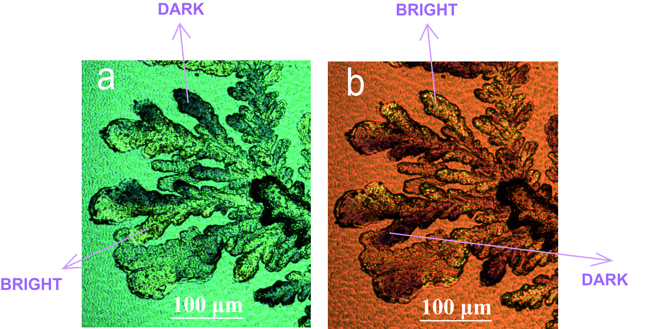
Self-ssembly of the mixture: LAF with MF
dendritic pattern represented as multi-branched nanostructures that are formed from the centre of the dendritic structure
A large number of microdomains changing the colour by changing the angle between the polarizer and analyzer
Birefringence
Parallel polarized images cross polarized images

Slide 9
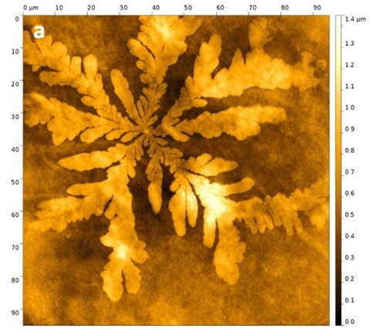
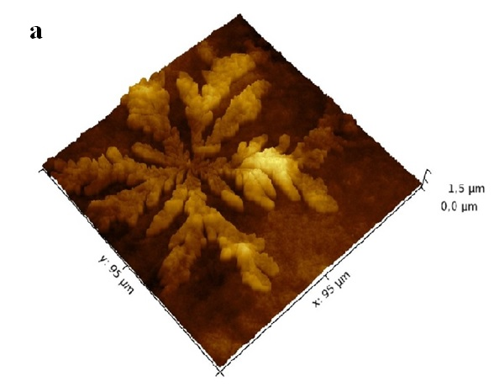
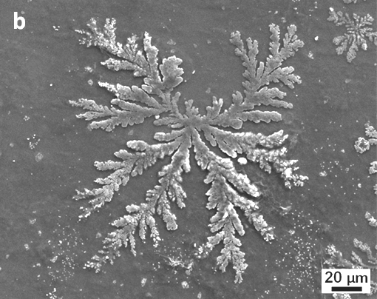
Self-ssembly of the mixture: LAF with MF
AFM
SEM

Slide 10
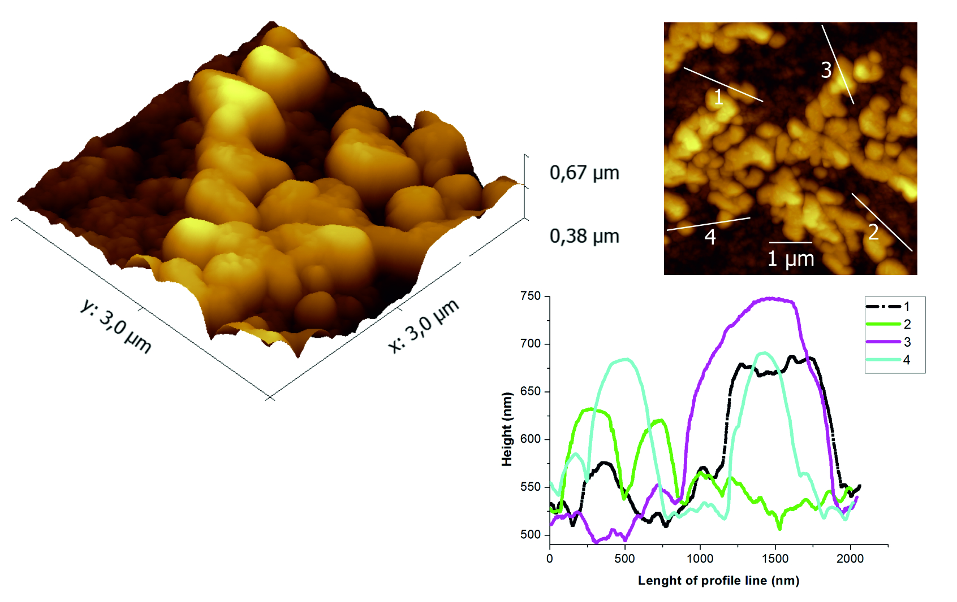
Building blocks

Slide 11
Self-ssembly of the mixture: LAF with MF
Scanning electron microscopy SEM
Dendritic arm
Dendritic centre
Precipitated salt

Slide 12
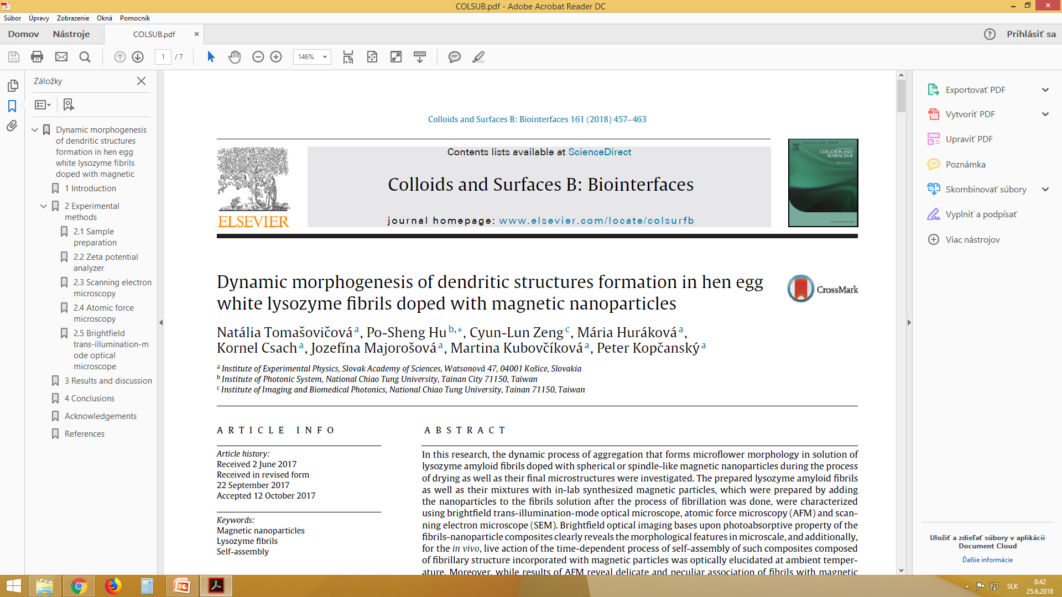
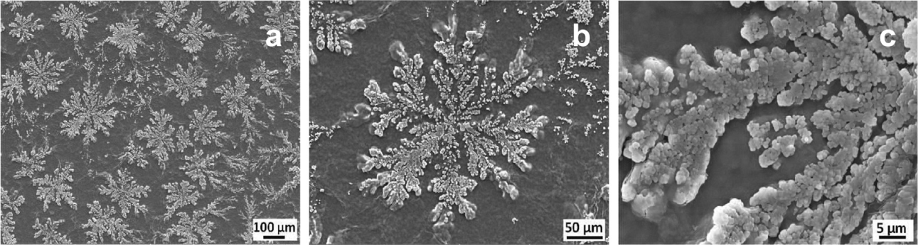
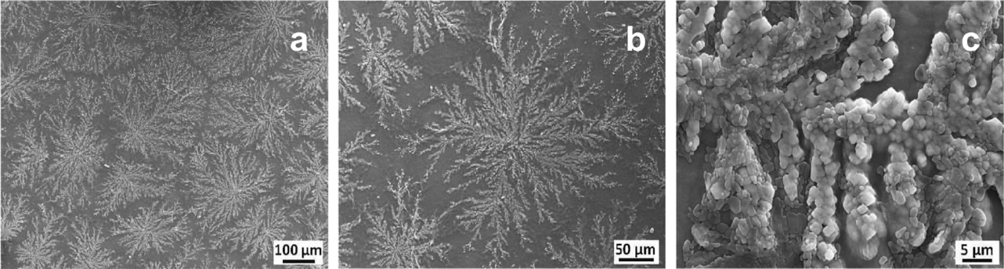
SEM images of LAF doped with spherical magnetic nanoparticles
SEM images of LAF doped with spindle magnetic nanoparticles
Konferencia vedeckých a klinických aplikácií magnetických nosičov

Slide 13
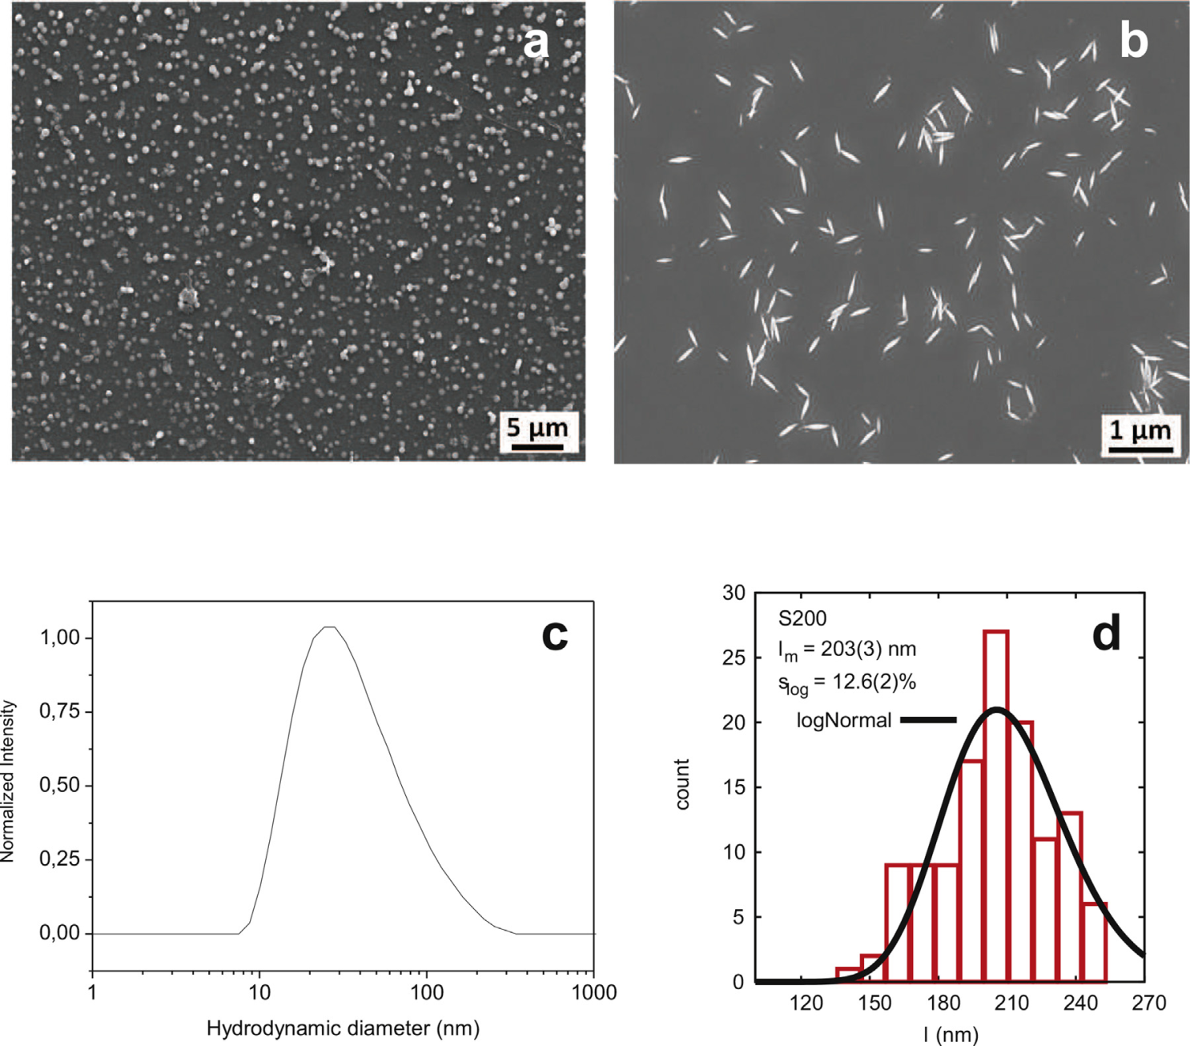
SEM images of (a) spherical and (b) spindle magnetic nanoparticles, (c) the hydrodynamic particle size distribution, (d) the size distribution of the length of spindle MNPs obtained from SEM micrographs are illustrated

Slide 14
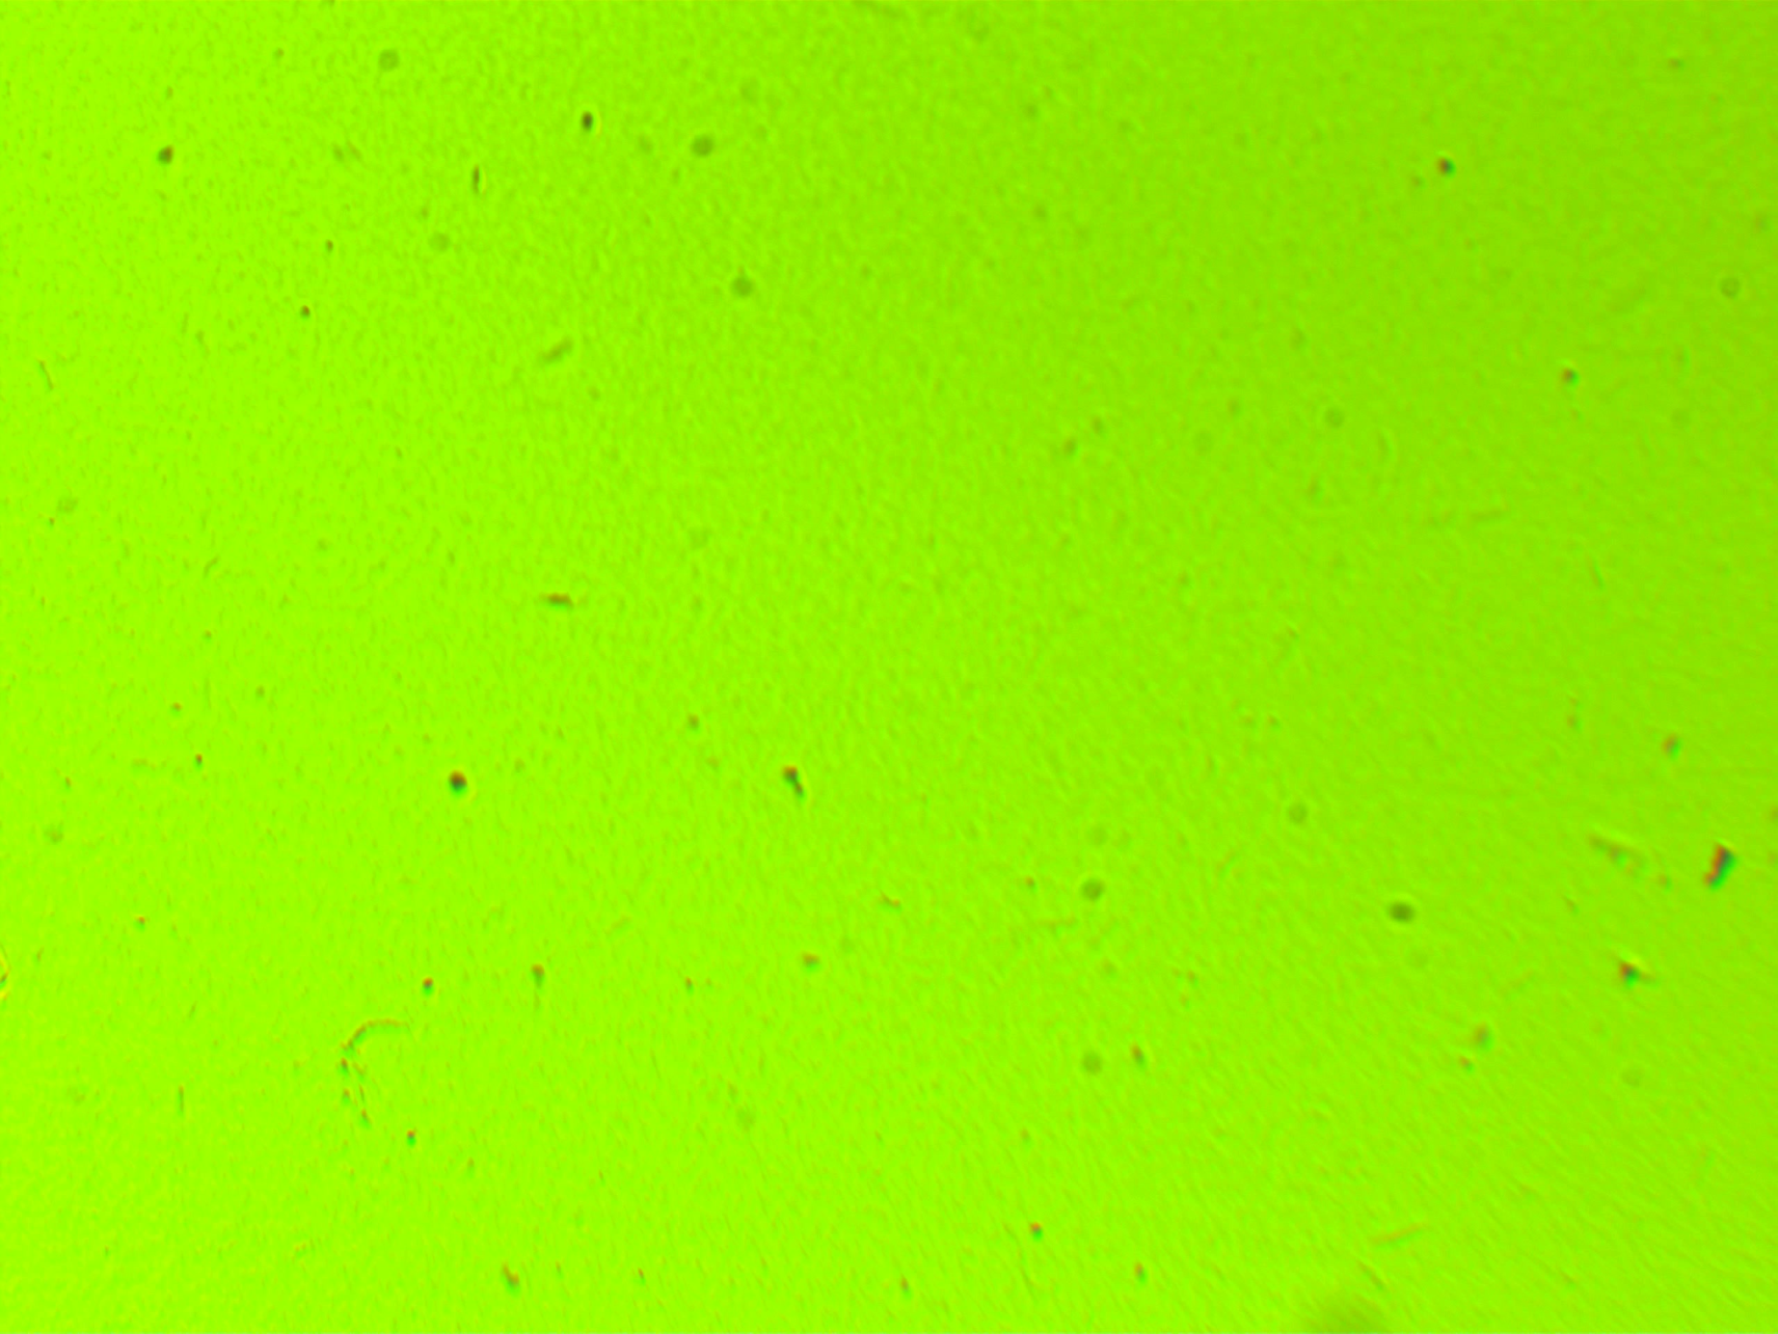

Slide 15
Publikácie 2017/2018
MAJOROŠOVÁ, J. et al. 2018. Lysozyme Amyloid Fibrils Doped by Carbon Nanotubes. In Acta Physica Polonica A. vol. 133, p. 588-590
MAJOROŠOVÁ, J. et al. 2017. The Influence of Magnetic Particles on the Nematic Droplets Formation in Liquid Crystal. In Acta Physica Polonica A. vol.131, p.955-957
MAJOROŠOVÁ, J. et al. Self-assembly of hen egg white lysozyme fibrils doped with magnetic particles. submitted in JOURNAL OF MAGNETISM AND MAGNETIC MATERIALS.
Kopcansky, P.- Gdovinova, V.- Burylov, S.- Burylova, N.- Voroshilov, A.- Majorosova, J.- Agresti, F.- Zin, V.- Barison, S.- Jadzyn, J.- Tomasovicova, N. 2018. The influence of goethite nanorods on structural transitions in liquid crystal 6CHBT. In JOURNAL OF MAGNETISM AND MAGNETIC MATERIALS vol. 26-32.
Tomasovicova, N.- Hu, PS.- Zeng, CL.- Hurakova, M.- Csach, K.- Majorosova, J.- Kubovcikova, M.- Kopcansky, P. 2018. Dynamic morphogenesis of dendritic structures formation in hen egg white lysozyme fibrils doped with magnetic nanoparticles. In COLLOIDS AND SURFACES B-BIOINTERFACES. vol. 161, p. 457-463.
Gdovinova, V.- Schroer, MA.- Tomasovicova, N. Appel, I.- Behrens, S.- Majorosova, J.- Kovac, J.- Svergun, DI.- Kopcansky, P. 2017. Structuralization of magnetic nanoparticles in 5CB liquid crystals. In SOFT MATTER. vol. 13, p. 7890-7896.
Gdovinova, V., Petrenko, V., Tomasovicova, N., Majorosova, J., Ivankov, O.I., Avdeev, M.V., HU, P.S., Kopcansky, P. Structure of amyloid fibrils doped with magnetic nanoparticles by SANS contrast variation technique. submitted in JOURNAL OF MAGNETISM AND MAGNETIC MATERIALS.

Slide 16
Prezentácia výsledkov
16.-20.4. 2018
Institute of Physics, Academia Sinica, Nankang, Taipei, Taiwan (prednáška)
22.3. 2018
Vystúpenie na seminári z fyziky kondenzovaných látok. UPJŠ, Košice. (prednáška)
17.10.2017
19th International workshop on theoretical physics, Small Triangle Meeting , Medzilaborce (prednáška)
22.-27.5.2018
12th International Conference on the Scientific and Clinical Applications of Magnetic Carriers (Magmeet 2018), University of Copenhagen (UCPH), Copenhagen, Denmark.- (poster)
Zahraničný pracovný pobyt
21.04-01.05.2018
National Chiao Tung University, College of Photonics, Tainan City, Taiwan. (Realizácia experimentov)
Odovzdanie dizertačnej práce
Jún 2018

Slide 17




Acknowledgement
Peter Kopčanský
Natália Tomašovičová
Lucia Balejčíková , Veronika Gdovinová
Marianna Baťková, Ivan Baťko
Kornel Csach, Mária Huráková
Institute of Experimental Physics, SAS, Watsonova 47, 040 01 Kosice, Slovakia
Viktor Petrenko
Joint Institute for Nuclear Research, Joliot-Curie 6, 141980 Dubna, Moscow region, Russia
Kyiv Taras Shevchenko National University, Volodymyrska Street 64, 01033 Kyiv, Ukraine
Vasil M. Garamus , Martin Schroer
Helmholtz-Zentrum Geesthacht: Centre for Materials and Coastal Research, Max-Planck-Street 1, 21502 Geesthacht, Germany
Marceli Koralewski
Faculty of Physics, Adam Mickiewicz University, Umultowska 85, 61-614 Poznaň, Poland

Slide 18
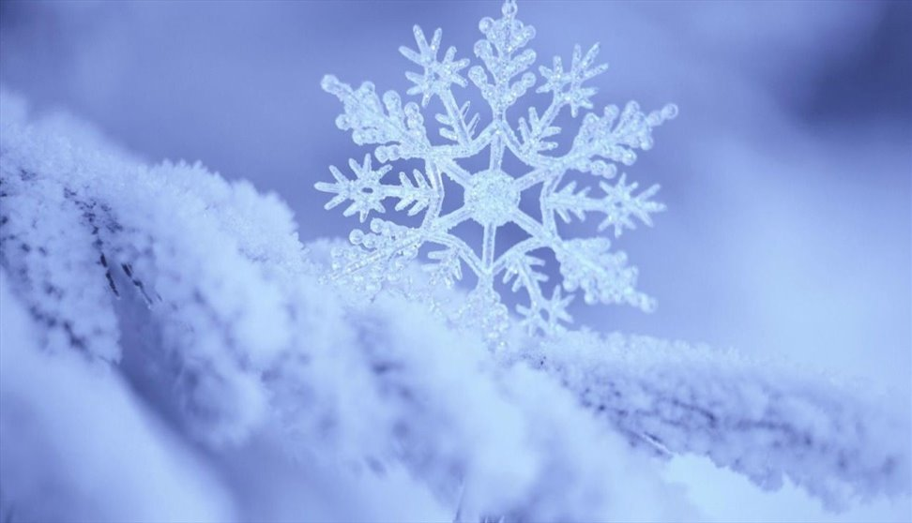


Thank you for attention !

